Slide 1


Pregnancy & Delivery with Complications
Sheila Bannister, MS, LPN, MCHES®, CHWC
May 14, 2025

Slide 2


The Impact of Preterm Births
A recent publication from the National Alliance of Healthcare Purchaser Coalitions noted a premature baby spends on average 25.4 days in a specialty care nursery at an average cost of just under $145,000.
The costs associated with preterm birth add $26.2 billion to U.S. healthcare costs each year, and the Coalition noted that prenatal and neonatal care was one of the top issues that drive high-cost claimants, along with cancer, gene therapies and specialty drugs.
The Pulse podcast March 26, 2025

Slide 3

2024 Data Analysis
  Year Over Year Trend
  Chronic Conditions
  Age Factor

Slide 4

Year Over Year Trend
Pregnancy & delivery with complications,
ER visits, and the number of C-sections performed began to increase during the pandemic and remain elevated.
 | 2021 | 2022 | 2023 | 2024
Pregnancy & Delivery WITH Complications (per 1000) | 46 | 48 | 48 | 49
Pregnancy & Delivery WITHOUT Complications (per 1000) | 33 | 35 | 34 | 35
ER Visits: Pregnancy and Delivery WITH Complications (per 1000) | 2.8 | 3.3 | 3.4 | 3.9
ER Visits: Pregnancy and Delivery WITHOUT Complications (per 1000) | 2.3 | 2.6 | 2.8 | 2.9
% of C-Section Episodes | 23% | 26% | 25% | 26%
According to the March of Dimes, 32.3% of live births in the U.S. in 2023 were Cesarean deliveries.
To filter national data via state, maternal age, race, and more, visit: https://www.marchofdimes.org/peristats/data?top=8&lev=1&stop=86&reg=99&obj=1&slev=1

Slide 5

Chronic Conditions
Hypertension is the most significant comorbidity risk factor for pregnancy & delivery with complications. In 2024, 36% of women with hypertension had C-sections.
 | 2021 | 2022 | 2023 | 2024
Hypertension | 12.2% | 12.7% | 12.7% | 12.1%
Diabetes | 4.9% | 4.9% | 5.2% | 4.8%
No Conditions | 30.0% | 30.7% | 29.8% | 29.2%
Hypertension usually has no symptoms.
During pregnancy, it can pose several risks to both mother and baby. These risks include preeclampsia, placental abruption, premature birth, and low birth weight.
Hypertension can also increase the mother’s risk of heart disease and stroke both during and after pregnancy.
Controlling hypertension is imperative for healthy pregnancy and postpartum outcomes, and newborn health.

Slide 6

Age Factor
Members ages 18-34 have significantly higher risk of complications than members ages 35+.
Pregnancies with Complications (per 1,000 Pregnancies)
Age Band | 2021 | 2022 | 2023 | 2024
18 - 26 | 50 | 55 | 61 | 72
27-34 | 135 | 135 | 127 | 129
35-44 | 59 | 56 | 47 | 40
45-54 | 3 | 2 | 1 | 1
  Among women ages 18-26:
  36% are no generalist seen
  70% are not compliant with adult wellness exam
  Among women ages 27-34:
  30% are no generalist seen
  60% are not compliant with adult wellness exam

Slide 7

Influencers
  Hospital-owned Physicians
  Access to Care
  Social Determinants of Health

Slide 8

Hospital-owned Physicians
“With the advent of employment of physicians by hospitals, it's changed how clinicians care for their patient population.”
Dr. Cindy Rosinski – The Pulse podcast March 26, 2025.
Obstetricians (OBs) receive a global fee to care for women from the very beginning to the very end of their pregnancy and delivery.
Hospitalist OBs are hired by hospitals to run ER departments and triage patients. They know that if they can get doctors to send their patients to the ER for triage, they will increase the hospital’s profits.
So, they market to area OBs to steer patients to the ER for evaluation and care.
A $100 - $150 office visit is now a $1000- $2000 ER visit.
In addition, imaging and lab fees can be 3-4 times higher in a hospital setting compared to an office setting.

Slide 9

Access to Care
Between 2006 - 2020, over 400 maternity programs closed in the U.S. creating significant care access challenges. Despite those closures, 97% of births still occur in hospital settings.
  Lack of reimbursement for independent practices and consolidation of hospital systems leads to fewer providers remaining in rural communities.
  Providers in these areas do not have the software, staff, and supports to meet value-based care metrics as outlined in Medicare models.
  Rural doctors take on more responsibilities and wear many hats due to a lack of resources compared to providers in urban settings where all resources are centralized and available.
  With hospital consolidation, OBs cannot live in rural communities as they need to be close to hospitals to be available for deliveries.

Slide 10
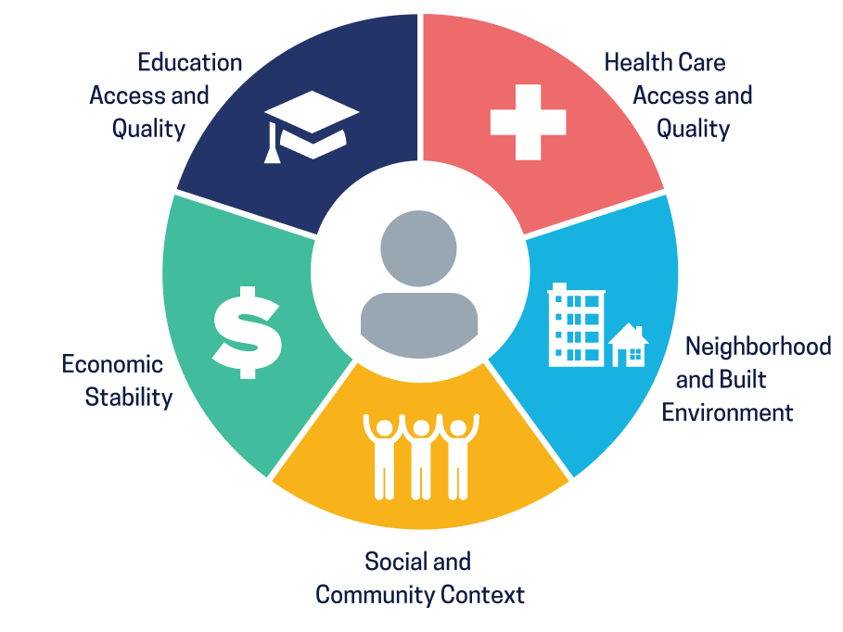
Social Determinants of Health
Social determinants of health (SDoH) are the conditions in the environments where people are born, live, learn, work, play, worship, and age that affect a wide range of health, functioning, and quality-of-life outcomes and risks.
Examples include
Safe housing, transportation, and neighborhoods
Education, job opportunities, and income
Access to nutritious foods and physical activity opportunities
Discrimination and violence
Air and water quality
Language and literacy skills
https://odphp.health.gov/healthypeople/priority-areas/social-determinants-health

Slide 11





SDoH at Work that Support Healthy Pregnancy Outcomes
Adequate network coverage for maternal and mental health.
Telehealth, 24/7 Live Nurse line, Case Management.
Transportation to and from prenatal care visits.
Health Care Access
Built Environment
Healthy vending/food options; safe places to walk on campus.
Comfortable, private, lactation room(s).
Blood pressure equipment for self-monitoring.
Social
Employee Resource Groups (ERGs): expecting parents, new parents, grieving parents.
Onsite and virtual group exercise classes: prenatal yoga, stretching, etc.
Economic
Affordable healthcare coverage.
Minimize out of pocket costs for pregnancy and delivery.
  Culturally relevant educational materials.
  Access to health coaching, including goal setting for a healthy pregnancy.
  Healthy pregnancy lunch and learns or virtual learning opportunities.
Education

Slide 12

Prevention Strategies
  Population Health Data
  Plan Design
  Postpartum Support
  Practical Action Steps

Slide 13

Population Health Data
“If you can’t measure it, you can’t manage it.”
Peter Drucker
  Identify and understand risk.
  Inform medical and pharmacy strategies.
  Uncover opportunities for steerage.
  Understand demographics (gender, generational considerations, trends).
  Target communication and education to specific populations.
  Leverage carrier case management.
  Develop and engage members in wellness programs and initiatives.
  Track outcomes (member health, plan performance).
  Pivot quickly when needed.

Slide 14

Plan Design
Cover contraception; 40% of pregnancies are unplanned, many of those end in termination or lead to poor pregnancy outcomes.
  Ensure the health plan minimizes out of pocket expenses for maternal care.
  Confirm network adequacy for both maternal and mental health care.
  Buy-up to include carrier Healthy Pregnancy programs.
  Cover home B/P machines for self-monitoring.
  For grandfathered plans, ensure breastfeeding support, counseling, and breast pump equipment is covered.
  Make sure the plan has a 24/7 Nurse Line and Case Managers who can help reduce fragmented care.
  Provide telemedicine. Allow members to use while at work as some areas have spotty network coverage.
  If in a rural community, choose health plans that pay adequately for services delivered at the rural hospital.

Slide 15

Postpartum Support
States with a 6-12 weeks paid maternity leave policy have increased return to work 1-2 years post-delivery and decreased infant mortality by 12%.
  Most maternal death occurs postpartum. Ensure continuous coverage throughout pregnancy and the 12-month post-partum period.
  Postpartum depression and substance use disorder is a significant problem for this population. Provide access to mental health support and health coaching.
  Promote support networks such as Post Partum Support International: https://postpartum.net/
  Support breast feeding; it reduces infant mortality, improves mental health and improves infant health. Remember, baby is now on the health plan too.
  Provide a comfortable, private lactation room with locked refrigeration. Women should not have to pump in the restroom.

Slide 16

Practical Action Steps
Prenatal health is one of the most important predictors of pregnancy outcomes.
  Promote the importance of establishing care with a primary care provider and getting annual exams.
  Encourage women to connect with care as soon as they suspect they may be pregnant.
  Establish programs for women who are thinking about getting pregnant to provide culturally relevant education on good nutrition, adequate physical activity, and managing existing chronic conditions.
  Partner with local and state health departments to leverage community resources for pre- pregnancy planning, pregnancy, and post-partum support.
  Support time away from work for prenatal care appointments, birthing classes, and infant care education.

