Slide 1


Trends in Obesity & Lack of Health
Neha Kumar, DO, MPH, DipABLM
May 2025

Slide 2


Background & Interests
Osteopathic Physician
Physical Medicine and Rehabilitation & Lifestyle Medicine
Clinical & non-clinical settings
  Outpatient, home visits
  Health insurance
My story
Lifestyle Medicine integration as first-line treatment
  6 pillars (nutrition, physical activity, stress management, avoidance of toxic substances, sleep, social connection)
  Evidence-based approach to prevent, treat, and reverse diseases
Notes:
DO- Holistic-mind, body, spirit
PMR- function & Quality of life
Payor- UM

Slide 3
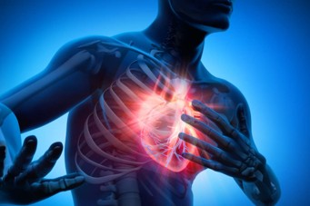
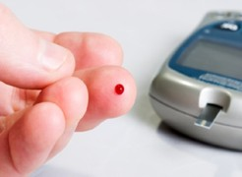

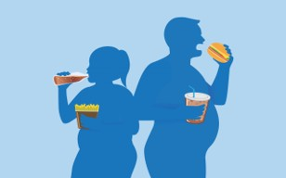
Some Facts about Chronic Diseases
  Heart Disease and Stroke
  CVD: 2580 U.S. deaths/day
  Stroke: 453 U.S. deaths/day
  Prediabetes & Diabetes >1/2 of U.S. adults
  Cancer
  Two million people will be diagnosed in 2025
  618,120 people will die in 2025
  Obesity
  At least 1 in 5 adults in each U.S. state
  23 states with Obesity rate of 35% or higher
Notes:
Causes of death-first: heart dz. And CVA
second: Cancer
AHA 2025: CVD: 1 every 34 sec.
AHA 2025: Stroke: 1 every 3 min. 11 sec.
AHA Diabetes 2025
ACS 2025: Cancer:
Obesity (CDC)2023: 42% in US; more than 2 in 5 adults
2021: In the U.S, adults: 42% with obesity; 9% with severe obesity

Slide 4

Obesity
  World Health Organization: “abnormal or excessive fat accumulation that presents a risk to health.”
  Obesity Medicine Association: “chronic, relapsing, multi-factorial, neurobehavioral disease, wherein an increase in body fat promotes adipose tissue dysfunction and abnormal fat mass physical forces, resulting in adverse metabolic, biomechanical, and psychosocial health consequences.”
Variations amongst populations
  BMI greater than 30
  BMI greater than 25 in Asians
Risk factor for chronic diseases
Notes:
OMA: comprehensive definition
Adipose-largest endocrine organ-26% in men; 38% in women
-actively communicates with most organs throughout the body through factors

Slide 5
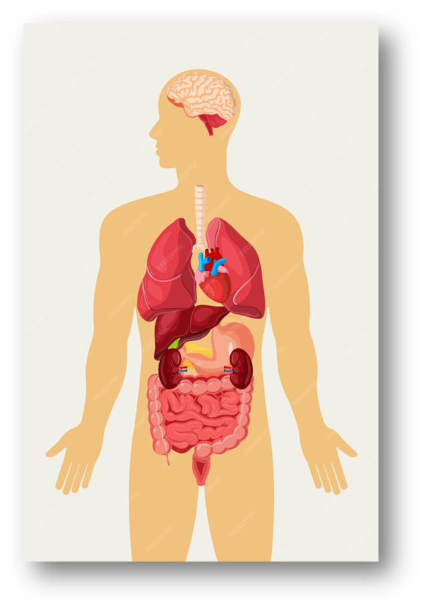
Being Overweight and Obese can lead to:
Type 2 Diabetes
High blood pressure
Heart disease & stroke
Metabolic syndrome
Fatty liver disease
Cancer
Osteoarthritis
Breathing problems
Diseases of the gall bladder & pancreas
Gout
Kidney disease
Fertility problems
Pregnancy problems
Mental health problems
Notes:
Talk about this per organ system:
Mental health→ breathing problems (OSA)→CVD & CVA→ fatty liver→ GB and pancreas→kidney dz., reproductive problems→pregnancy problems→ OA + Gout→ metabolic syndrome→ Cancer.

Slide 6
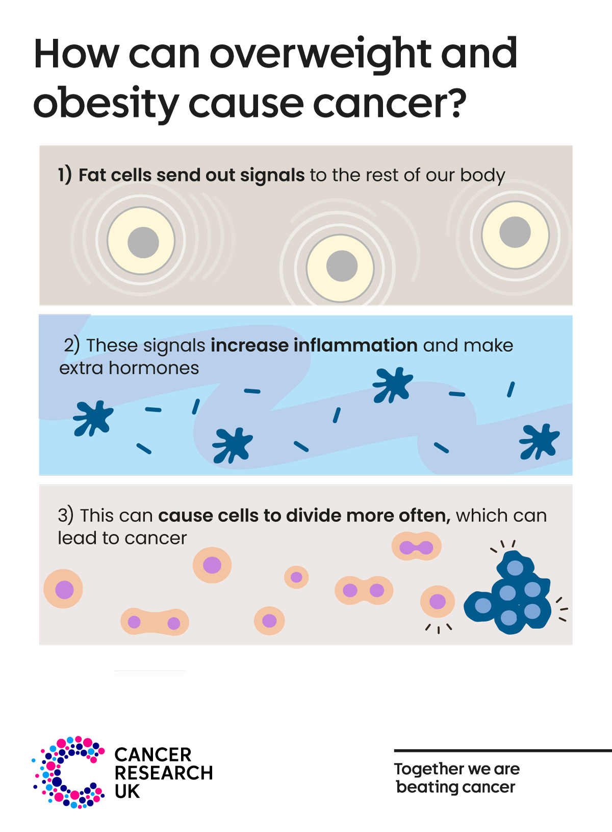
Obesity and Cancer
Adipose tissue
  Largest endocrine organ
  More than just for energy storage & insulation
  “Cross-talk” with other organs
  Reacts to outside stimulus
Factors released from adipose tissue can contribute to cancer growth & progression
  Directly or indirectly (systemically)
Visceral vs. subcutaneous
  Visceral ~ metabolic syndrome and Type 2 Diabetes
Obesity is associated with:
  13 types of cancer
  Increased mortality for certain cancers
Notes:
Talk about this per organ system:
Mental health→ breathing problems (OSA)→CVD & CVA→ fatty liver→ GB and pancreas→kidney dz., reproductive problems→pregnancy problems→ OA + Gout→ metabolic syndrome→ Cancer.

Slide 7
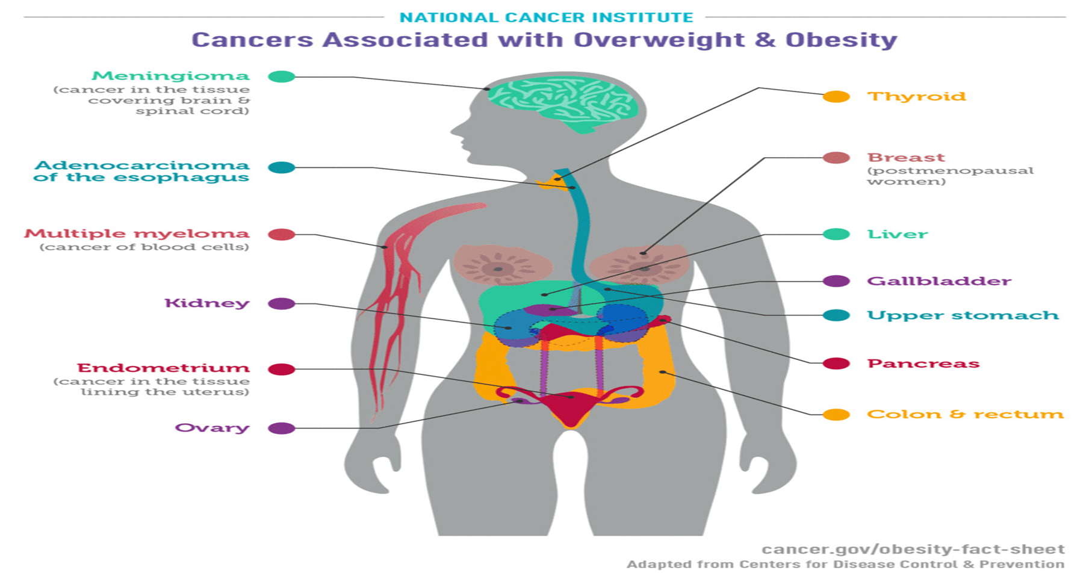
Notes:
Talk about this per organ system:
Mental health→ breathing problems (OSA)→CVD & CVA→ fatty liver→ GB and pancreas→kidney dz., reproductive problems→pregnancy problems→ OA + Gout→ metabolic syndrome→ Cancer.

Slide 8
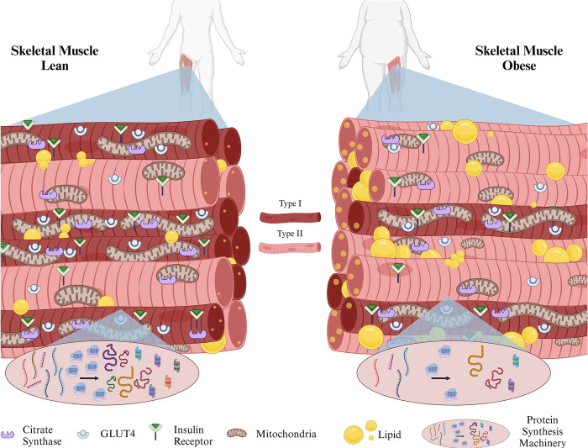
Obesity and Musculoskeletal conditions
Physiology
  Biomechanical + metabolic + inflammation
  Increased BMI ~ shift from Type I fibers to Type II fibers
  Accumulation of lipids in skeletal muscle
Risk factor for Osteoarthritis
  Hips, knees, ankles, spine, hands
  Cartilage degrades, bone remodels, osteophytes form
Sarcopenic obesity
  Low muscle mass/function + excess fat
Balance
  Postural instability
  Falls
Serrano N, Hyatt JK, Houmard JA, Murgia M, Katsanos CS. Muscle fiber phenotype: a culprit of abnormal metabolism and function in skeletal muscle of humans with obesity. Am J Physiol Endocrinol Metab. 2023 Dec 1;325(6):E723-E733.
Notes:
OA-cartilage degradation, bone remodeling and osteophyte formation
Symptomatic knee OA: 14 million people
Increased risk of knee OA by 3 x in people with obesity----due to inflammation
More cartilage volume loss + OA progression on radiographs-correlated to poor m. quality & increased fat in muscle.
Obesity causes OA: metabolic and inflammatory mechanisms
Obesity-m. fibers- Obesity associated with Altered distribution of m. fibers (reduced number of slow type 1 m. fibers)—highest capacity for oxidative metabolism (metabolize glucose) and lower fatigability vs. fast type II fibers. (slow and fast refer to contraction speed of myosin fibers)
-accumulation of lipids in skeletal m.
Increased muscle glucose metabolism ~ Type I fibers
Increased mitochondria- Type I fibers
Low protein synthesis- due to low type I fibers
Likely to gain weight and less likely to lose weight
Sarcopenic obesity- importance of need to balance wt. loss with “healthy” muscle physiology- wt. loss, nutrition, exercise (low cal. Diet high in protein + exercise
Falls in older adults with obesity: poor balance, muscle mass, gait abnormalities (change in body shape, center of gravity); decreased equilibrium

Slide 9
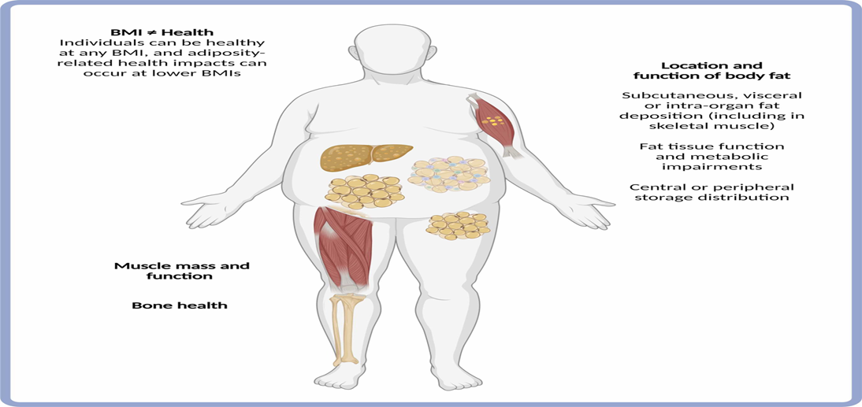
Obesity and Musculoskeletal conditions
Godziuk, Kristine et al., Obesity and body mass index: Past and future considerations in osteoarthritis research; Osteoarthritis and Cartilage; Volume 32, Issue 4, 452-459
Notes:
Obesity is a complex disease.
Factors to consider besides BMI; location of body fat (subcut. Or visceral or intra-organ fat);
centrall or peripheral distribution
M. mass/function & bone health

Slide 10
Obesity and Pregnancy
Pre-existing maternal obesity ~ twice the risk of childhood obesity.
Excess gestational weight gain leads to:
  3x increased risk of childhood obesity
  Increased long-term risk of chronic diseases in women
Retention of weight 1 yr. post-partum increases risk of long-term weight gain and chronic diseases.
Obesity in the mother can lead to:
  Gestational diabetes
  Preeclampsia
  Depression
  Cesarean birth
  Pre-term birth
  Large for gestational age babies
  Congenital anomalies
Notes:
Maternal obesity→adverse outcomes for mom and baby
→ 40% higher health system cost compared to normal weight pregnancies
Pre-existing obesity- obese prior to pregnancy
Normal weight gain for normal BMI pregnancy: 25-35 lbs.

Slide 11

Obesity and Mental/Cognitive Health
        Pathophysiology
          Chronic inflammation (increased ROS production)
          Increased pro-inflammatory cytokines
          Neuroinflammation (HPA axis dysregulation, gut microbiome related mechanisms, insulin resistance etc.)
        Risk factor
          23% of individuals with obesity are affected by depression
          Increased risk of anxiety disorder by 30%
        Bidirectional relationship with Depression
        Depression poses an increased risk for Alzheimer’s disease
Notes:
Depression- one of the leading causes of disability and loss of productive life years worldwide
Depression and DM- bidirectional assoication
Mid-life (40-60) obesity→independent risk factor for AD
Causes of depression: metabolic + inflammatory causes
Ly M, Yu GZ, Mian A, Cramer A, Meysami S, Merrill DA, Samara A, Eisenstein SA, Hershey T, Babulal GM, Lenze EJ, Morris JC, Benzinger TLS, Raji CA. Neuroinflammation: A Modifiable Pathway Linking Obesity, Alzheimer's disease, and Depression. Am J Geriatr Psychiatry. 2023 Oct;31(10):853-866. doi: 10.1016/j.jagp.2023.06.001. Epub 2023 Jun 11. PMID: 37365110; PMCID: PMC10528955.
The menace of obesity to depression and anxiety prevalence
Fulton, Stephanie et al.
Trends in Endocrinology & Metabolism, Volume 33, Issue 1, 18 – 35

Slide 12
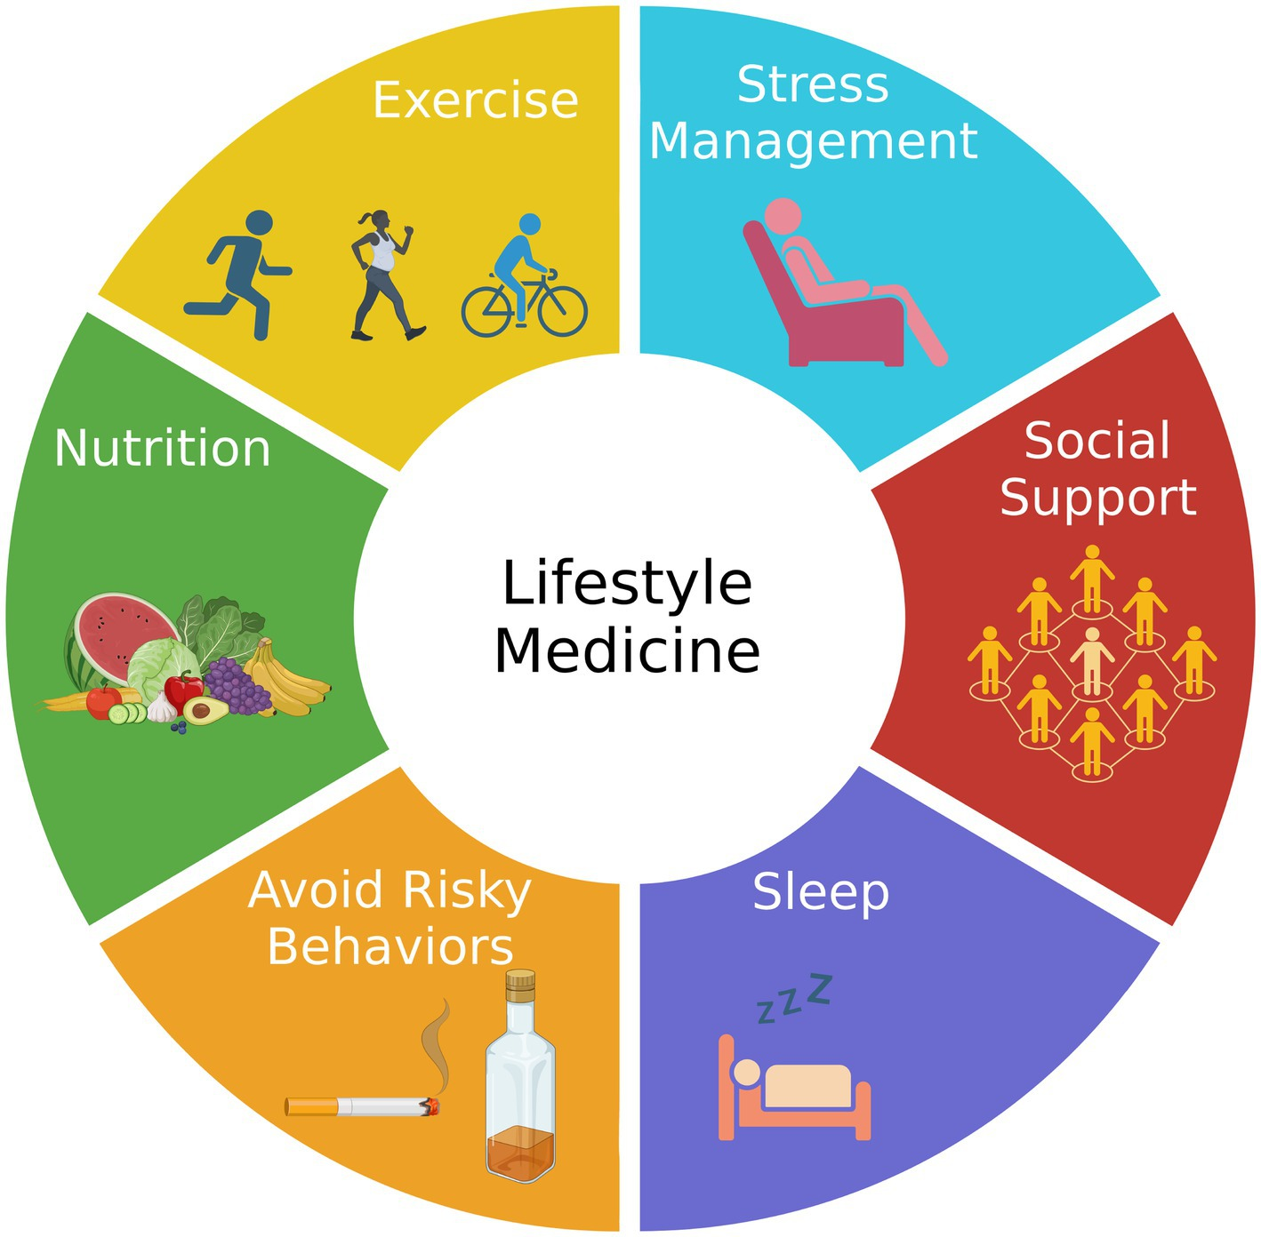
Increasing Health span and Lifespan
Notes:
Are we increasing life span and health span?
6 pillars- help with DM, HTN, heart disease, stroke, cancer, metabolic syndrome, obesity

Slide 13


Slide 14
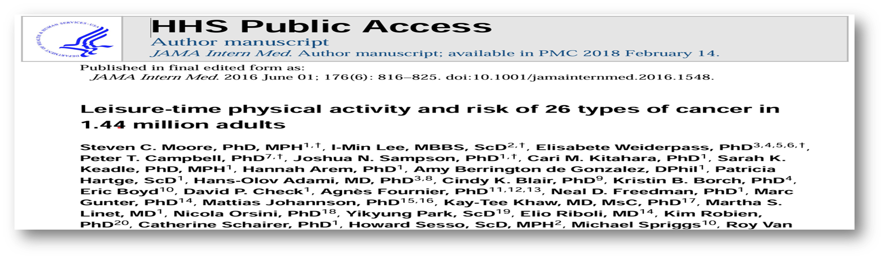
Lifestyle and Cancer
Higher Leisure time physical activity
  7% decreased risk of cancer
  Lower risk of 13 types of cancer
Notes:
PA already associated with decreased risk of endometrial, colon, breast CA but this study
Moore SC, Lee IM, Weiderpass E, Campbell PT, Sampson JN, Kitahara CM, Keadle SK, Arem H, Berrington de Gonzalez A, Hartge P, Adami HO, Blair CK, Borch KB, Boyd E, Check DP, Fournier A, Freedman ND, Gunter M, Johannson M, Khaw KT, Linet MS, Orsini N, Park Y, Riboli E, Robien K, Schairer C, Sesso H, Spriggs M, Van Dusen R, Wolk A, Matthews CE, Patel AV. Association of Leisure-Time Physical Activity With Risk of 26 Types of Cancer in 1.44 Million Adults. JAMA Intern Med. 2016 Jun 1;176(6):816-25. doi: 10.1001/jamainternmed.2016.1548. PMID: 27183032; PMCID: PMC5812009.

Slide 15
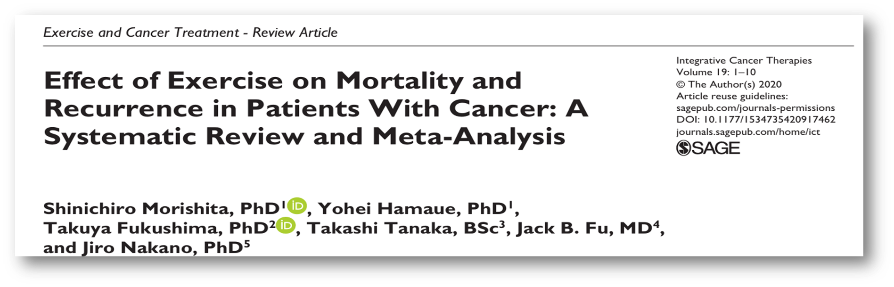
Lifestyle and Cancer
Physical activity associated with:
  Decreased risk of breast, colorectal, prostate cancer recurrence
  Reduced cancer-specific mortality
Notes:
Morishita S, Hamaue Y, Fukushima T, Tanaka T, Fu JB, Nakano J. Effect of Exercise on Mortality and Recurrence in Patients With Cancer: A Systematic Review and Meta-Analysis. Integr Cancer Ther. 2020 Jan-Dec;19:1534735420917462. doi: 10.1177/1534735420917462. PMID: 32476493; PMCID: PMC7273753.

Slide 16

Lifestyle and Musculoskeletal Conditions
Regular physical activity in those with knee and hip Osteoarthritis is associated with:
  Improved function (physical)
  Improved quality of life (health-related)
  Decreased pain

Slide 17
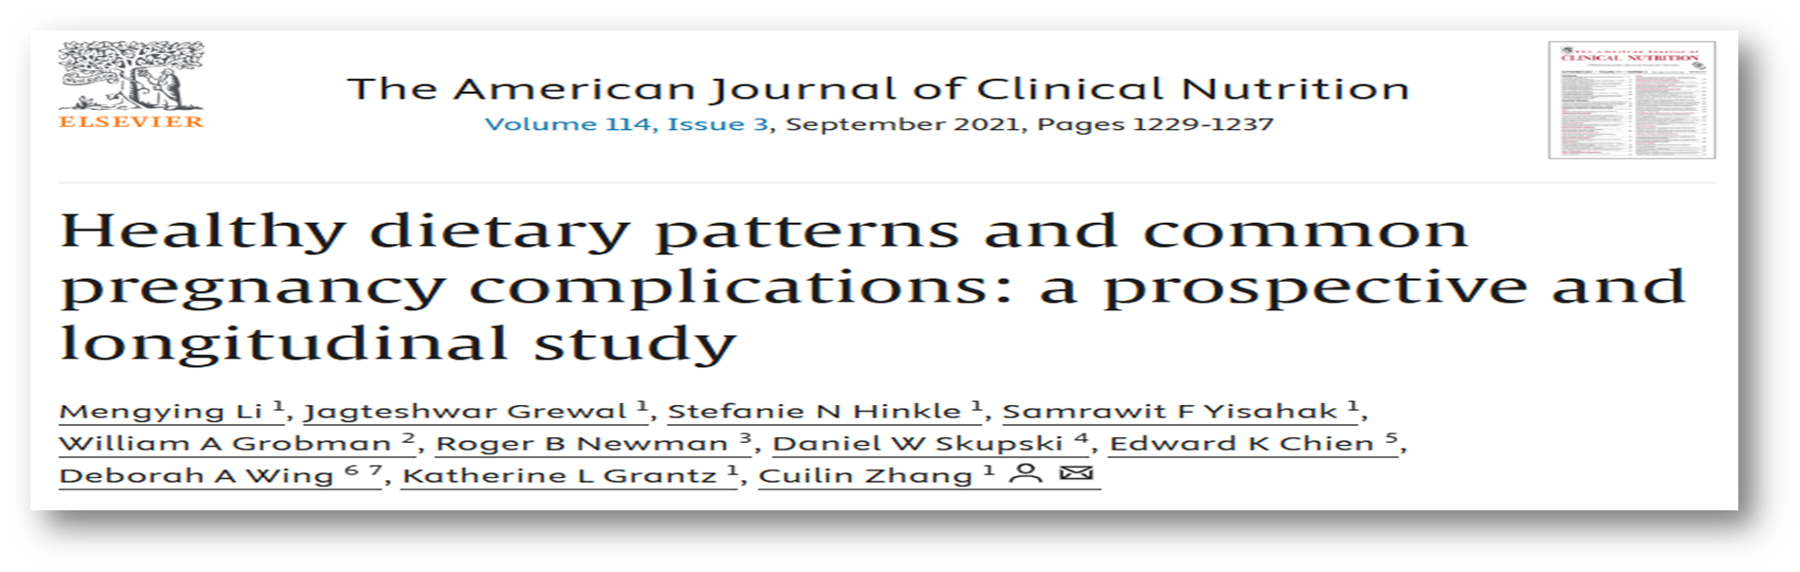
Lifestyle and Pregnancy Complications
“healthier dietary patterns during periconception and pregnancy characterized by higher AHEI, AMED, or DASH scores were related to lower risks of common pregnancy complications including gestational Diabetes Mellitus, gestational hypertension, preeclampsia, and preterm delivery.”
Notes:
AHEI (alternate Healthy eating index);
Higher intakes of vegetables, fruits, whole grains, nuts, and legumes
AMED (alternate mediterranean diet):
plant foods including plant proteins, monounsaturated fat, fish, and lower consumption of animal products and saturated fat.
DASH (Dietary approaches to stop hypertension)
Vegetables, fruits, whole grains, fat-free or low-fat dairy products, fish, poultry, beans, nuts, and vegetable oils
Li M, Grewal J, Hinkle SN, Yisahak SF, Grobman WA, Newman RB, Skupski DW, Chien EK, Wing DA, Grantz KL, Zhang C. Healthy dietary patterns and common pregnancy complications: a prospective and longitudinal study. Am J Clin Nutr. 2021 Sep 1;114(3):1229-1237. doi: 10.1093/ajcn/nqab145. PMID: 34075392; PMCID: PMC8408886.

Slide 18
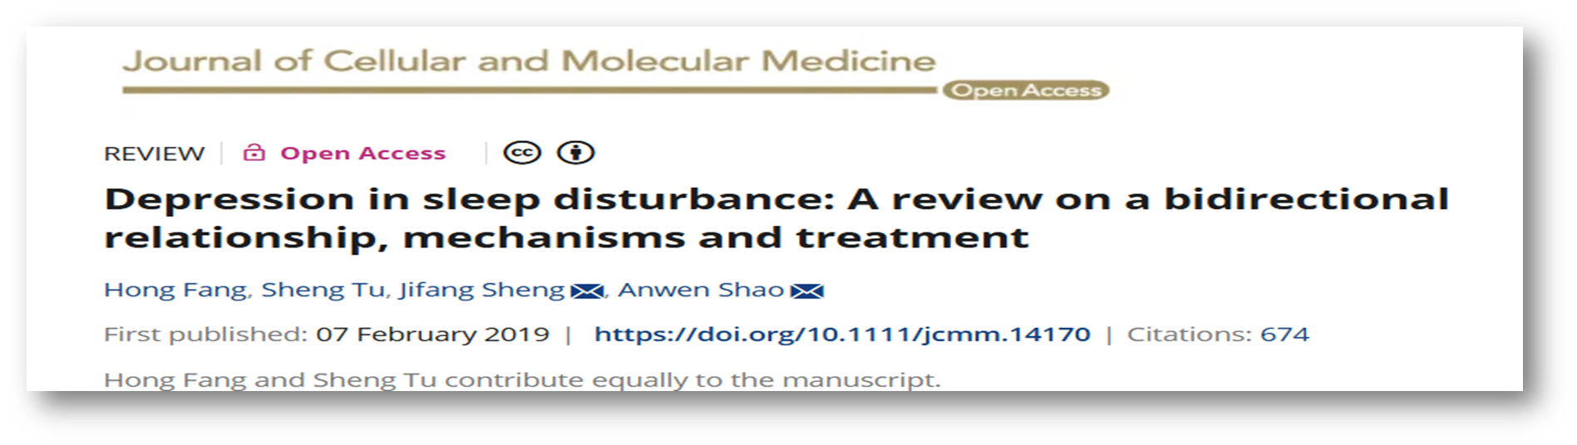
Lifestyle and Depression
Insomnia is an independent risk factor for developing depression
90% of patients with depression have sleep disturbances
Notes:
AHEI (alternate Healthy eating index);
Higher intakes of vegetables, fruits, whole grains, nuts, and legumes
AMED (alternate mediterranean diet):
plant foods including plant proteins, monounsaturated fat, fish, and lower consumption of animal products and saturated fat.
DASH (Dietary approaches to stop hypertension)
Vegetables, fruits, whole grains, fat-free or low-fat dairy products, fish, poultry, beans, nuts, and vegetable oils
Li M, Grewal J, Hinkle SN, Yisahak SF, Grobman WA, Newman RB, Skupski DW, Chien EK, Wing DA, Grantz KL, Zhang C. Healthy dietary patterns and common pregnancy complications: a prospective and longitudinal study. Am J Clin Nutr. 2021 Sep 1;114(3):1229-1237. doi: 10.1093/ajcn/nqab145. PMID: 34075392; PMCID: PMC8408886.

Slide 19

Getting down to the Basics
Prevention is better than cure
Lifestyle first approach
  Root-cause
  Prevent, treat, reverse
Improve Healthspan and Lifespan
  Cambridge Dictionary definition:
    Healthspan: “The number of years that someone lives or can expect to live in reasonably good health.”
    Lifespan: “The length of time for which a person, animal, or thing exists”
Whole-person health
https://www.ardmoreinstituteofhealth.org/about-us/about-ardmore-institute-of-health
Notes:
Healthspan: living a better quality of life not just more number of years
Improve health outcomes and identify medical spend waste

Slide 20
References
Allen KD, Thoma LM, Golightly YM. Epidemiology of osteoarthritis. Osteoarthritis Cartilage. 2022 Feb;30(2):184-195.
Alice, A., Yadav, M., Verma, R., Kumari, M., & Arora, S. (2022). Effect of obesity on balance: A literature review. International Journal of Health Sciences, 6(S4), 3261–3279. https://doi.org/10.53730/ijhs.v6nS4.9126
Batushansky A, Zhu S, Komaravolu RK, South S, Mehta-D'souza P, Griffin TM. Fundamentals of OA. An initiative of Osteoarthritis and Cartilage. Obesity and metabolic factors in OA. Osteoarthritis Cartilage. 2022 Apr;30(4):501-515.
Brown KA, Scherer PE. Update on Adipose Tissue and Cancer. Endocr Rev. 2023 Nov 9;44(6):961-974.
Cancer: Cancer Statistics Working Group. U.S. Cancer Statistics Data Visualizations Tool, based on 2021 submission data (1999–2021): U.S. Department of Health and Human Services, Centers for Disease Control and Prevention, and National Cancer Institute. Updated June 2024. Accessed July 2024. www.cdc.gov/cancer/dataviz
Centers for Disease Control and Prevention. (n.d.). New CDC data show adult obesity prevalence remains high. Centers for Disease Control and Prevention. https://www.cdc.gov/media/releases/2024/p0912-adult-obesity.html
Centers for Disease Control and Prevention. (2021a, February 8). Products - health e stats - prevalence of overweight, obesity, and extreme obesity among adults aged 20 and over: United States, 1960–1962 through 2017–2018. Centers for Disease Control and Prevention. https://www.cdc.gov/nchs/data/hestat/obesity-adult-17-18/obesity-adult.htm#citation
Common cancer sites - cancer stat facts. SEER. (n.d.). https://seer.cancer.gov/statfacts/html/common.html
CVD + CVA: Centers for Disease Control and Prevention, National Center for Health Statistics. Multiple Cause of Death 2018-2022 on CDC WONDER Online Database website. Reviewed April 26, 2024. Access May 3, 2024. http://wonder.cdc.gov/mcd.html
Notes:
Healthspan: living a better quality of life not just more number of years
Improve health outcomes and identify medical spend waste

Slide 21
References
DM: Centers for Disease Control and Prevention. Diabetes Statistics Report. U.S. Dept of Health and Human Services; 2023. https://www.cdc.gov/diabetes/php/data-research/index.html
Fulton, Stephanie et al.; The menace of obesity to depression and anxiety prevalence.Trends in Endocrinology & Metabolism, Volume 33, Issue 1, 18 – 35
Lim S, Harrison C, Callander E, Walker R, Teede H, Moran L. Addressing Obesity in Preconception, Pregnancy, and Postpartum: A Review of the Literature. Curr Obes Rep. 2022 Dec;11(4):405-414.
Ly M, Yu GZ, Mian A, Cramer A, Meysami S, Merrill DA, Samara A, Eisenstein SA, Hershey T, Babulal GM, Lenze EJ, Morris JC, Benzinger TLS, Raji CA. Neuroinflammation: A Modifiable Pathway Linking Obesity, Alzheimer's disease, and Depression. Am J Geriatr Psychiatry. 2023 Oct;31(10):853-866.
Marchi J, Berg M, Dencker A, Olander E, Begley C. Risks associated with obesity in pregnancy, for the mother and baby: a systematic review of reviews. Obes Rev. 2015;16(8):621–38.
Martin et al. Heart disease and stroke statistics: A report of US and Global data from the American Heart Association. Circulation. Published online January 27, 2025
Obesity: Stierman B, Afful J, Carroll M, et al. National Health and Nutrition Examination Survey 2017–March 2020 Prepandemic Data Files Development of Files and Prevalence Estimates for Selected Health Outcomes. National Health Statistics Reports; 2021(158). https://stacks.cdc.gov/view/cdc/106273/cdc_106273_DS1.pdf
Pathophysiology-Batushansky A, Zhu S, Komaravolu RK, South S, Mehta-D'souza P, Griffin TM. Fundamentals of OA. An initiative of Osteoarthritis and Cartilage. Obesity and metabolic factors in OA. Osteoarthritis Cartilage. 2022 Apr;30(4):501-515.
Notes:
Healthspan: living a better quality of life not just more number of years
Improve health outcomes and identify medical spend waste

Slide 22
References
Rippe, J. M. (2024). Lifestyle medicine (Fourth). CRC Press.
Serrano N, Hyatt JK, Houmard JA, Murgia M, Katsanos CS. Muscle fiber phenotype: a culprit of abnormal metabolism and function in skeletal muscle of humans with obesity. Am J Physiol Endocrinol Metab. 2023 Dec 1;325(6):E723-E733. doi: 10.1152/ajpendo.00190.2023. Epub 2023 Oct 25. PMID: 37877797; PMCID: PMC10864022.
U.S. Department of Health and Human Services. (n.d.). Health risks of Overweight & obesity - niddk. National Institute of Diabetes and Digestive and Kidney Diseases. https://www.niddk.nih.gov/health-information/weight-management/adult-overweight-obesity/health-risks
What is obesity?. Obesity Medicine Association. (n.d.). https://obesitymedicine.org/blog/what-is-obesity/
World Health Organization. (n.d.-a). Obesity and overweight. World Health Organization. https://www.who.int/news-room/fact-sheets/detail/obesity-and-overweight
Notes:
Healthspan: living a better quality of life not just more number of years
Improve health outcomes and identify medical spend waste

