Slide 1


Plan Cost Drivers and Successful Deflators
Kaycee DeGabriele
May 14, 2025

Slide 2

Overall Trends
Notes:
Medical Non hcc trend 4% from 2022-2023
Medical Non hcc trend 6% from 2023 to 2024

Slide 3
High Cost Claimant Trends
% of Total Cost by Spend Band
 | 2021 | 2022 | 2023 | 2024
< $5,000 | 8.4% | 7.1% | 6.9% | 8.1%
$5,000 - $10,000 | 6.3% | 6.0% | 5.8% | 6.2%
$10,000 - $25,000 | 13.3% | 12.6% | 12.7% | 13.4%
$25,000 - $50,000 | 13.5% | 13.4% | 13.7% | 14.1%
$50,000 - $75,000 | 8.7% | 8.7% | 8.8% | 8.8%
$75,000 - $100,000 | 6.2% | 6.0% | 6.1% | 6.3%
$100,000 - $150,000 | 8.0% | 8.4% | 8.3% | 8.4%
$150,000 - $200,000 | 5.8% | 6.1% | 6.1% | 5.7%
$200,000 - $500,000 | 15.6% | 16.2% | 16.1% | 15.3%
$500,000 - $750,000 | 5.0% | 5.6% | 5.4% | 5.1%
$750,000 - $1,000,000 | 2.9% | 3.1% | 3.3% | 2.7%
$1,000,000 and up | 4.5% | 6.0% | 6.4% | 5.4%
% of Member by Spend Band
 | 2021 | 2022 | 2023 | 2024
< $5,000 | 58.98% | 58.45% | 59.30% | 62.31%
$5,000 - $10,000 | 11.62% | 12.24% | 12.20% | 11.46%
$10,000 - $25,000 | 12.89% | 13.54% | 13.35% | 12.36%
$25,000 - $50,000 | 7.12% | 7.40% | 7.24% | 6.69%
$50,000 - $75,000 | 2.85% | 2.92% | 2.83% | 2.60%
$75,000 - $100,000 | 1.47% | 1.48% | 1.44% | 1.33%
$100,000 - $150,000 | 1.44% | 1.45% | 1.40% | 1.28%
$150,000 - $200,000 | 0.74% | 0.75% | 0.72% | 0.65%
$200,000 - $500,000 | 1.21% | 1.20% | 1.13% | 1.02%
$500,000 - $750,000 | 0.20% | 0.20% | 0.19% | 0.16%
$750,000 - $1,000,000 | 0.09% | 0.09% | 0.08% | 0.07%
$1,000,000 and up | 0.09% | 0.09% | 0.08% | 0.07%
Notes:
Jump in the higher spend bands from 2021 to 2022

Slide 4
Notes:
High cost specialty meds driving high claimant spend include cancer treatments, inflammatory medications, skin medications, and cystic fibrosis treatment.

Slide 5
Notes:
MSK Surgeries were the top procedure driver of spend driven by spine and total joint replacements.

Slide 6
Notes:
MSK Surgeries were the top procedure driver of spend driven by spine and total joint replacements.

Slide 7
Musculoskeletal Impact on Plan Spend
2024 Top 5 MEDC | Plan Paid PMPM | Mbrs per 1000
General Health | $65 | 734
Musculoskeletal | $58 | 294
Malignancies | $38 | 33
Cardiovascular | $37 | 217
General Surgery | $34 | 197
In 2024, MSK was the second highest medical cost driver for Vital Incite’s book of business.
MSK Surgeries were the top procedure driver of spend driven by spine and total joint replacements.
2024 Top 5 EDC | Plan Paid PMPM | Mbrs per 1000
Musculoskeletal disorders | $11 | 86
Degenerative joint disease | $11 | 35
Low back pain | $8 | 87
Fractures (excluding digits) | $6 | 22
Acute sprains and strains | $4 | 50

Slide 8
Cancer
Notes:
Cancer prevalence continues to increase, with the largest jump from 2020 to 2021. In 2020, 2.79% of members had a cancer diagnosis compared to 3.11% in 2024.
Greatest increase among low impact malignant neoplasms from 2020.
Risk among members with cancer increased 5% from 2020 (8.0) compared to 2024 (8.4). Coordination risk among members with cancer increased from 9% in 2020 to 12% in 2024.

Slide 9
Cancer
Notes:
Not only does cancer prevalence continue to increase, but cancer spend has as well. Spend has increased in each of the 3 categories, medical and both pharmacy through med and PBM. Since 2020, per member per year spend for those with cancer has increased almost 27%.
Greatest increase is among pharmacy Rx though the PBM.

Slide 10
Healthy Pregnancies
Pregnancy and deliveries with complications increased during COVID and has not dropped
  Upcoding
  Increased ER Use
Provider Feedback
Quality of care has decline with hospital owning providers
Areas of care deserts are at highest risk
Younger women are delaying care
Younger women expect they are healthy
Good health prior to pregnancy is critical
Pregnancies w/ Complications per 1,000 Pregnancies
Age Band | 2021 | 2022 | 2023 | 2024
18 - 26 | 49.8 | 55.3 | 61.2 | 71.8
27-34 | 135.3 | 135.1 | 127 | 129
35-44 | 59.1 | 56.1 | 47.1 | 40.2
45-54 | 2.8 | 2 | 1.1 | 0.9

Slide 11
Mental Health
Notes:
Mental health prevalence has continued to increase from 2021 now impacting 197 per 1,000 members (medical claims data).
Most notable increase seen has been anxiety, the most prevalent condition, which increased from 67 per 1,000 members in 2021 to 87 per 1,000 members in 2024.

Slide 12
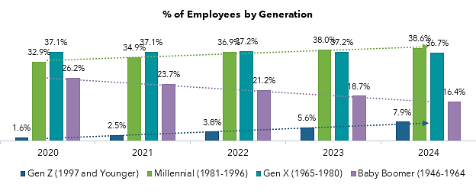
Generational Changes

Slide 13
The Science of Employee Engagement
Generation
Ages
What is Important
What is Not
Gen Z
13
-
28
•
Ethnically/racially diverse generation
medical, dental, vision, life
Communication through
mailing
•
Just entering the workforce,
Non
-
•
traditional benefits: mental health, societal influence,
pet insurance, student loan assistance
•
Pharmacy benefits
Millennials
28
-
43
Career trajectory
-
•
career development benefits
Student loan assistance,
•
Starting/young families: childcare, life ins., physical
dental, HRA, life spending
health, telemedicine, EAP, STD
accounts
Gen X
45
-
60
•
Peaking in their career
Societal influences, Student
•
Older families/empty nesting: secondary education,
loan assistance
Caregiving
-
EAP
•
Realizing chronic conditions:, cancer prevention,
menopause, dental care
Long term and short
-
•
term disability
Baby Boomer
57
-
75
•
Empty nesters
Mental health benefits
•
Medical benefits
•
Financial wellness
•
Caregiving

Slide 14
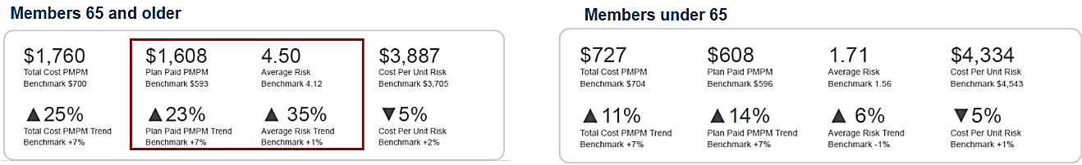
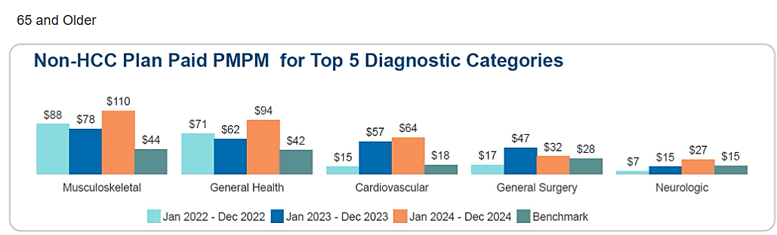
Economy Shift

