Slide 1


Vital Oversight
Lessons Learned and Plans to Differentiate Alera Group
Mary Delaney John Delaney Magda Graves

Slide 2
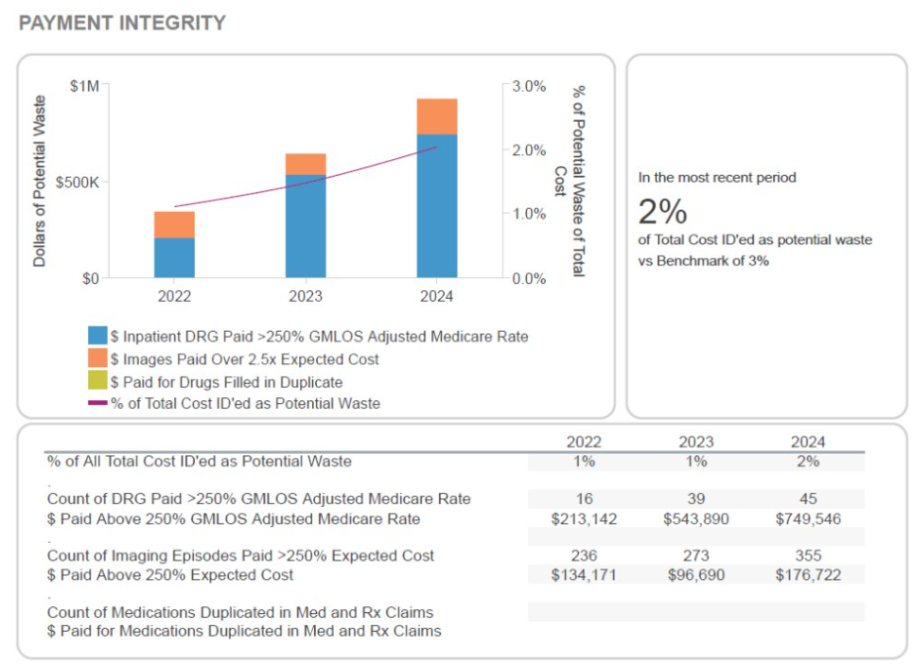
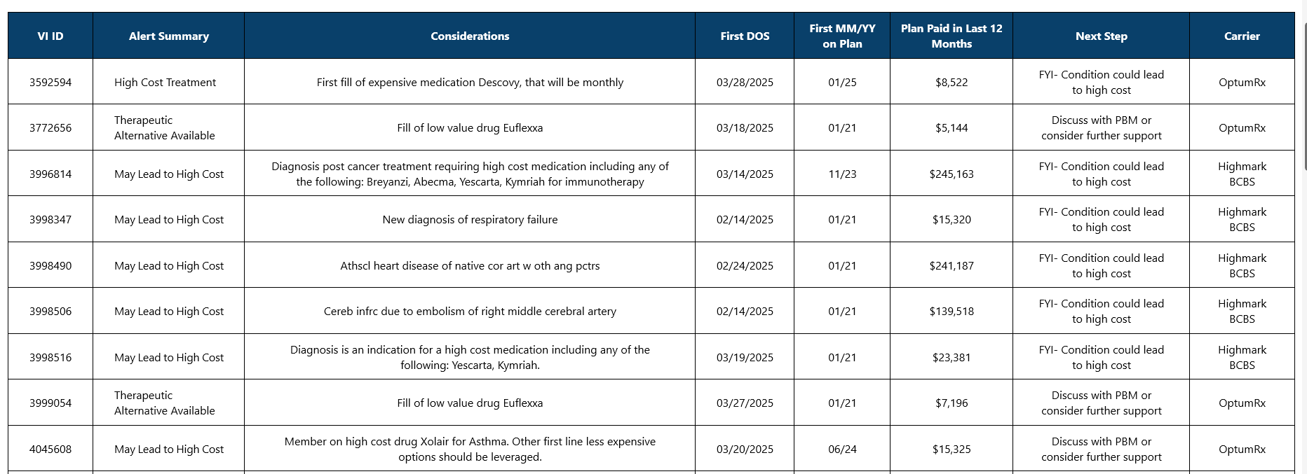

What Motivated the Development of This Department?

Slide 3

Vital Oversight
Correct Resource bring best Result
Contract Review
  Determine rules of engagement
  Suggest improved contracting language
Claims Specialist
  Price paid is outside of expected
  Duplicate or erroneous payments
Clinical Specialist
  Clinical review of new cases that will likely drive-up cost
    Appropriate treatment
    New Dx that may lead to ongoing HCC
    New Gene therapy or genetic testing -potential candidate
    New treatment to audit site of care and procedures
Pharmacy Specialist
  Clinical review of drugs where there are therapeutic alternatives
  Medications filled that are considered low value
  Medications filled where prior auth may need to be modified

Slide 4
Administrative Agreements
Data, Auditing, “Shared Savings”, Provisions impacting Total Plan Cost
Notes:
Background
Heavy in Finance (Auditor, Controller and CFO)
Mid-life Law degree (heavy in contract review and compliance; as well as fiduciary responsibility)
Respective
Oversight of a major company vendor (the TPA)
What is necessary to satisfy (via required performance) corporate leadership’s fiduciary duty surrounding is Health Plan
Is there an opportunity wring out money from this business activity

Slide 5
Overview of ASA-Related Topics
Fiduciary responsibility of Employer to Understand the contents of an ASA/ASO
Employer’s Access to Data without Cost
Establishing the Right to Review Claims Outliers
Access to Substantive Documentation for any Amounts that TPA Charges the Health Plan
Understanding of “Share Savings”/”Payment Integrity” Provisions
Other Financially-Impactful Provisions
  TPA arbitrage (Charges to Health Plan which Exceed Payments to Medical Providers);
  Health Plan obligations for prompt review of claims paid; and
  BSBC – Blue Card

Slide 6
Fiduciary responsibility of Employer to Understand the contents of an ASA/ASO
Employers are considered Fiduciaries of Health Plan
Relevant obligations of Employer
  Active engagement: Employers cannot passively rely on the TPA; they must actively engage in monitoring and overseeing the TPA's performance.
  Ongoing monitoring: Regularly reviewing the TPA's performance, claims data, and financial reports to ensure compliance and cost-effectiveness.
  Documentation: Maintaining proper documentation of the ASA, TPA performance reviews, and any communication with the TPA.
Activities that can help to Satisfy Fiduciary Duty
  Analytics (Vital Incite)
  Claims investigations (Vital Oversight)
  Review of non-claims paid charges to the Health Plan (Vital Oversight)
Notes:
[Bullet 1] Employers are considered Fiduciaries of Health Plan
Employers can be sued for breaching their fiduciary responsibility in managing health benefit plans under ERISA, specifically the duty of prudence. This duty requires employers to act in the best interest of plan participants and beneficiaries when selecting and monitoring plan service providers.
Duty of Prudence - requires a fiduciary to act with care, skill, and caution when managing assets or making decisions on behalf of another.
Bullet 2 – just read all
[last main bullet] Activities Required to Satisfy Duty - read all three sub-bullets and then close with…
The focus of this presentation is what might we do to help our clients undertake the necessary activities surrounding their TPA (contractual and financial)
To satisfy fiduciary obligations
To lower costs

Slide 7
Employer’s Access to Data without Cost
Why – Pop Health Analytics, or course
Common issues (which limits unlimited access)
  Group size
  Fully insured
  Termination of relationship
  Fees
Guidance is available in Arch https://arch.aleragroup.com/sites/eb-engage/documents/preview/69710/Contract-Language-Considerations
Guiding Principles
Data is provided free of charge
Goes back 36 months, and includes run-out
Obligation survives termination
No masking of data
Timely provided (monthly by the 10th of each month)
Timely correction of data errors
No unreasonable restrictions in use or disclosure of data (pursuant to pre-agreed upon data sharing agreement)
Notes:
[Bullet 1 and 2 – just read and provide quick comment]
Guidance on Arch
This is available and can be used anytime we are assisting client in review/negotiation of ASA
Guiding Principles
Without reviewing the entire document on Arch, these are the key data requirement considerations to include in the ASA
Read and provide brief explanation of each
[Last sub bullet] No unreasonable restrictions – importantly, this requires a pre-negotiation (or review of existing) template for the DSA that TPA will put forth when supplying data
The DSA is typically between TPA and VI, but can also include the employer
We would prefer that this be negotiated when the ASA is put in place (I can assist with review)
It is then added as an exhibit to the ASA (pull out of the locker if/when data is being sought for analytics)

Slide 8
Establishing the Right to Review Claims Outliers
THIS RIGHT IS ESSENTIAL TO A) SATISFYING THE HEALTH PLAN’S FIDUCIARY DUTY AND B) TO CAPITALIZE ON THE SERVICES OFFERED THROUGH VITAL OVERSIGHT
Frustrated by common Auditing provisions in the ASA
  Limits a review to statistical sample and limited # of claims
  Only recognizes “approved” auditing firms
  Recoveries limited to only the audited claims (no extrapolation permitted)
  BCBSIL seemingly prohibits
  Health Plan or Designee (i.e., Vital Incite) needs to be permitted to review claim outliers
    This is so untested, that it would need to be negotiated
    Considerations when negotiating
      Thresholds for inquiry
      Path
      TPA obligations to cooperate
Notes:
Auditing permissions
Never been negotiated
Need to be practical – resource allocation concerns
250% of Medicare for Medical Issues (specified $5k in potential waste)
Medications through the medical plan 150% above average paid (specified over $5k in waste)
Need to identify path for claims inquiries (who will respond)

Slide 9
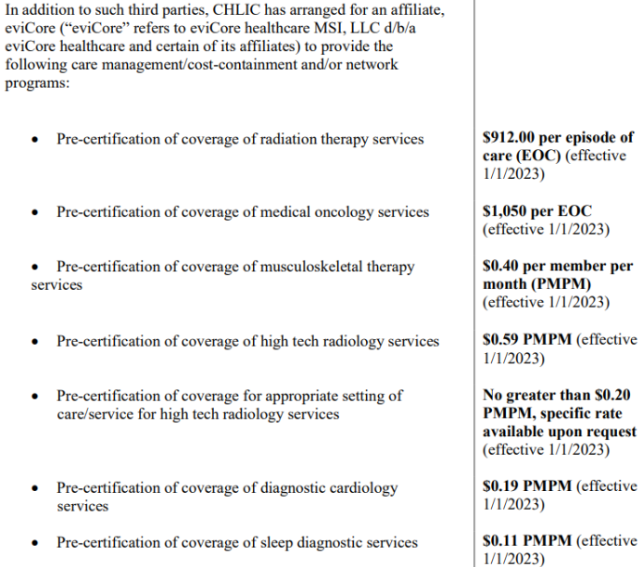
Documentary support for any amounts that TPA charges the Health Plan
WHILE THE “PLAN PAID” AND PEPM CHARGES ARE BY FAR THE LARGEST, THE TPA IS PERMITTED TO CHARGE FOR A VARIETY OF OTHER REASONS. THESE CHARGES SHOULD COME UNDER THE SCRUTINY OF THE HEALTH PLAN REVIEW
Payment Integrity Fee
Shared Savings Fees
Care Management fees
Notes:
As we have begun to review contracts, we are seeing complicated provisions that relate to “additional” claims review services that the TPA may perform; if they result in recovery, the amount that comes to the Health Plan is not clear, as it can be conditioned by:
Whether a vendor was used to investigate
A % that is kept by TPA
Whether TPA was negligent
Cigna has these add-on services
Aware?
Efficacy?
Materiality?

Slide 10
Shared Savings and Payment Integrity Services
ASAs outline a series of Claims Review services that are beyond the claims filing/paying processes included in the TPAs base-line Administrative PEPM. How can Employer Satisfy its Duty surrounding these provisions?
Develop an understanding of:
  The complete list of claims review processes (with in the ASA) (examples on the prior slide)
  How (and why) these review processes are distinct from the base-line claims services that are a part of the administrative PEPM; and
  What triggers a particular claim to be reviewed (under each of the particular service)
  TPA’s right to not return overpayment (BCBS – i.e., not the result of negligence)
Review of Results of these Services – Seek reporting that includes the following:
  All claims for which TPA sought overpayment recovery;
  Under which provision of the ASA was each recovery pursued;
  The dollar amount recovered for each claim;
  The dollar amount of any recovery that was retained by TPA and/or paid to a third party; and
  The amount of the recovery paid to the Health Plan
Notes:
It would seem that in order to Employer satisfy fiduciary duty, it should know (Overview)
what claims investigation services are built into the Admin PEPM
The substance of each additional service, and what triggers a review
The results of these additional services

Slide 11
Shared Savings and Payment Integrity Services
ASAs outline a series of Claims Review services that are beyond the claims filing/paying processes included in the TPAs base-line Administrative PEPM
Fees for these Programs
  25 – 40%
  Ability to negotiate?
    yes
  Caps per claim?
    Some have been successful
  Seek reporting that shows the fees and who received them (TPA or 3rd party)

Slide 12
Other Financially-Impactful Provisions
Each TPAs ASA has some interesting provisions that should be considered and addressed for reasonableness
Provisions that permit the TPA to charge the Health Plan more than the net amount it pays to medical providers.
  These provisions seemingly justify by TPA’s:
    Extensive managed care
    Alternative compensation arrangements
    Comparable sister-provider companies and the fees paid to them
    Negotiations of discounts, rebates, allowances, rate differentials, commissions (all of which stay with TPA)
Cigna – client responsibility to review claims filed (otherwise, right to argue mispayment is waived)
  Is this being performed by Employer?
  Vital Oversight opportunity
BCBS – Blue Card (cross state) pricing, rebates, etc.
Notes:
BCBS – Blue Card
Provide a few provisional examples
Refer to lawsuit

Slide 13
Identifying Issues
Driving Change

Slide 14
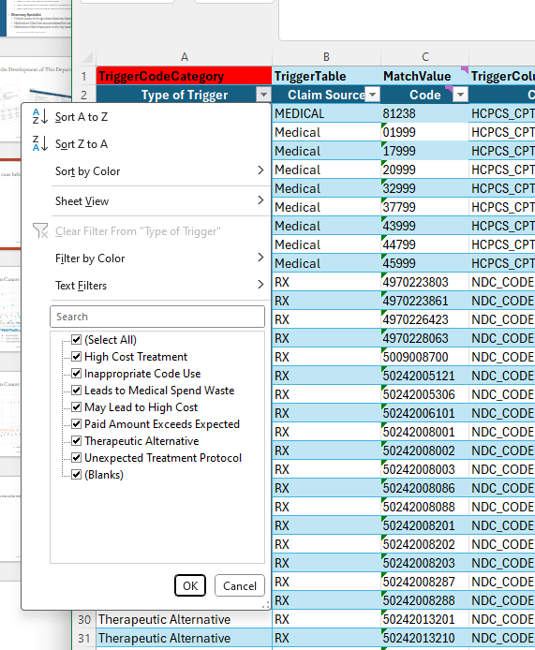
Incite Table that runs behind the scenes
Therapeutic Alternative- Low Value Drug
High-Cost Treatment- First Fill or First Rx
Inappropriate Code Use- Generic Codes
Leads to Medical Spend Waste- Low Value Service
May Lead to High Cost- First Incidence of New Dx
Paid Amount Exceed Expected- excessive or increased of cost
Unexpected Treatment Protocol- too frequent Tx
Notes:
Many times, unexepted is meds through the medical plan.

Slide 15
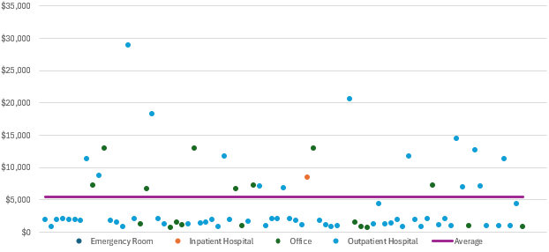
Impact of Cost on Cancer Treatment
Neulasta J2506
Call out when 150% above Average
For Outpatient and Office

Slide 16
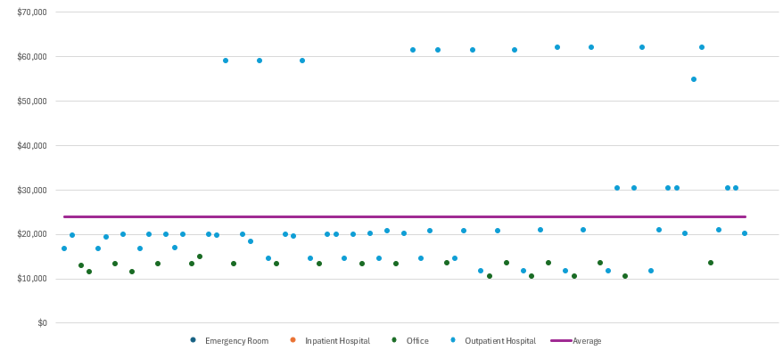
Impact of Cost on Cancer Treatment
Kadclya J9354
Same hospital -Same Patient
Will be called out each time until first fill language can be written
Kadclya- J9354
Notes:
One Facility – Northside Hospital

Slide 17
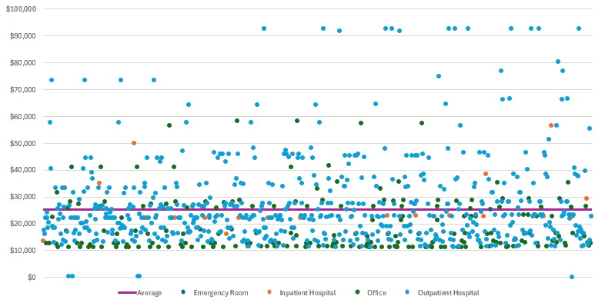
Data to Defend Case Rate or Redirection
Keytruda J9271
Overpayment of
Over $1M
Notes:
Georgetown is the highest

Slide 18

Shared Savings
Claim lines mostly denied but carrier was paid.
7 visits with the same provider- all were denied but $35 paid on one visit
Carrier took 30% of billed charges
OON with billed amounts far exceeding expected amounts and should have been billed as a bundled service
Fiduciary responsibility
No information to reconcile with bank account
Carrier treated the claims as unbundled
Carrier took 23% of billed charges- more than was paid to the provider
Need access to a system that allows us to connect data to claim lines.

Slide 19
Carrier Feedback
Amount paid is significantly higher than expected.
Amount paid is correct per provider contract.
Can you tell us if the claim was paid based off a set contract rate or a percentage billed?
For x service, claim line xxx, it appears this service was paid at least 5x more than expected. Can you verify if this was paid correctly?
UMR does not have access to the detail you are requesting. When a claim comes to UMR its routed to a third party for repricing, then returned to UMR with allowed amounts so that we may process the claim according to the benefit plan.
Third Party is owned by UMR

Slide 20
Carrier Feedback
Claims does not believe there are any differences on how DRGs are handled compared to inpatient stays.
We find outpatient services billed as a DRG
Could we establish a call with your claims or provider team since using DRG for an outpatient procedure does not fit the definition for appropriate billing? Since our client has a fiduciary responsibility, we need to understand this.
Contracting team will not join a call as the information about contracts is proprietary and they will not engage in this level of discussion with Vital Incite.
Why are outpatient claims billed and paid as DRGs when they should be denied. DRGs are intended for hospital inpatient stays. Can you share the specific scenarios in which DRGs are used for outpatient services?
Could be a skip clause that in contracting if they bill a DRG no one evaluates the billed amount and pays a % of billed.

Slide 21
Carrier Feedback
We are unable to help you since the health plan has carved out their PBM services.
The client is paying you an additional PEPM to coordinate this and you do receive the PBM claims monthly! Are you unable to support a carved out PBM?
We cannot advise how the provider is billing the insurance. They were contacted and said the way they are billing is correct and the services were provided.
Duplicate payment for an IUD through the PBM and Medical Plan.
VI provided advice on how to audit the providers chart to know which device was used for the patient.
Seeking a refund on a drug (IUD) where the medical plan and PBM paid for the same item. Please see the claims information that illustrates the provider erroneously billed for the IUD and the placement of the IUD.
No effort from the Carrier until Vital Oversight had to explain in more detail.
Refunds are on their way

Slide 22
Lessons Learned
Your Strategic Account Manager will not be our contact
We need to connect with a clinical manager or claims/ UM manager
We have set up an admin person to track follow up
This is a very inefficient process
Case Selection
Working to develop a relationship with carriers

Slide 23
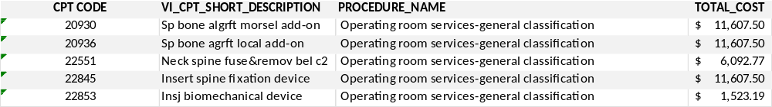
One out-patient procedure- 5 surgery room fees
Came in as 240 claim lines for the outpatient spinal surgery
Billed as a DRG for an outpatient service but paid unbundled
Outpatient Neck Fusion one level
Outpatient Surgery Suite Payment= $42,438

Slide 24

Medication Win
Udenyca
Stimulates neutrophil growth to fight infection following chemo
Plan Paid $13k per unit for the infusion
Average Paid $900 per unit
Client received a $350k refund

Slide 25

CAR-T Therapy
‘Hey Folks, we have a member on a plan that’s currently up to $1.3M and getting Car-T Cell Therapy for their cancer diagnosis.
Has anyone had success finding cost savings solutions for this type of therapy?
Employer is a Vital Incite Client
Henry Ford Health System: The $991,711 Claim was repriced to $600,407, achieving $391,304 in savings
University of Michigan: The $991,711 Claim was repriced to $594,464, achieving $397,247 in savings
Next step: reviewing a contract that would allow our medical directors to coordinate specific cases into their services.

Slide 26


We have just started
Added 2 very strong medical directors
Incite Development-Development-Development
  Technology side
  Medications filled through the PBM vs. medical plan
  New Drugs coming to market
  Better evaluation of expected costs
    % of Medicare- 200% - at times find errors
    Average amount filled
    Alerts vs Oversight
Getting feedback from Stop Loss companies
Learning how to ask the question
Alera improves contract language
How to evaluate potential clients who need help

Slide 27

Exploring –Service Agreements
Direction of Care for Emerging Therapies
  Direct care to top tier providers when cell and gene therapies may be required
  Direct care when transplants are required
Centers of Excellence
  Usually, would require an employer of a certain size and a contract per employer
  Willing to have medical directors refer into their system
    Mayo: “Of you have this set up like Lockton, we can do that!”
Insert a windy road path

