Slide 1


Optimizing Primary Care Models
Allison France & Lindsey Pedigo

Slide 2






Primary Care Models
Onsite Clinic
Near Site Clinic
Direct Primary Care
Virtual Care
Combination
Notes:
Allison

Slide 3
When to Consider an Onsite/Nearsite Clinic
Size
Industry
  Manufacturing, Construction & Blue-Collar
  Healthcare, Education & Technology
Insurance Funding Type
Geography
Costs & Conditions
Employee Needs Survey
Notes:
Allison
Size:
More cost-efficient for large employers. Mid-size is beneficial based on industry and geography. Small employers could consider a near site clinic or direct primary care option rather than a traditional onsite clinic.
Mid-size (100-500) to Large (500+) employers
Industry:
Manufacturing/Construction – more physically demanding jobs, often less healthy populations. The immediacy that a clinic provides onsite is helpful for injury prevention and chronic condition management. Also, usually localized to one or 2 offices/plant/manufacturing sites. Helps reduce absenteeism and improves compliance by bringing care to employees.
Healthcare/education/ technologies – usually have large campuses/offices with a central access location. High amounts of acute illness and mental health that can benefit from having resources onsite to reduce time away from work.
Insurance funding
- Usually self-insured but not always
Geography
Beneficial when there are highly concentrated areas. If members are spread out, a near site clinic or direct primary care option might be better. Access concerns
Costs & conditions
- For groups with high healthcare costs and high incidence of chronic conditions

Slide 4
When to Consider Direct Primary Care
Concentrated population geographically
Data supports a local high quality/low-cost provider
Ability to support with plan design
Low engagement in primary care
Notes:
Allison

Slide 5
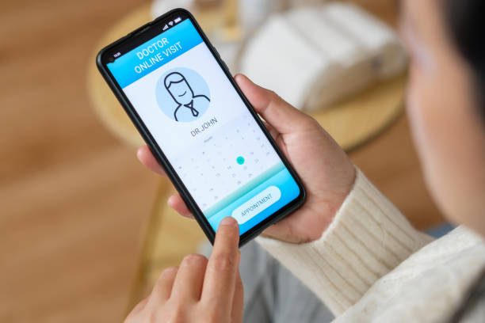
When to Consider Virtual Primary Care
Geographically dispersed
Younger population
Low primary care engagement due to access, time or geographic constraints
Access to national lab provider
Mobile workforce
Notes:
Allison

Slide 6
Small Group Discussion
Do you have any clients that might benefit from an onsite clinic or other direct primary care model? If so, why?
Notes:
Allison
~3 minutes

Slide 7
Vital Incite Support
How Vital Incite supports advisors and clients during implementation and data tracking of clinics
Notes:
Lindsey

Slide 8

RFP/ Contracting for Clinic
Vital Incite can support the onsite clinic RFP and contract process.
Vital Incite’s RFP template outlines:
  Client background, purpose and goals
  Terms and Conditions including minimum qualifications of vendor, method of award, amendment, subcontracting, and negotiations
  Mandatory requirements for proposal acceptance
  Proposal requirements
  Evaluation criteria and bid deadlines
  Confidentiality
Vital Incite will also support on:
  Performance Guarantees
  Onsite clinic space layout
  Pharmacy cost
  Lab cost
Notes:
Lindsey
Can edit template to focus on what client needs

Slide 9
What is Integrated
On a monthly basis, Vital Incite integrates the following clinic files:
  Medical Services File
  Rx Dispensed File
    Onsite pharmacy and mail order
  Labs and Vitals File(s)
  Additional Programs/Services File(s)
  Invoices
Notes:
Lindsey
Vital Incite has established file layouts and will work with the clinic vendors to get all the necessary data in a format that can be ingested into the Vital Incite platform.
Medical services file- This file applies to this clinic if it performs any medical services not being sent to the TPA as a claim. If any services are being sent to the TPA as a claim, please provide the clinic’s NPI/TIN so that we may identify those in the existing claims file we integrate for the group.
It is preferred that services billed to the client as pass-through charges are included in the medical services file. We understand that PEPM and flat rate charges will not be included and will be included on the invoice as outlined below.
Rx Dispensed file- This file type applies if the clinic dispenses any medications and does not send those to the TPA as a claim.
Labs and Vitals file- This may be one or multiple files, used to provide Vital Incite with patient lab, biometric and vitals information. Vital Incite may integrate a full lab file out of your system or multiple files if necessary.
Additional Programs/Services file- This file type applies if the clinic provides any services not captured on the Medical or Rx services files being provided. This may include coaching participation, medication management visits, group coaching or other wellness program participation.
Invoice- monthly clinic invoice so VI can include these costs in reporting

Slide 10
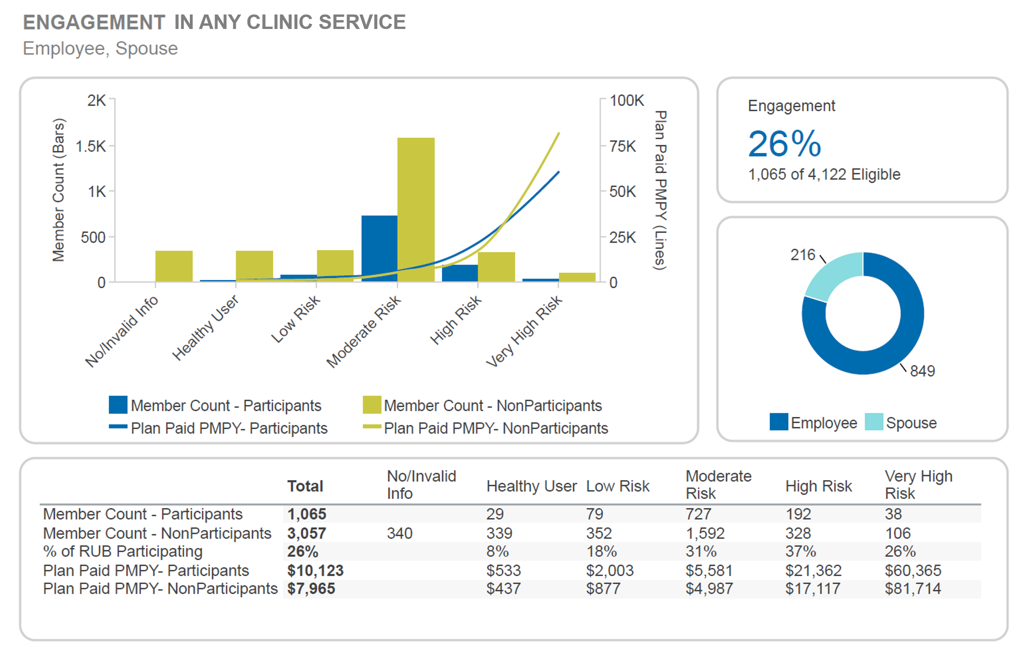
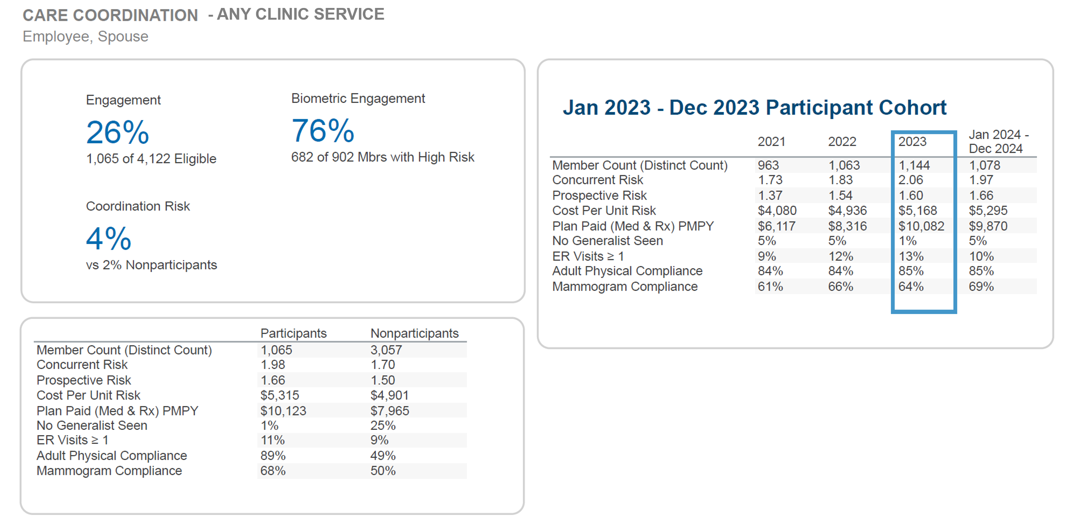
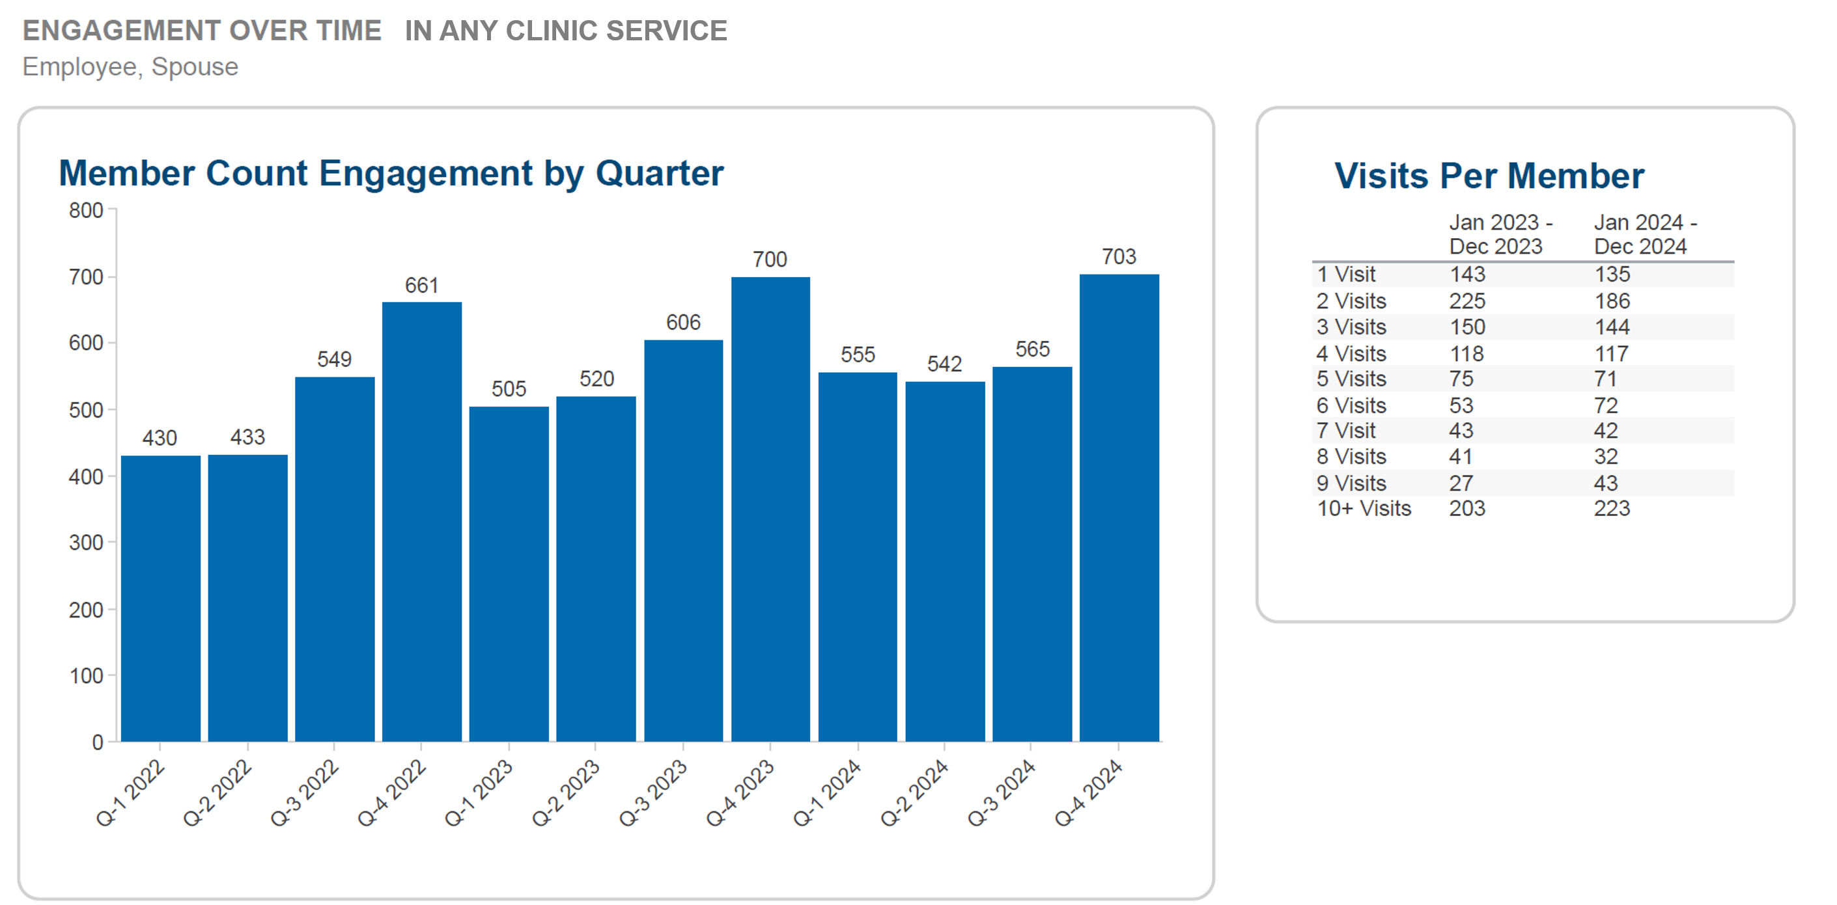
Vital Incite Clinic Reporting
Guidance Report
  Engagement and cost
  Care coordination
  Diabetes management
  Hypertension management
  Future Cost Drivers
  Biometrics
Performance Guarantees
Capacity
Outreach lists
Adhoc reports
Notes:
Lindsey
VI can share this reporting with advisor, employer, and clinic vendor to review what is going well and where there is opportunity to improve.

Slide 11
Contracting for Direct Primary Care
Vital Incite can:
  Identify high-quality, low-cost provider based on group’s data.
  Support the contract process with a provider/provider group for direct primary care.
  Work with the carrier and provider to negotiate rates/fee schedule.
  Set goals to evaluate outcomes of contract.
  Provide reporting on the partnership and identify opportunities to improve.
Notes:
Lindsey
Typically, no separate file feed needed as VI would flag claims from carrier

Slide 12
Performance Management
Creating Performance Guarantees and Goals to ensure the clinic is operating effectively
Notes:
Lindsey

Slide 13
Performance Guarantees
Performance guarantees (PGs) are important to ensure clinic is operating effectively, having a positive impact on member health, and saving the health plan money.
Vital Incite can help negotiate and track performance guarantees.
Year 1 Performance Guarantees
  Focus on engagement, care coordination, and chronic condition control
Year 2 and Onward
  Focus on retention of participants, care coordination, chronic condition management (biometric outcomes), and pharmacy management
Notes:
Lindsey
VI has standard PGs that we highly recommend to use to hold clinic vendor accountable and ensure they are performing well. Below are examples of what VI’s standard PGs focus on.
Year 1:
Percent of ELIGIBLE POPULATION that engaged with the clinic at least one time in the measurement period.
Percent of ENGAGED POPULATION that are compliant with annual physicals.
Percent of ENGAGED POPULATION with >= 12 ACTIVE INGREDIENTS.
Percent of ENGAGED POPULATION in ENGAGEMENT PERIOD SUBSET BP with a BP >= 140/90 in DEFINED PERIOD (BP) , whose last blood pressure has been reduced to a controlled range (BP < 140/90)
Percent of ENGAGED POPULATION that have an A1c >=7.0 in the first periodwho reduce their level by 1% or <7.
Percent of ENGAGED POPULATION ID'ed with DIABETES who had 2 or more A1C TEST (PROCEDURES) in the calendar year.
Year 2:
Percent of individuals who remain engaged in the clinic (satisfaction).Percent of ENGAGED POPULATION in PREVIOUS PERIOD are compliant with WELLNESS EXAM (PROCEDURE) in current calendar year
Count of AVOIDABLE ER VISITS in the RISK PERIOD per 1,000 ENGAGED members
Percent of ENGAGED POPULATION with >= 12 ACTIVE INGREDIENTS
Percent of ENGAGED POPULATION who are ID'ed with HYPERTENSION spending >= $50 per month on Cardiovascular Medications.
Percent of ENGAGED POPULATION who are ID'ed with DIABETES spending >= $500 per month on Endocrine-Diabetic Medications.
Percent of ENGAGED POPULATION from PRIOR ENGAGEMENT PERIOD have a controlled BP range <= 140/90.
Percent of ENGAGED POPULATION who are ID'ed with DIABETES in RISK PERIOD and have 2 or more A1C TEST (PROCEDURE) in the measurement year.
Percent of ENGAGED POPULATION whose last A1c in the PRIOR ENGAGEMENT PERIOD >=7.0 , who reduce their level by 1% or <7 in CURRENT ENGAGEMENT PERIOD
Clinic vendors will often have their own standard PGs that they try to push onto the employer, but they are not always in the best interest of the client or are reported in a way that could be biased. Examples of this include:
Considered an A1c value of 8 as controlled for members with diabetes (according to the ADA, the goal should be 7)
Spreading clinic cost across all members even if they have not participated. VI believes clinic cost should only be attributed to those who use the clinic.
Looking for participation during a wider time frame, rather than just within the plan year.
Counting lab draws and flu shots as meaningful engagement.

Slide 14
Clinic Outcomes
Evaluating cost and health impact
Notes:
Allison

Slide 15
Vital Incite Book of Business
59 Groups with Clinics
1,352 Average Employee Population
79,782 Employee Lives total
18 Clinic Vendors
Notes:
Allison
Education – as a benefit

Slide 16
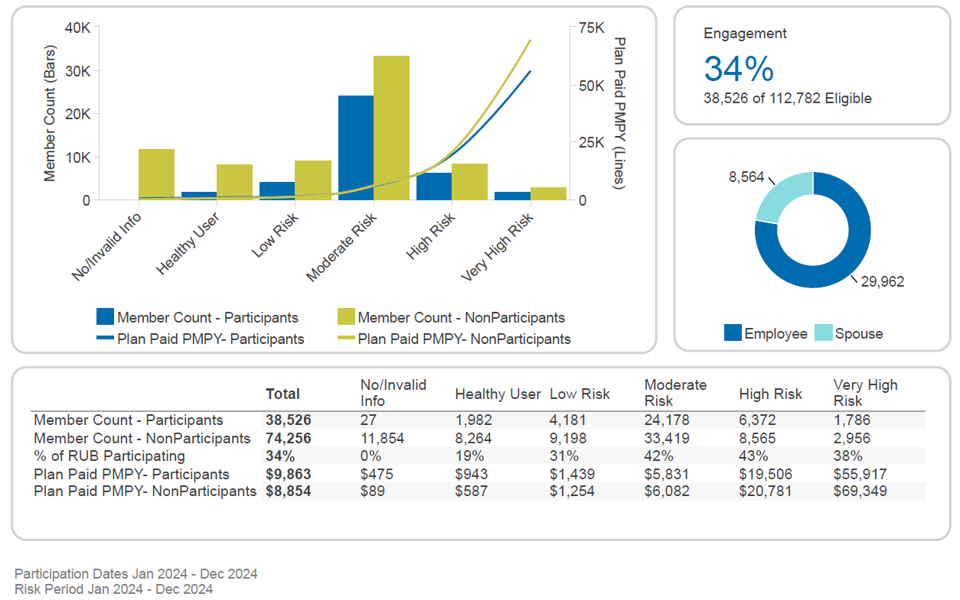
Engagement- Clinic Primary Care
Notes:
Allison

Slide 17
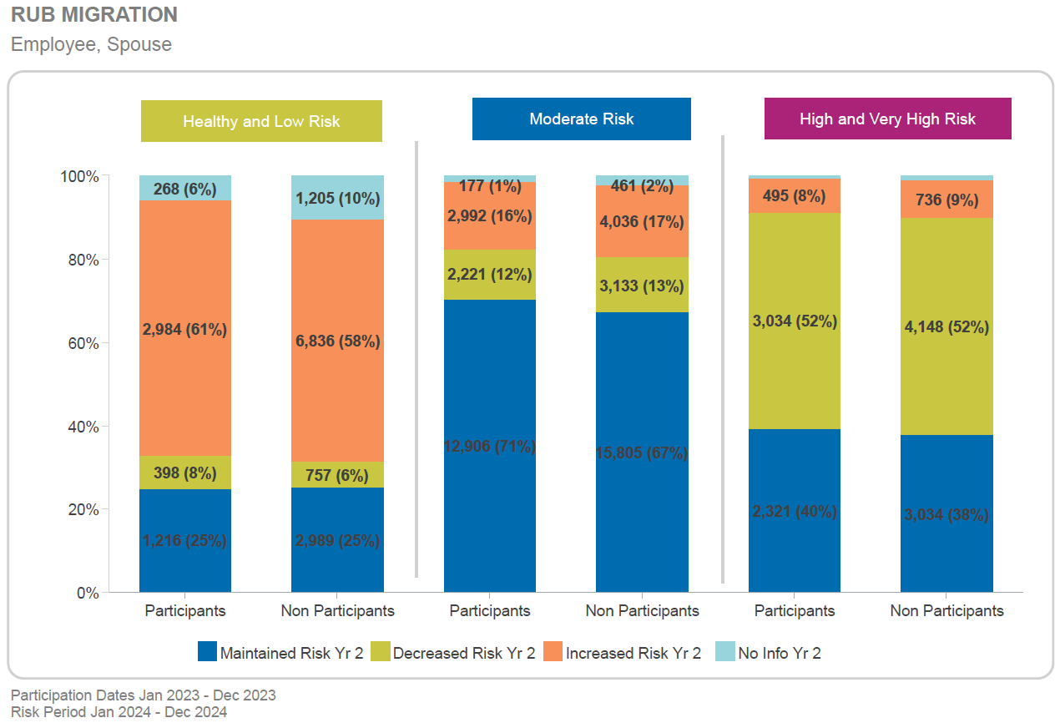
Resource Utilization Band Migration- Clinic Primary Care
12,906 (71%)
15,805 (67%)
2,321 (40%)
3,034 (38%)
1,216 (25%)
2,989 (25%)
Notes:
Allison

Slide 18
Onsite Clinic Outcomes
Participants have higher physical compliance – 78% compared to 40% for nonparticipants
Participants have higher mammogram compliance – 64% compared to 54% for nonparticipants
Prospective risk is lower for participants.
Coordination risk is below benchmark.
Care Coordination Outcomes
Participants with hypertension reduced medication use by 2% in year 2.
Participants with hypertension increased blood pressure control 5% over 4-year period.
Participants with diabetes decreased medication gaps by 4% over 3-year period.
Participants with diabetes improved A1c control by 9% over 4-year period.
Hypertension and Diabetes Outcomes
Notes:
Allison

Slide 19
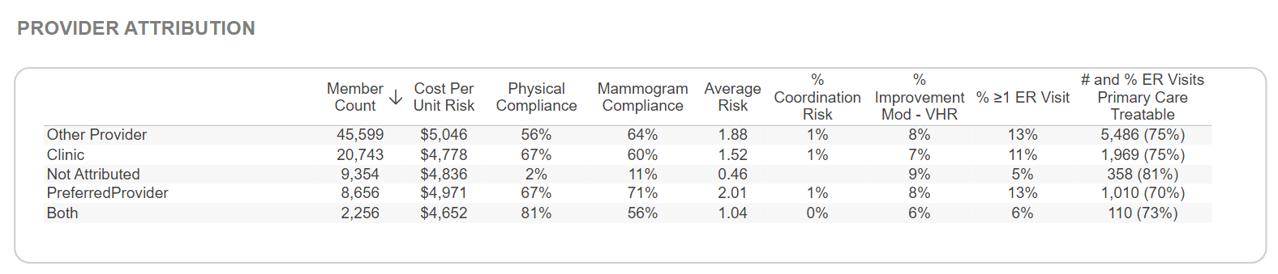
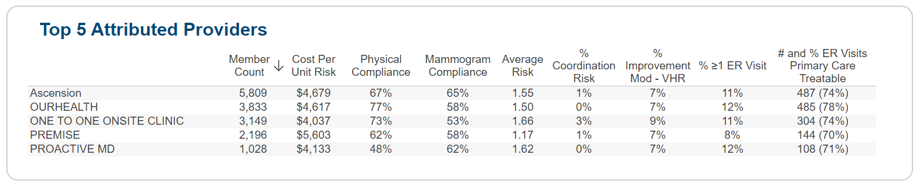
Provider Attribution and Outcomes
Notes:
Allison
Costs can be impacted by region and plan design.

Slide 20
Provider Attribution and Chronic Conditions
Provider Attribution- Members with Hypertension
 | Member Count | Cost Per Unit Risk | Average Risk | % Improvement Mod - VHR | % >=1 ER Visit | % ER Visits Non-Emergent | % ER Visits Emergent- Primary Care Treatable | % of Uncontrolled HTN Improved to Controlled
Other Provider | 11,861 | $4,929 | 3.24 | 9% | 19% | 31% | 42% | 23%
Clinic | 5,607 | $4,899 | 2.44 | 9% | 16% | 32% | 40% | 30%
Not Attributed | 453 | $6,510 | 1.08 | 10% | 10% | 34% | 40%
Provider Attribution- Members with Diabetes
 | Member Count | Cost Per Unit Risk | Average Risk | % Improvement Mod - VHR | % >=1 ER Visit | % ER Visits Non-Emergent | % ER Visits Emergent- Primary Care Treatable | % of Diabetics > 7 Improved by 1%+
Other Provider | 5,787 | $5,403 | 3.77 | 9% | 18% | 30% | 46% | 8%
Clinic | 2,749 | $5,392 | 2.78 | 9% | 15% | 36% | 38% | 11%
Not Attributed | 165 | $9,285 | 1.45 | 11% | 10% | 26% | 43% | 29%
Notes:
Allison
Costs can be impacted by region and plan design.

Slide 21
Vendor 2024 Cohort Comparison
 | Ascension | One to One | Marathon | Premise
Member Count | 6,088 | 9,440 | 7,113 | 3,619
Concurrent Risk | 2.25 | 2.24 | 2.26 | 1.92
Prospective Risk | 1.82 | 1.63 | 1.82 | 1.56
Cost Per Unit Risk | $5,057 | $4,327 | $5,257 | $5,606
Plan Paid (Med & Rx) PMPY | $10,755 | $9,392 | $11,551 | $11,015
No Generalist Seen | 6% | 6% | 6% | 8%
ER Visits >1 | 12% | 11% | 13% | 8%
Adult Physical Compliance | 72% | 80% | 79% | 63%
Mammogram Compliance | 68% | 63% | 64% | 64%
Notes:
Allison

Slide 22
Risk Indexing in Clinic Cohort - 2024
 | Moderate Risk | High Risk | Very High Risk
% of RUB Participating | 42% | 43% | 38%
Plan Paid PMPY - Participants | $5,831 | $19,506 | $55,917
Plan Paid PMPY – Non-Participants | $6,082 | $20,781 | $69,349
Concurrent Risk
 | Total | Moderate Risk | High Risk | Very High Risk
Participants | 2.06 | 1.27 | 4.03 | 11.81
Non-Participants | 2.04 | 1.29 | 4.36 | 14.51
  Members with risk engaged in the clinic have much lower prospective risk compared to non-participants
  PMPY is lower for participants with moderate to very high risk compared to non-participants
Prospective Risk
 | Total | Moderate Risk | High Risk | Very High Risk
Participants | 1.61 | 1.19 | 2.91 | 6.64
Non-Participants | 2.04 | 1.29 | 4.36 | 14.51
Notes:
Allison

Slide 23
Virtual and Direct Primary Care Outcomes
Highest engagement among Millennial and Gen X members (15% and 17%, respectively)
Average of 3.2 interactions per member per year
Participants have lower cost per unit ($4,440 vs. $4,668)
Participants have higher physical and mammogram compliance
Participants with diabetes and/or hypertension are lower cost
Virtual Primary Care
Moderate risk members engaged have lower PMPY ($4,772 vs. $5,233)
Average of 2.3 interactions per member per year
Engaged riskier members, but have lower CPUR
Participants have higher physical and mammogram compliance
Participants with diabetes are lower cost
Direct Primary Care
Notes:
Lindsey
Groups with FSH and OTO Textcare
Goodwill direct primary care- AHN and Eskenazi

Slide 24

Lab Cost Savings
  Onsite Clinic provided by Hospital System
  Client Type - Education
  Avg EE Count – 2,685
  Clinic available for employees and spouses
Lab | Total Claim Count | Clinic Claim Count | Plan Paid Per Claim | Avg Medicare Payment | Clinic Cost | Savings Per Claim when done in clinic | Total Savings
Lipid Panel | 1154 | 602 | $21 | $14 | $6.66 | $14.34 | $8,632.68
Comprehensive Metabolic Panel | 1188 | 686 | $22 | $13 | $6.39 | $15.61 | $10,708.46
Complete CBC w/diff | 1370 | 741 | $13 | $9 | $5.43 | $7.57 | $5,609.37
Notes:
Lindsey
VI can regularly assess cost effectiveness of clinic services.
(Example is Fort Wayne)

Slide 25

Pharmacy Cost Savings
  Some clinics include onsite pharmacies, while others provide prescriptions through mail order
  Example of cost savings analysis:
Drug Name | PBM Quantity | Clinic Quantity | PBM Total Cost per Quantity | Clinic Total Cost per Quantity | Savings Per Quantity when filled in clinic
Atorvastatin Calcium | 2,150,409 | 771,098 | $0.34 | $0.19 | $0.15
Rosuvastatin Calcium | 1,119,589 | 456,628 | $0.52 | $0.38 | $0.14
buPROPion HCl ER (XL) | 1,073,115 | 310,848 | $0.51 | $0.30 | $0.20
Escitalopram Oxalate | 1,230,386 | 383,896 | $0.34 | $0.15 | $0.19
Albuterol Sulfate HFA | 150,711 | 58,695 | $2.65 | $1.34 | $1.31
Based on claims paid in 2024 for VI clients with clinic pharmacy data.
Notes:
Lindsey

Slide 26
Additional Strategies a Clinic Can Support
Health Coaching/Nutrition Counseling
GLP-1 Programs
Mental Health
Physical Therapy
Pharmacy/MTM
Telehealth/Virtual Care
Imaging (x-rays)
Care Navigation
Wellness Programming
Notes:
Lindsey
GLP Premise example:
Prior to filling a GLP-1 for weight loss, a member must:
Engage in at least 3 months of coaching with the clinic
Consult with clinic physician to determine if lifestyle initiatives are sufficient or if GLP-1 is necessary
GLP-1 will be considered with a BMI of 35 with additional comorbidities or BMI 40 without comorbidities
GLP-1 will be filled through clinic pharmacy for cost efficiency
Members must remain engaged with the clinic provider for ongoing support and lifestyle maintenance

Slide 27
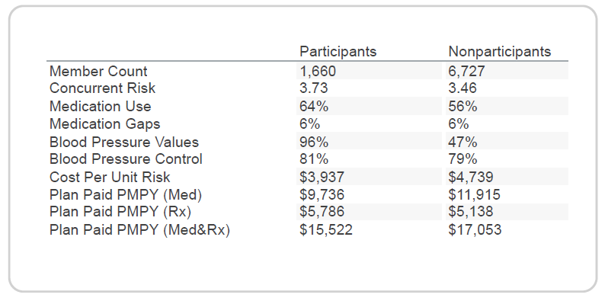
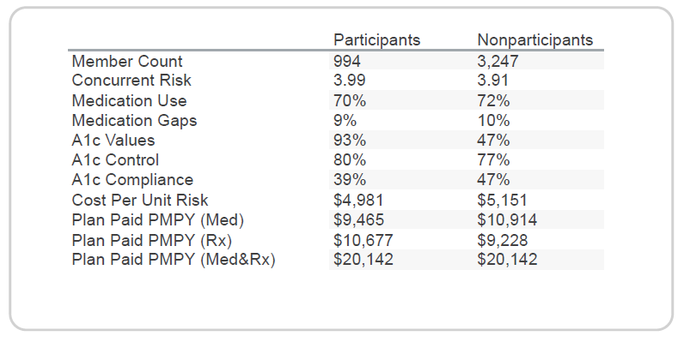
One to One Health Coaching/Dietitian Support
Hypertension
Diabetes
VI does not receive A1c CPT codes in data feed, resulting in A1c testing compliance being understated.
Notes:
Lindsey

Slide 28
Challenges, Barriers, and Successes
Challenges clients have encountered, how to overcome barriers, and how other clients have leveraged clinic services to drive better health outcomes and generate healthcare savings
Notes:
Allison

Slide 29
Challenges and Barriers
Limited access to after hour care could result in more urgent care and ER use
Lack of data sharing and transparency
Lack of strategies to drive clinic engagement
Care navigation and referrals for care outside of clinic to high-cost providers
Clinician turnover
Risk identification will initially drive higher cost
Notes:
Allison
Limited access to after hour care could result in more urgent care and ER use
- If clinic does not provide steerage and education to after hours care, then members who use clinic may not know where to go when clinic is closed. Or work with clinic provider that offers telehealth.
Contract language and data sharing
- Make sure the contract includes language that the clinic provider will share identified, claim level detail data with third party vendor at no additional cost.
Lack of strategies to drive clinic engagement
- Consider plan design strategies and incentives to drive engagement at the clinic. Vital Incite’s physical incentive form.
Care navigation and referrals for care outside of clinic to high-cost providers
- Provide referral sheets so providers know where to direct members.
Clinician turnover
Risk identification will drive initially cost, but clinic should manage appropriately

Slide 30
Success Stories
Client 1: Large School System in Tennessee
  The Need: 69% of EE and spouses had at least 1 chronic condition, low preventive care compliance, poor care coordination, low impact clinic vendor
  The Solution: leveraged VI data analytics, created plan design to promote wellness through premium reductions, partnered with more strategic clinic vendor
  The Results (over 5 years): wellness exam compliance increased 48%, pharmacy spend decreased 22%, onsite clinic became medical home for many and continued to expand services
Client 2: Large School System in Indiana
  The Need: School district wanted to contain costs and reinvest funds into the health of their population by driving more engagement in their wellness center.
  The Solution: Partnered with a clinic vendor to not only leverage school leadership, but also listened and adapted to members’ needs. As savings were realized, they continued to add clinic services, which drove more engagement.
  The Results: Members engaged had 36% decrease in costs, 86% of moderate risk members improved risk, and medication use decreased. Over the past 10 years, the Wellness Center has generated an estimated $10 million in savings.
Notes:
Lindsey
Sumner and CCS

