Slide 1

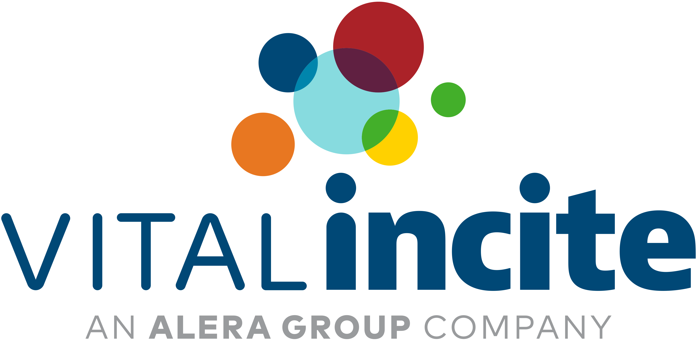
Evidence-Based Plan Management
Improving Health Outcomes & Reducing Costs:
The Critical Role of Care Management in Self-Funded Plans
Georges Markarian, MD
May 13, 2025
Notes:
Good afternoon and thank you, Mary for including me in this meeting and for allowing me to present to you some thoughts around how we might be able to craft solutions to help your clients provide better care for their families while reducing costs. I’ve structured this discussion in a way that should allow us to discuss the issues and problems faced by employers, following which we will talk about what solutions we could offer to help them. Along the way, we will showcase some real-life anonymous examples to better highlight these concepts.

Slide 2
“Every system is perfectly designed to get the results it gets”
Donald Berwick, MD
13th Administrator of CMS
Notes:
In the world I come from, every neurosurgeon believes that he or she is the best at what they do and that their results are perfect and that they never have a complication. Unfortunately, when a process if failing, we need to take a hard look at what we’re doing to find a better solution.

Slide 3

Georges Markarian, MD, MBA, FAANS, FACS
Medical Education: The Ohio State University 1994
Residency and Fellowship: The Cleveland Clinic Foundation 2001
Neurosurgical Practice in Akron, Ohio
Led development of Cleveland Clinic Akron General Health System’s Neuroscience Institute
Graduate School: The Wharton School of the University of Pennsylvania 2016
Founder and Chief Medical Officer: Meges Health
Focus on solving healthcare issues by leveraging technology to optimize delivery of healthcare and administrative efficiencies:
    Remote patient monitoring
    Care navigation
    Care coordination
    Network optimization
Notes:
Mary asked me to tell you a bit about my qualifications: I am a neurosurgeon; I trained at the Cleveland Clinic and have a MBA from the Wharton school with a major in finance and entrepreneurship. I have held leadership positions within the Cleveland Clinic and over the last few years I have developed a passion for crafting solutions that help patients get higher value care and get healthier. I founded Meges Health which was initially focused on care solutions for patients recovering from surgery, however, we now have a much broader focus on RPM, care navigation, coordination and network optimization.

Slide 4
Employer-Funded Health Plan: Advantages
Several potential benefits:
  Flexibility in plan design
  Reduced administrative expenses
Self-funded health insurance arrangements
  Employer assumes financial risk for providing healthcare benefits to employees
  In theory, employers should be able to help their employees achieve healthier lives, which should ultimately result in reducing unnecessary spending
Notes:
You are all much better versed on the notions around self-funded health plans than I am. To the end, I want to emphasize that the main advantages include:
Flexibility in plan design
Reduced administrative expense and most importantly,
In theory, employers should be able to help their employees achieve healthier lives, which should ultimately result in reducing unnecessary spending

Slide 5
Employer-Funded Health Plan: Challenges
Employees with chronic conditions are not helped in a traditional health plan model, leading to several issues:
Rising healthcare costs
Poor management of prescription drug costs
Poor employee health and wellness measures
Regulatory compliance
Risk management
Federal and state regulations: ERISA
Stop-loss regulations
Reporting requirements
Financial risk and plan solvency
Risk assessment and pooling
Cost containment
Chronic disease management
Employee engagement
Notes:
There are obviously significant challenges: For today’s purposes, I will primarily focus on the healthcare and risk management related issues.

Slide 6
Self-Funded Health Plan: Rising Costs Are Real
Kaiser Family Foundation Report:
Workers in smaller firms faced higher deductibles on average ($2434 PEPY) compared to larger firms ($1478 PEPY)
Employers continue to face higher costs with average increases of 7% per year: In some instances, these increases have escalated by up to 15%-20% per year over the last few years.
Family coverage contribution:
  Small firms: 33% of premium
  Large firms: 23% of premium
Year | % Covered in SFP | Premium Costs (Family) | Workers Contribution (Family) | Deductibles (Estimated Family) | Premium Costs (Single) | Workers Contribution (Single) | Deductibles (Single)
2023 | 65% | $23,968 | $6,575 | $4,500 | $8,435 | $1,401 | $1,735
2024 | 63% | $25,572 | $6,296 | $5,000 | $8,920 | $1,432 | $1,787
Notes:
This is a bit of a busy slide. The key takeaway from The KFF shows gradual increases in the cost of healthcare for self-funded plans affecting both employers as well as employees that on average is about 7% per year. The other key takeaway is that employee contributions disproportionately affect those working for smaller firms compared to larger ones.

Slide 7
Main Challenges for Self-Funded Plans
Lack of data transparency
Limited integration of medical, Rx, and behavioral data
Misaligned incentives with third parties
Poor network management
Delayed & inadequate intervention for high-risk members
Behavioral health gaps
Plan design confusion among employees
Fragmented care and poor communication across providers
Notes:
Lack of data transparency
Limited real time access to claims data making it difficult to identify cost drivers or tracking ROI on wellness/care management programs
Limited integration of medical, Rx, and behavioral data preventing holistic care due to silos between various segments
Misaligned incentives with third parties (TPAs, PBMs and provider networks prioritizing revenues over cost containment and potential for inflated pharmacy costs through rebates and spread pricing)
Poor network management with no gatekeeper leading to excessive costs
Out of network excessive costs
In network price differences
Excessive imaging, ER visits and testing
Delayed intervention for high-risk members: No proactive management of high-risk members
Behavioral health gaps: Insufficient access with long wait times and network inadequacy
Plan design confusion among employees leading to underusage of benefits, delayed care and preventable complications
Fragmented care and poor communication across providers
I believe that several of these issues are the result of poor understanding by the employers about these factors. In fact, most employers that I have spoken with aren’t even aware that within their clinical networks there are substantial price differences even though there is no difference in quality.

Slide 8
The End Result: Worsening High-Cost Claims
Understanding these problems should allow us to craft the appropriate solutions.
The alternative is bleak…
High-Cost Claimants (HCC)
  On average 5% of members = 50% of spend
  Some Vital Incite claims data analyses suggest:
    Top 1% of HCC = 30% of spend
    Top 10% of HCC = 70% of spend
  Financial Threat: High-cost claims are a major concern for employers, with the number of million-dollar claims rising by 39.9% from 2019 to 2022
Employers’ Perspective:
  84% concerned about HCC as a significant risk
Notes:
This all leads to worsening of high-cost claims:
On average 5% of members = 50% of spend
In fact, some of the Vital Incite claims data analyses suggest:
Top 1% of HCC = 30% of spend
Top 10% of HCC = 70% of spend
And to me, the future is bleak if this continues…

Slide 9
Understanding the Healthcare Drivers of High-Cost Claims
Common Cost Drivers:
  Cancer
  Prenatal/Neonatal Care
  Sepsis
  Gene Therapy & Rare Diseases
  Specialty Drugs
  Chronic Diseases
  Inadequate Network Utilization
New gene therapies, medications & advanced treatments are creating new financial pressures
Notes:
Now, on the clinical side of the equation, the highest cost-drivers are:
Cancer
Pre-natal/Neonatal care
Sepsis
Gene therapy & rare diseases
Specialty drugs
Chronic diseases
Inadequate or suboptimal network utilization
For me personally, gene therapy, specialty meds and some of the new treatment modalities are likely to really escalate cost of care in the next few years.

Slide 10
Key Concepts to Create Successful Employer Strategies: Operational/Financial Goals
Data Utilization & Transparency: “In God We Trust, All Others Bring Data” (W. Edwards Demming)
Prevention and Early Intervention:
  Preventive care
  Early identification of high-risk cases
Patient/Employee management & engagement:
  Personalized member engagement
  Strengthen case management
    Assign case manager to high risk patients to oversee their care
    Enhance care coordination between providers, employers, and insurers
    Establish “air traffic control” model to assist all plan members
Notes:
Fixing these problems requires an integrated approach that starts with the data. So… “In God we Trust…All others bring data”
Once we understand the issues based on data, we can craft solutions based on a robust plan design that focuses on financial responsibility and operational efficiency. To achieve these goals, we must have the following:
Data Utilization & Transparency:
Improve access to claims data to proactively manage costs
Use predictive analytics to identify high-cost claim risks early
Hold PBMs and TPAs accountable for transparent data reporting
Prevention and Early Intervention:
Preventive care:
Promote early screening and testing to identify cancers and CV disease early
Provide maternal health programs to reduce neonatal complications and costs
Support wellness intitiative to address chronic conditions early
Early identification of high-risk cases:
Early identification of employees at risk of costly medical events
Implement care cooordination teams to monitor at-risk individuals
Patient/Employee management & engagement:
Personalized member engagement:
Educate employees on managing chronic disease
Provide navigation services for complex medical conditions
Offer second-opinion services to ensure correct diagnoses
Strengthen case management:
Assign case manager to high risk patients to oversee their care

Slide 11
Key Concepts to Create Successful Employer Strategies: Operational/Financial Goals
Adoption of nontraditional, payment models:
  Alternative payment approaches:
    Reference base pricing
    Value based contracts
    Direct employer – provider contracts
    Transparent PBM’s
Optimize the existing clinical network, using technology and telehealth options:
  Adoption of digital technology
  Offer telehealth screening to minimize inappropriate resource utilization
  Continuously monitor spending and “watch it like a hawk”
Notes:
I know that this conference will discuss several items on this list including DPC and VBP. I truly believe that these models can be very successful at eliminating stochasticity and improving predictability of prices. There is also significant evidence to suggest better patient care based on experience and quality.
It’s also really important to watch claims and audit the payment methodologies. We have reason to believe that certain procedure-based claims processing has led to excessive and unreasonable payments well beyond usual and customary. Unfortunately, the TPA’s incentives frequently run counter to those of the employers.

Slide 12
Condition Specific Employer Strategies
Sepsis: prevention and early treatment are key
Cancer: managing cost and ensuring quality care
Prenatal/Neonatal care: reducing NICU expenses
Diseases and genetic therapy: Establishing medical necessity
Specialty medications: Proactive formulary management
Chronic diseases: Patient compliance is critical
Notes:
Now, let’s shift gears and talk about those really high-cost healtcare drivers. Are there specific strategies that can be used here?
Sepsis: prevention in early treatment are key
Focus on patients who have high risk conditions that predispose them to sepsis. Active management of these patients should help produce a number of patient suffering from sepsis in the long run.
Cancer: managing cost and ensuring quality care
Promote early detection screenings
Implement cancer care coordination services for employees
Direct employees to centers of excellence for advanced treatment as needed
Ensure proper billing and coding to reduce unnecessary costs
Prenatal/Neonatal care: reducing NICU expenses:
Premature births cost over $25.2 billion annually
These are best managed using employer strategies around:
Managing maternity and fertility benefits to reduce high risk pregnancies
Use data analytics to track, high risk, pregnancies, and intervene early
Diseases and genetic therapy:
Treatments range from $300K to $3.5M dollars per dose
Actionable recommendations include evaluating the medical necessity of such treatments as well as using alternative funding models as needed. This requires integrating Pharmacy and medical data to track efficacy. It is also important to assess stop loss insurance policies for potential cost exclusions.
Specialty medications:
Escalating specialty drug costs now account for 40% of outpatient prescription revenues
This could require employers to implement preferred drug lists to guide employees toward cost-effective options while negotiating directly with pharmaceutical companies to control cost. In addition, moving drug infusions from hospitals to home based care when feasible could provide significant cost savings
Chronic disease diseases:
These patients have much higher utilization of healthcare resources resulting in higher cost
Ensuring patient’s compliance is critical and leveraging telehealth options to provide CCM and/or RPM as needed. These modalities have been shown to reduce cost significantly.

Slide 13
Sepsis Case Study
Sepsis is a life-threatening medical condition that arises when the body’s response to an infection causes widespread inflammation, which can lead to tissue damage, organ failure, and death.
Case Study: 63-year-old patient with hypertension, diabetes and significant cardiac disease including arrhythmia:
  Patient admitted with infection requiring replacement of pacemaker
  Cardiac condition worsens
  Pacemaker infection
  Secondary endocarditis leading to sepsis
  Requires multiple open heart procedures including valve replacement
  Plan paid (Medical & Rx.) $758,071
Retrospective review shows lack of preventive care in the setting of a very high-risk patient who would have likely avoided this ordeal had early warning signs been addressed appropriately using care management methodologies.
Notes:
Here is a case study: This is a patient with significant underlying risk who ended up with sepsis which is a life-threatening medical condition that arises when the body’s response to an infection causes widespread inflammation, which can lead to tissue damage, organ failure, and death. The plan paid almost $760K and a retrospective review showed lack of preventive care in the setting of a very high-risk patient who would have likely avoided this ordeal had early warning signs been addressed appropriately using care management methodologies.

Slide 14
So…How Can We Do Better to Achieve the Following Goals:
1) Better Outcomes
2) Lower Employer Costs
3) Increased Employee Engagement and Retention
Notes:
So…how can we do better to lower costs, deliver better care and improve employee satisfaction and retention? Is it even possible? I believe the answer is yes!

Slide 15
DATA
Operational Excellence
Financial Performance
Efficient Healthcare Delivery
Optimized Plan Design
Notes:
As I mentioned earlier, it all starts with the data at the center and once we understand it, we can craft a plan that fits that employer’s needs, while we deliver high quality, cost-effective care using an efficient operational model.

Slide 16
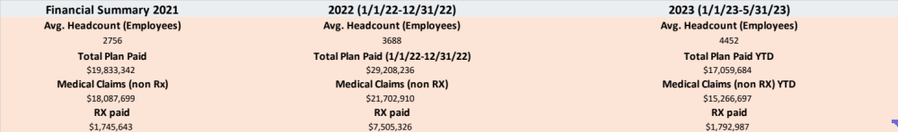
Case Study: Public Entity (School District)
Future cost drivers:
5% of population will result in 52% of cost in the next 12 months
1% of population will result in 30 % of cost in the next 12 months
Notes:
The next few slides are an anonymous medium size public entity that has had drastic increases in cost over the last several years. The takeaway from this first slide is that their costs have been rising at an alarming rate and 5% of the population will cost the system over half its total spend.

Slide 17
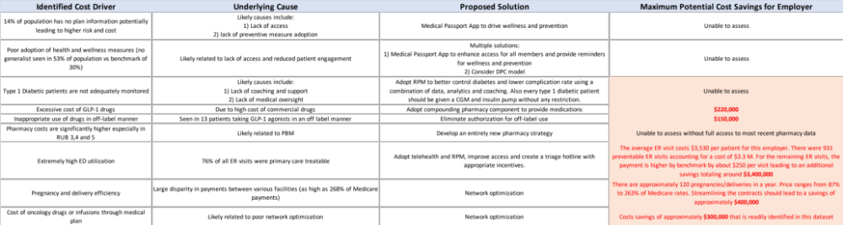
Case Study: Public Entity (School District)
Notes:
Based on Vital Incite’s analysis, we were able to quantify specific savings we can create for a potential employer and in this case, we believe that on the medical side alone, the potential costs savings could reach 30%-40%

Slide 18
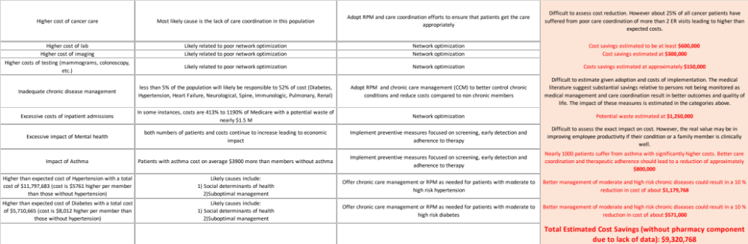
Case Study: Public Entity (School District)
Notes:
Obviously, there are areas that are harder to quantify, however, there is supporting scientific evidence that cost savings for such areas like chronic disease management could reach 25%-40%

Slide 19
Where Solutions Lie: Focus on Care Delivery
Integrated models can solve high-cost clinical problems while maintaining client and employee satisfaction
The best options combine elements of human interaction with technology to maintain acceptable cost for the services
There are four care delivery focus areas:
  Care coordination
  Care management
  Case management
  Patient navigation
Notes:
As I discussed a couple slides ago, integrated models can address high-cost clinical problems while keeping employers, patients and their families happy. This requires the merging of technology-based solutions with human interaction to ensure patient engagement and to keep costs low.

Slide 20
Care Coordination: Why it Matters
Definition: Organizing, patient care activities, and sharing information among all participants
Impact:
  30% fewer hospital readmissions (NEJM, 2018)
  20% increase in adherence to evidence based care pathways
Employer value:
  Reduce medical waste and duplication
  Fewer avoidable ER visits by up to 26% (AHRQ)
  30% reduction in readmissions (AHRQ)
  Fewer avoidable hospital stays
  Lower spend
  Increased employee satisfaction and accelerated return to work
  Enhanced patient engagement
Notes:
From a care delivery standpoint, there are 4 areas that are critical: Care coordination, care management, case management and care navigation. There seems to be a lot of confusion around these modalities, and I want to define them clearly for you in terms of their function, impact and what type of value they create. So, Care coordination is Organizing, patient care activities, and sharing information among all participants. This leads to 30% fewer readmissions and should eliminate waste by improving the communication between providers and patients as well as among the providers around patient activity.

Slide 21
Care Management: Driving Behavior & Outcomes
Definition: A proactive, patient centered approach, focused on those with chronic or complex conditions
Various modalities can be used, including: CCM, RPM, RTM
Clinical evidence supporting care management:
  Diabetes management programs: 10 to 15% reduction in total cost of care (Health Affairs, 2019)
  35% fewer ER visits among management patients (JAMA, 2020)
Employer value:
  reduce catastrophic claims
  Reduction in total cost by 10 to 15%, especially in multi morbid patients (Health Affairs, 2019)
  Improve medication adherence
  Personalized member centric support
  Enhanced preventive care compliance
  Early detection of complications
Notes:
Care management is a proactive, patient centered approach, focused on those with chronic or complex conditions. This is basically medically managging a patient in between provider visits to ensure that the patient is compliant with the ir care. There is significant evidence that this reduces ER visits and that the total cost of care can go down by 15% and that it can reduce catastrophic claims like the sepsis case I showcased earlier. This is a chronic activity that continues as long as a patient suffers from these chronic issues.

Slide 22
Case Management: Controlling High-Cost Claims
Definition: Intensive support for acute, catastrophic, or complex medical events
Impact:
  40% cost savings on complex cases with case management (AHRQ, 2017; Milliman)
Employer value:
  Mitigate unpredictable high costs
  Reduction in hospital admissions and Readmissions
  Improved quality and outcomes
  Member advocacy and experience
  Mitigation of future claims related to social determinants and minimizing disease progression at critical stages
  Typical ROI reported to be between 3:1 to 5:1
Notes:
On the other hand, case management is defined as Intensive support for acute, catastrophic, or complex medical events. This has been shown to reduce costs by 40% on complex cases by reducing unnecesary admissions and readmissions. This is best illustrated for patients diagnosed with work-related injuries, cancer and other episodic care to get the patient through the acute phase of their illness.

Slide 23
Patient Navigation: A Critical Emerging Need
Definition: Helping patients, overcome barriers to care, including logistics, finance, and education
Clinical evidence:
  Navigation programs improve timely care delivery by 25% (CA: Cancer J Clinicians, 2019)
  Reduced delays in diagnosis and treatment leading to better outcomes
  Higher screening and preventive care compliance
  Support for behavioral and social determinants of health
  Increase patient engagement and satisfaction
  Streamline specialty referrals based on quality and value
  Care continuity across health system touch points
Employer value:
  Lower long-term claims costs
  Reduced employee absenteeism
  Higher employee satisfaction with plan design
Notes:
Finally, patient navigation, which is defined as Helping patients, overcome barriers to care, including logistics, finance, and education. This has been shown to reduce costs by 25% because the ensure that patient get the right care in the right place and at the right cost. It prevents delays in care and reduces long-term complicaitons. This also is a huge patient satisfuer as patients feel like someone is looking out for them and helping them naviaget the complex maze of healthcare.

Slide 24
Where Solutions Lie: Focus on Alternative Arrangements
Must be based on continuous monitoring and analysis:
  Claims simplified due to predictable pricing
  Care utilization
  Value Benchmarks
Alternative arrangements can include:
  Reference Based Pricing
  Bundled payments
  Value Based Contracts/Outcomes Based Payments
  Shared Savings and Risk Sharing models
  Direct Contracting with Providers or Centers of Excellence
Notes:
Now, beyond the clinical and care delivery aspect we can also develop models that include alternative arrangements. However, these alternative arrangements require continuous monitoring and analysis based on claims, care utilization and value benchmarks. There are many alternative arrangements out there.

Slide 25
Alternative Arrangements: Strengths & Weaknesses
Arrangement | Definition | Strength | Weakness
Reference-Based Pricing | Employer sets a fixed price for service usually off Medicare fee schedule | Significant savings (20%-40%) | Potential for balance billing if provider doesn’t accept price
Bundled Payments | Single pre-set price for an entire episode of care | Predictable cost, Incentivizes providers to coordinate care/reduce comps and readmissions Savings of 15%-30% | Requires care navigation and coordination for successful implementation
Value-Based Contracts | Providers paid based on achieving defined health outcomes | Aligns financial incentives with health outcomes and encourages prevention and chronic care management | Complex measurement and attribution with data lag and integration issues
Risk-Sharing Models | Employers and providers share in the financial results | Strong incentives for providers to manage population health and build long-term relationships | Slow implementation curve to achieve results: It’s a long-term play and it requires continuous monitoring
Direct Contracting with Providers | Employer contracts directly with high-quality providers for specific services | Enhanced quality Predictable lower cost | Requires contracting expertise, care coordination and patient support services. Also requires ongoing monitoring and QA
Notes:
Each one of these arrangements has strengths and weaknesses as you can see here. As you think of how you help your clients design plans, it is critically important to make recommendations in this area that match their needs. So, if an employer has a high rate of orthopedic or spine injuries, you could consider bundled payment-based contracts with a high-quality provider or system that can take care of these issues.

Slide 26
Where Solutions Lie: Continous Financial Monitoring
Must be based on continuous monitoring and analysis:
  Claims: Are they processed properly?
  Care utilization: Was the care based on proper evidence or care pathways?
  Value Benchmarks for pricing
Must ensure contract adherence:
  Contract review
  Individual claims review
  Clinical validation
  Pharmacy validation
Notes:
I can’t over emphasize the importance of continuous financial monitoring. I have now seen several cases where the employer is overpaying by up to 100%-150% over what would be appropriate because their lack of understanding of what would be usual, customary and legal.

Slide 27

Vital Oversight
Correct Resource bring best Result
Contract Review
  Determine rules of engagement
  Suggest improved contracting language
Claims Specialist
  Price paid is outside of expected
  Duplicate or erroneous payments
Clinical Specialist
  Clinical review of new cases that will likely drive-up cost
    Appropriate treatment
    New Dx that may lead to ongoing HCC
    New Gene therapy or genetic testing -potential candidate
    New treatment to audit site of care and procedures
Pharmacy Specialist
  Clinical review of drugs where there are therapeutic alternatives
  Medications filled that are considered low value
  Medications filled where prior auth may need to be modified
Notes:
To that end, Vital Oversight can help employers review contracts to determine rules of engagement and improve the employer’s leverage. The program also helps identify whether claims have been paid appropriately and whether the care that’s been recommended is clinically appropriate. The other increasingly important and relevant factor is the pharmacy related problem. This is something that Vital Oversight can help benchmark both clinical based on evidence and from a pricing standpoint.

Slide 28
Drivers of Long-Term Success: Quality and Safety
Patient quality and safety need to always be ”Front and Center”:
To achieve this, it all starts with “Data”
  Understanding cost-drivers
  Understanding risk
  Preemptive identification of future risk
Only then will you be able to craft solutions that address the problems
These solutions require:
  Evidence-based approach
  Deliberate targeting of desired outcomes
  Clinically safety and efficacy
  Patient empowerment and removal of barriers to care
  Transparency, accountability and communication to ensure a virtuous cycle to enhance value for all stakeholders
Notes:
It is also imperative to remember that everything we do has to be built around the notion of quality and safety as a key driver for long-term success. Again, this starts with data! Once we understand the data, we can craft solutions that are evidence-based, purposeful and clinically safe and effective. They must also strive to eliminate access barriers. We also need to be transparent, accountable and ensure that we are always communicating with the employer to create the appropriate environment for success.

Slide 29
Status Update & Future Directions
Multiple self-funded plans reviewed in detail
Data confirms several recurrent themes across industries and structure that align with academic literature:
  Lower than benchmark adoption of health, wellness and prevention
  Poor management of patients with high-cost/high-risk chronic disease
  Tremendous waste based on existing network inneficiency
  Excessive utilization of expensive “locations” of care
  Poor management of prescription drug utilization and cost
Other considerations:
  Regulatory and legal requirements
  Role of advisors/consultants/brokers
  Aligning incentives with all stakeholders
Notes:
So…where are we along this journey? We have now reviewed several employer plans in detail and the data suggests findings that are very consistent with the published literature. We are now beginning to engage with employers to help craft solutions to match their needs.
We believe that the role of advisors, consultants and brokers is critical to the success of their employer partners and your contribution and insight is critical.

Slide 30
From Concept to Implementation
Human Interaction
Patient Needs:
Smart Software
Network Optimization:
Data Transparency
Ensure Financial Success:
Pharmacy Optimization
Optimize Prescription Drug Program
Chronic disease management
Remote patient monitoring
Employee engagement & education
Decrease waste
Efficient care delivery based on quality, outcomes measures and safety
Right care/Right time & place/Right cost
Utilization management
Cost optimization
Maximize rebates
Continuous monitoring
Access to real-time data
Constant feedback loop to create virtuous cycle
Wellness and prevention
Care coordination, navigation and case management
Benchmarking
Notes:
I’d like to finally put it together in this chart format and to really drive home the importance of aligning all stakeholders’ interests. The employers and employees needs must be met. To keep costs low, we must leverage advances in technology, to optimize clinical care and delivery while creating an operationally efficient model with well articulated financial KPIs. I want to emphasize that the most successful models and results in such areas come from Medicare Advantage data. These have universally shown that success is dependent on maintaining human interaction to ensure patient engagement and compliance.

