Slide 1

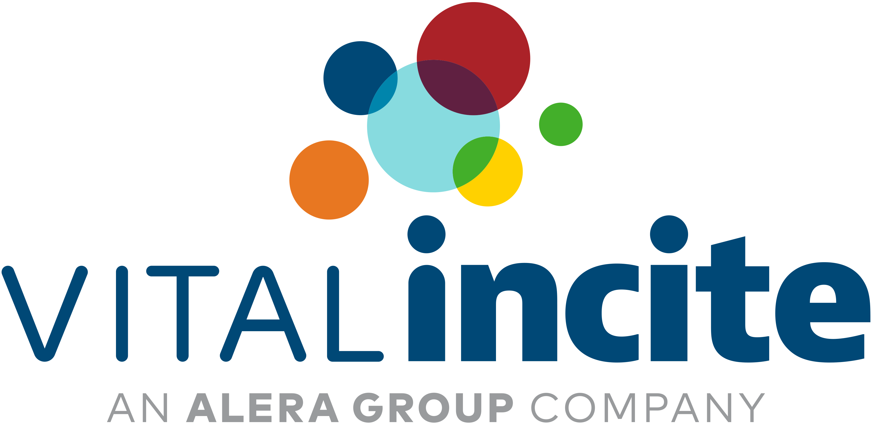

VIP: Changing the Landscape of Interventional Oncology Delivery
Joshua Dowell, MD, PhD, FSIR
May 15, 2025

Slide 2
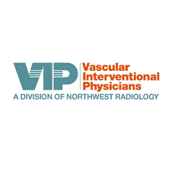
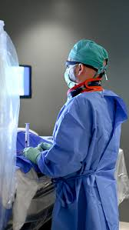
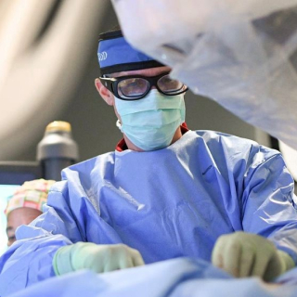

What is IR?
Vincent Flanders, MD
Joshua Dowell, MD, PhD

Slide 3
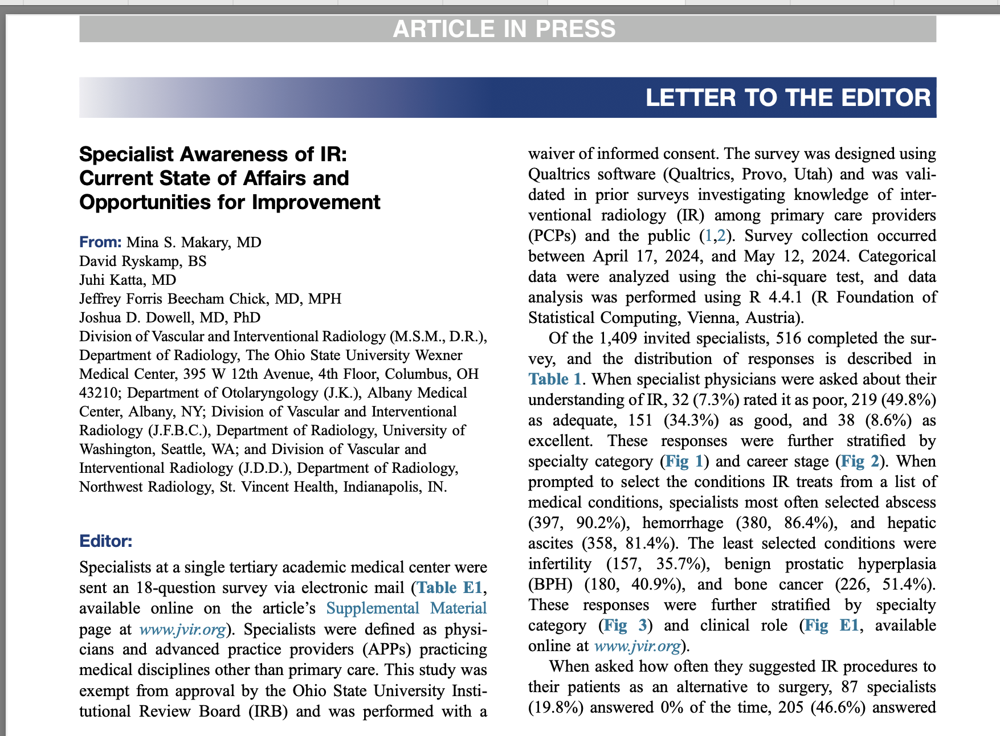
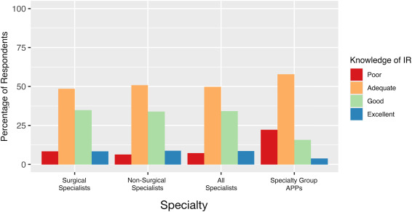

Slide 4

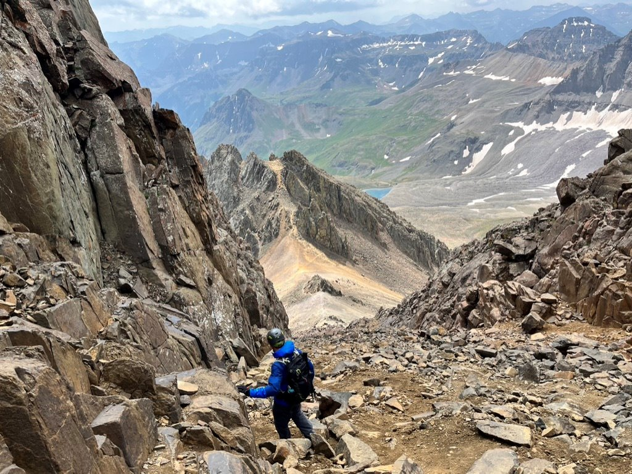
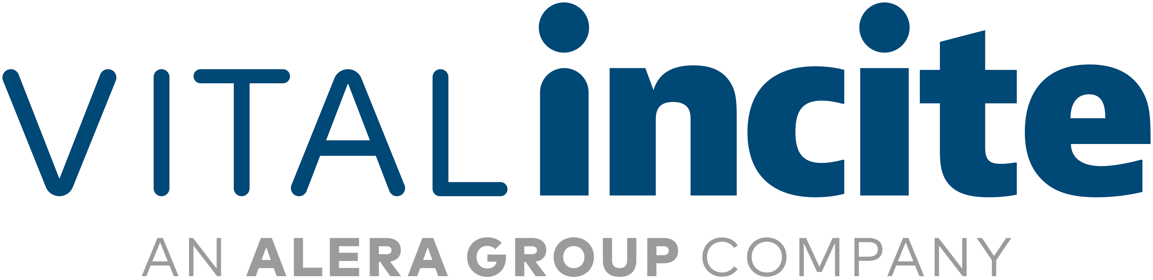
Trailblazing Outpatient IR Care
Shifting from Hospital-based to Office Based Lab (OBL)
Program Model
  Specialized, high-level expertise
  Patient-focused care
  Simplified scheduling
  Expedited procedural care
  Cost savings outside the hospital
Volume Growth and Expansion

Slide 5
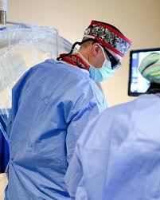
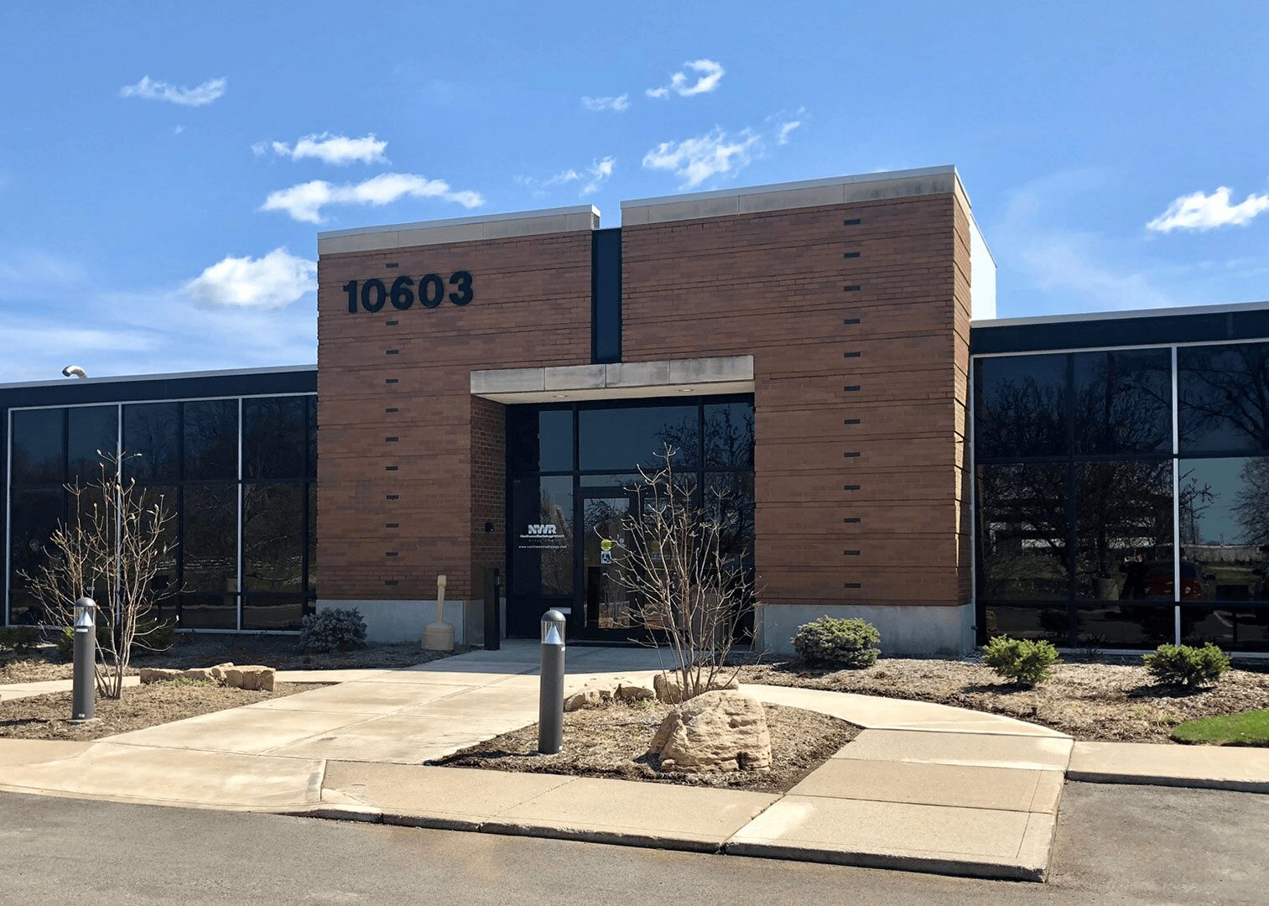
VIP formed as a cost center of Northwest Radiology in 2023 and provides outpatient IR procedures within the NWR Carmel location
First outpatient facility in Midwest to provide Yttrium-90 radioembolization for liver tumors outside the hospital
First outpatient facility of its kind in Midwest to offer many minimally-invasive IR procedures including tumor embolization, uterine fibroid embolization, and prostate embolization

Slide 6
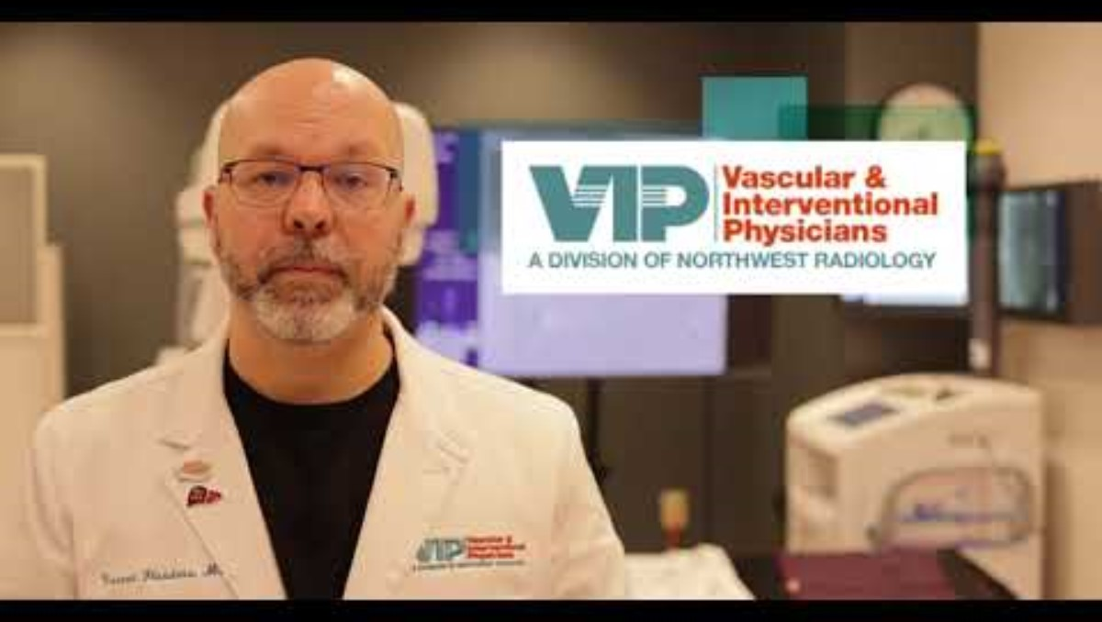

Slide 7
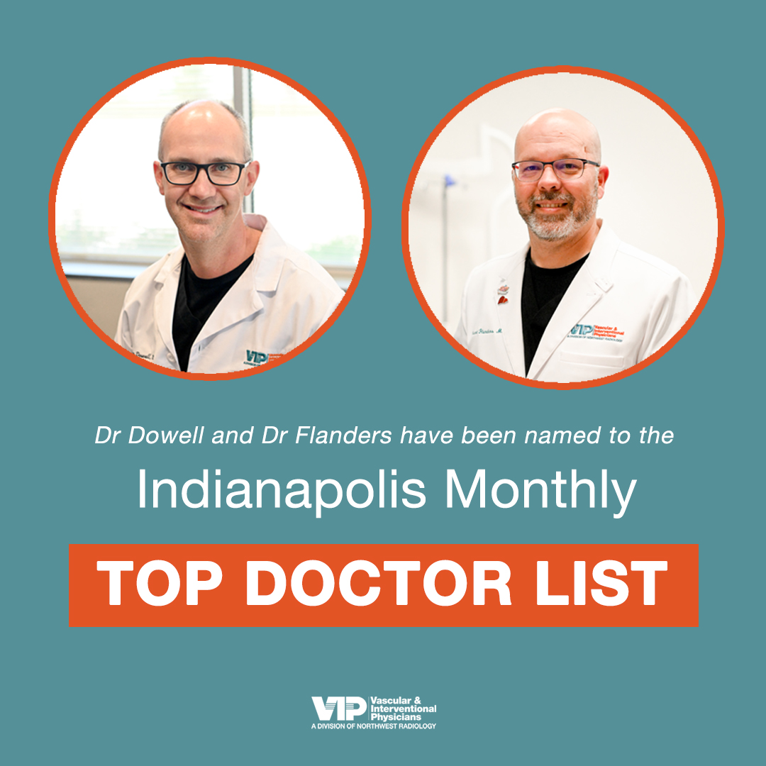
Expertise
Interest in providing high level IR patient care
Academically-minded, evidence-based practice
Outstanding training

Slide 8
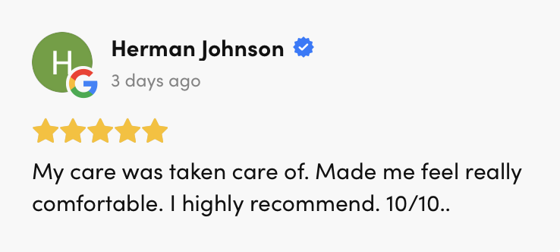
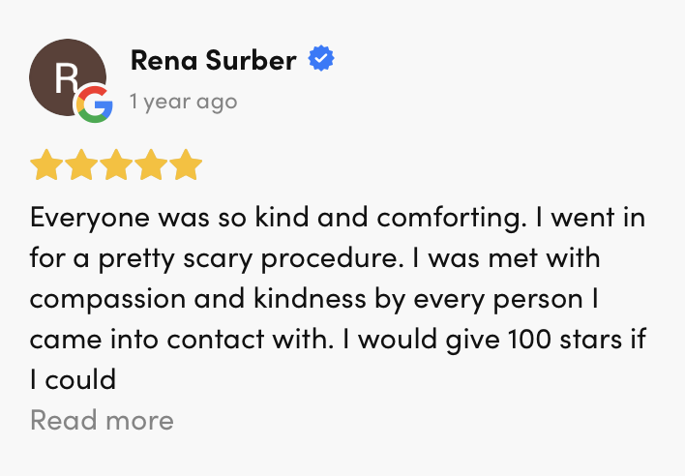
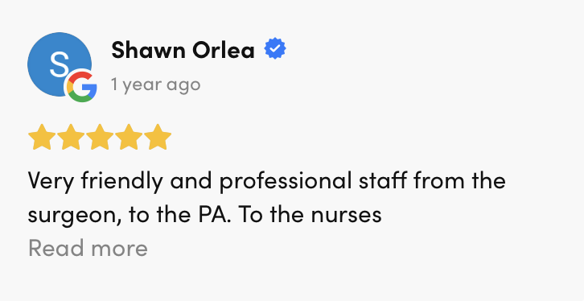

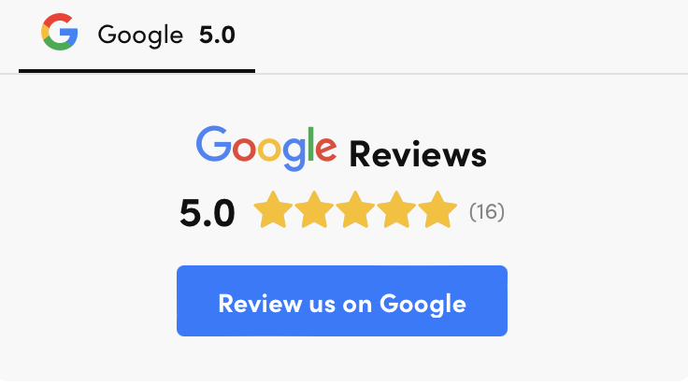
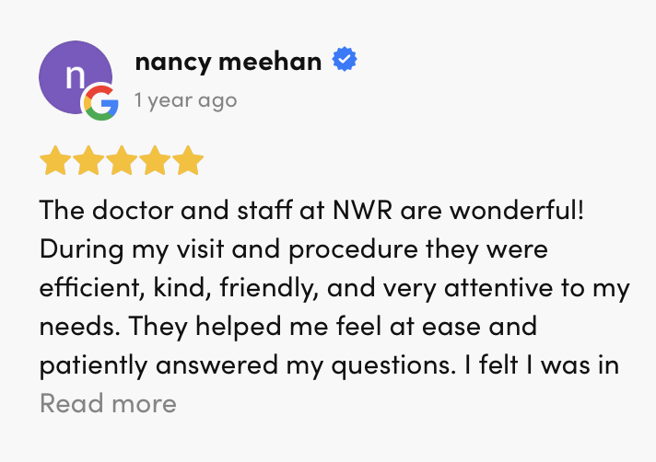
II. Patient Experience:

Slide 9
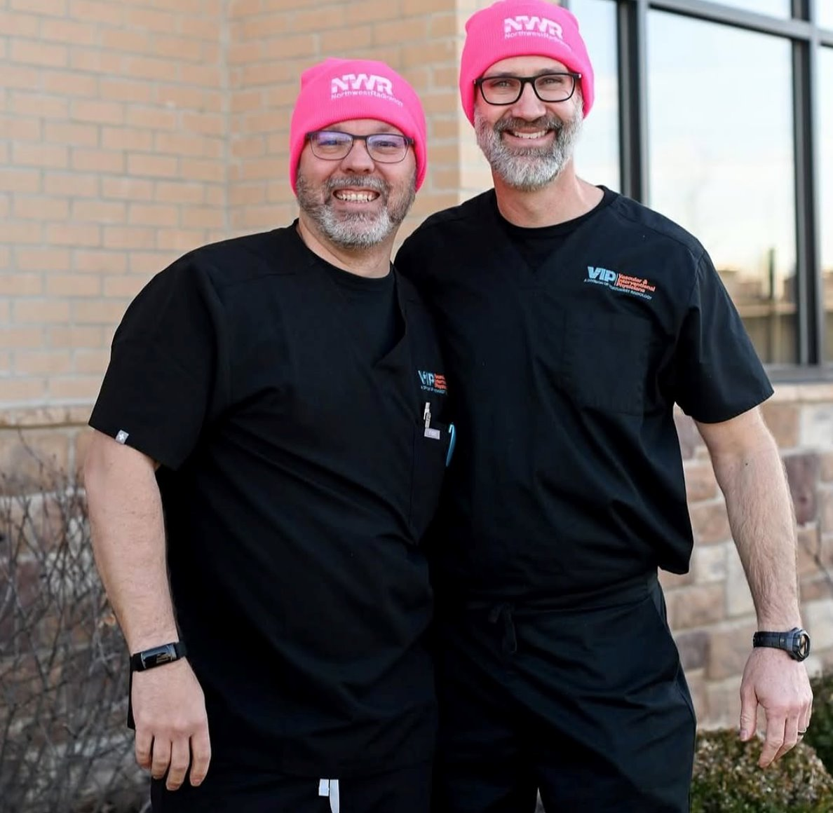
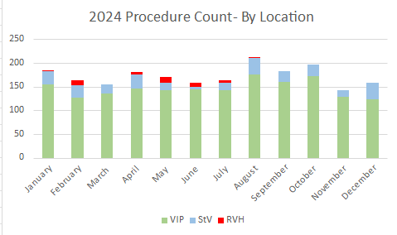
By the Numbers:
Over 2000 procedures performed in 2024
Approximately 150 procedures performed per month at VIP

Slide 10
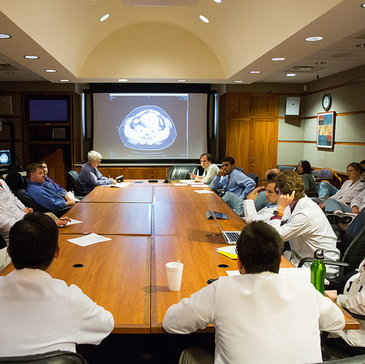
Tumor Board:
A Multidisciplinary Approach

Slide 11
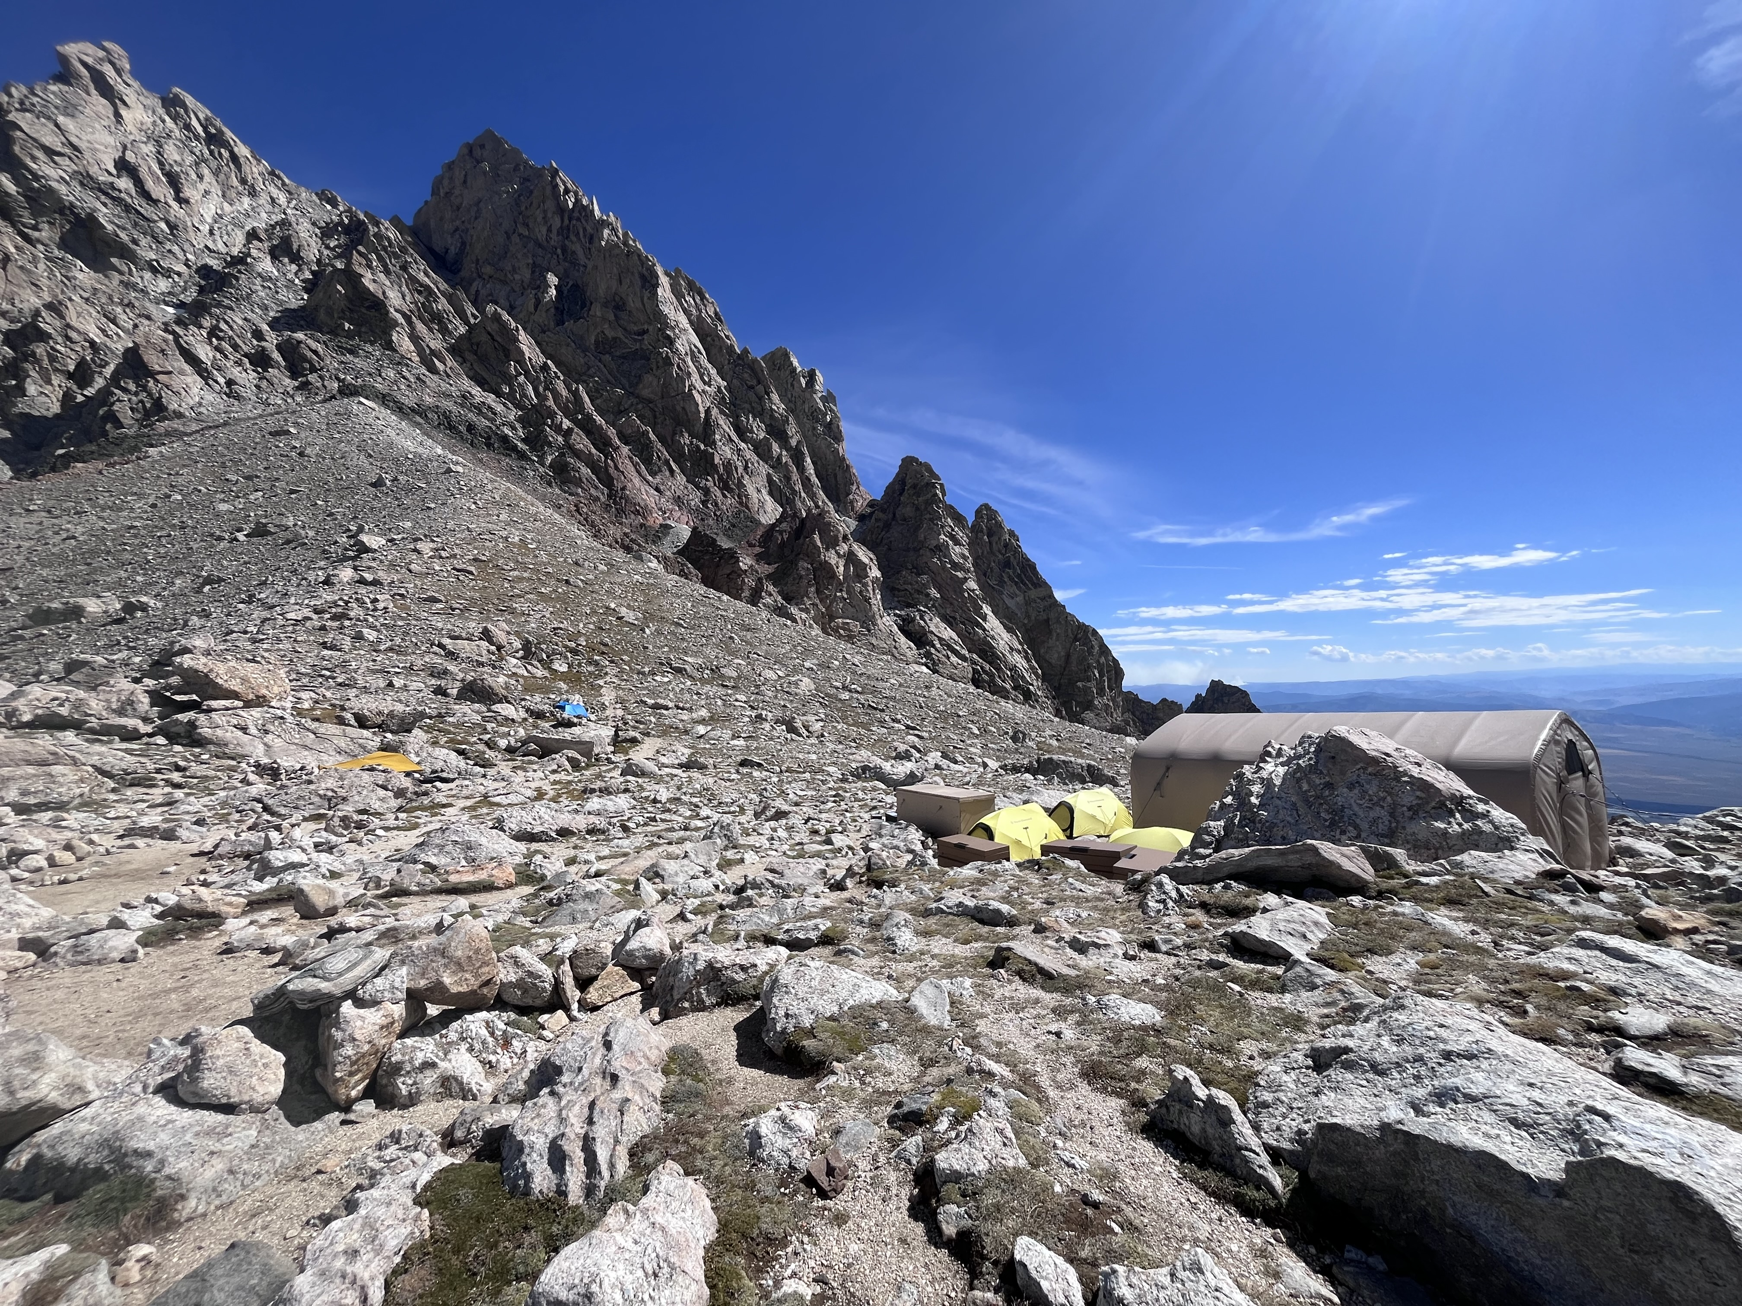
What happens next?​
Collaboratively discuss each case at tumor board and decision is made on if a patient may be a good candidate for locoregional therapy or surgery
Oncologist or Surgical Oncologist sends a referral to IR
Patient is scheduled for IR clinic to discuss clinical history and plan
Order is placed for the procedure and preauthorization begins

Slide 12
The Decision Process and Clinic
Cancer patients are referred to us from all major hospital systems as we are not directly associated with any system and direct communication is kept with the patient's oncologist through treatment.
Many patients have never seen their CT or MR imaging or the mass we plan to treat
Large screen PACS machine to review images
Draw the liver, the mass location, and vascular anatomy
List and describe locoregional therapy options:
  Ablation
  Bland embolization
  Chemoembolization
  Y90 radioembolization

Slide 13
Case Examples:
Liver cancer patients will have a MRI and PET/CT as part of the process toward diagnosis followed by a port placement for chemotherapy and sometimes a biopsy.
The biopsy, port placement, and all imaging can be performed at VIP/NWR
Y90 is a catheter-based treatment option for liver cancer patients performed at the hospital or at VIP/NWR. VIP is the first outpatient facility in the Midwest to offer Y90 outside the hospital.
Liver cancer patients will get MRI or CT studies every 3 months after treatment to monitor the treatment response.

Slide 14
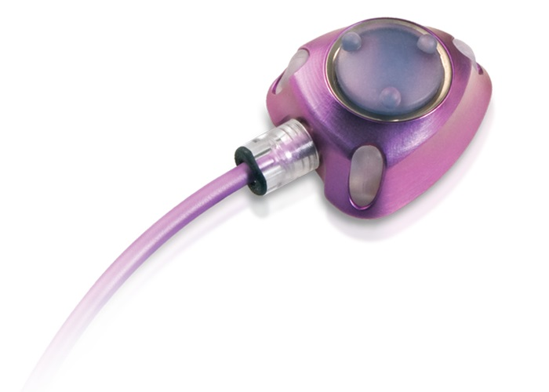
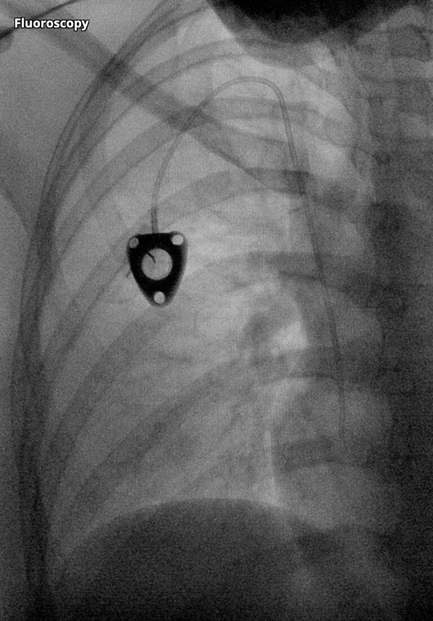
Chest Ports:
Chest port is the first step in a cancer patient's care plan and serves as access for chemotherapy, blood work, and for contrast for a CT or MRI
Easy scheduling and prompt placement is critical to expedite a patient's treatment plan and to initiate chemotherapy
VIP/NWR Ports are placed within 48 hours of receiving the request
Each port translates to approximately $10,000 in health care savings to the patient, employer and to UHC when placed at VIP/NWR

Slide 15
By the Numbers:
At a savings of $10,000 per port, 434 ports placed at VIP/NWR since our opening in 2023 translates to a savings of $4.3 million to patients, employers and their insurance providers over port placement that would have been placed at the hospital.

Slide 16
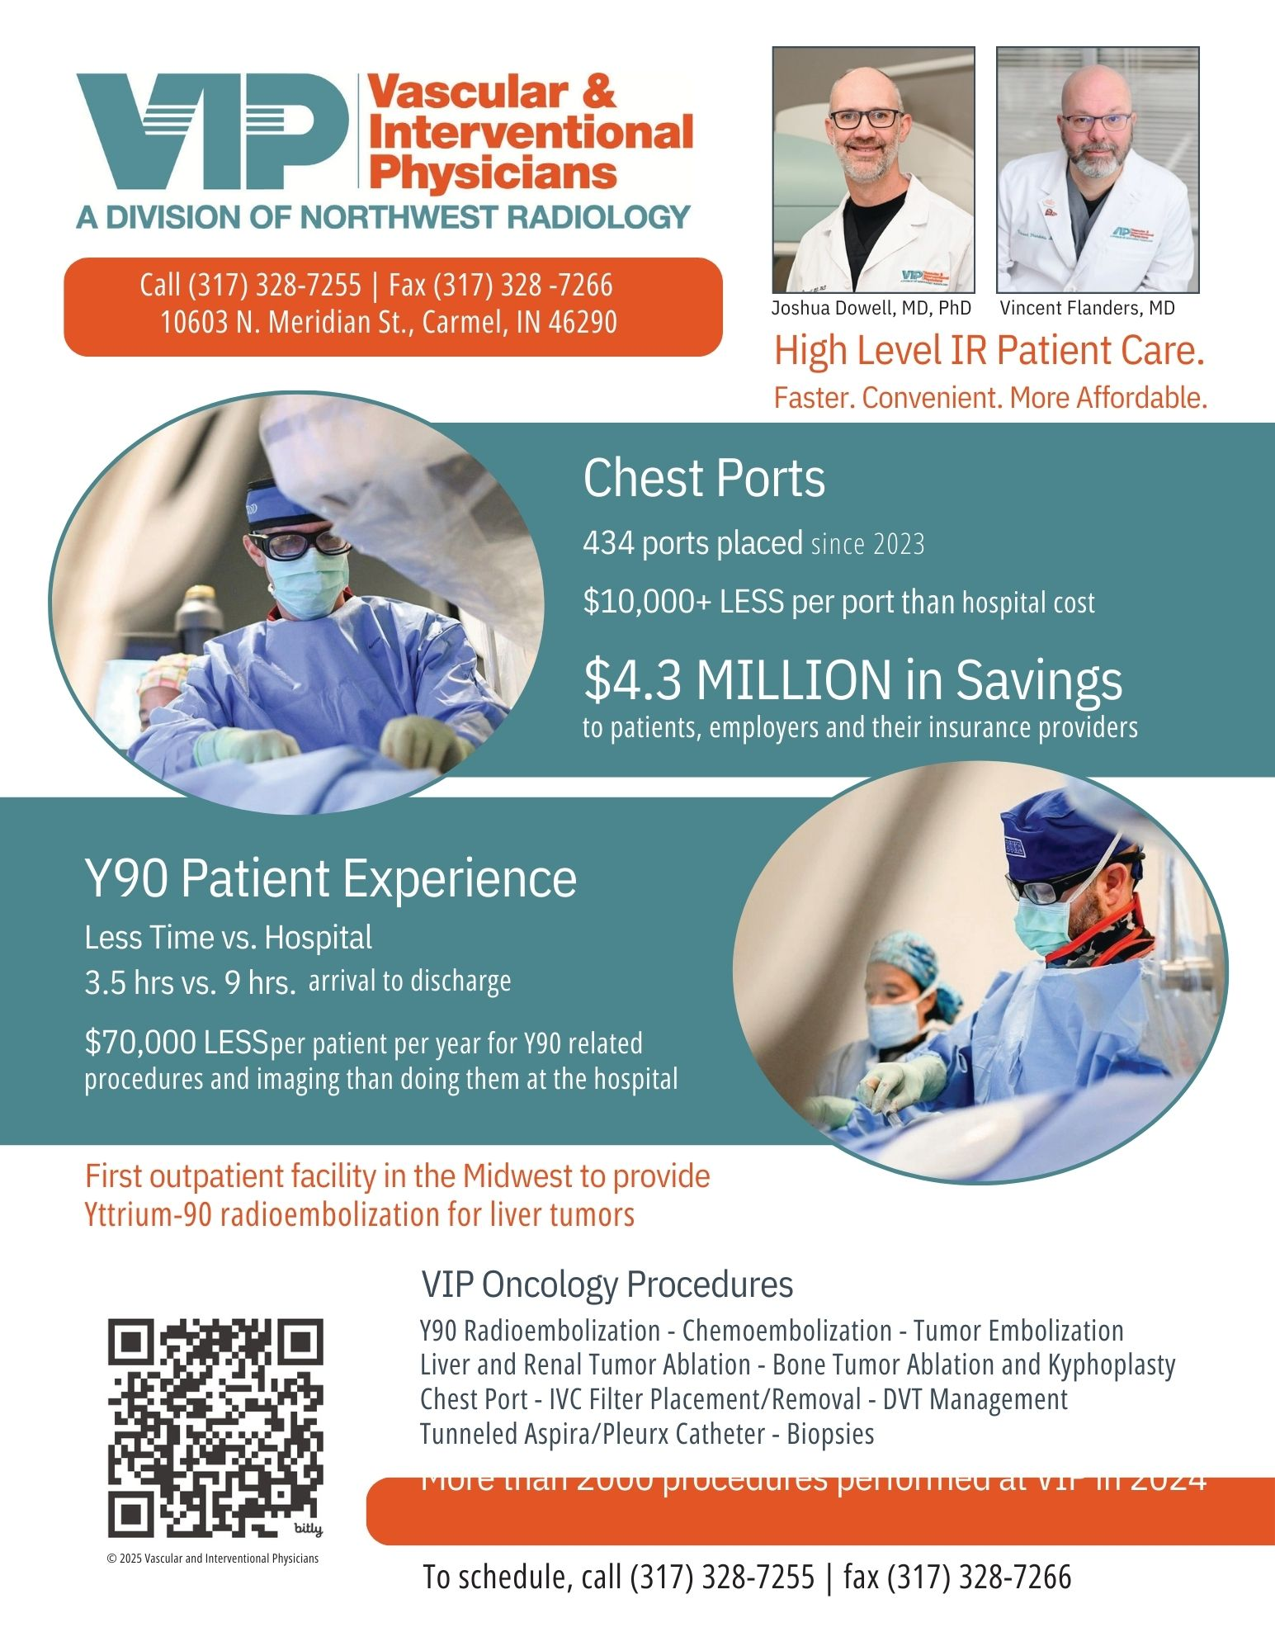

Slide 17
A Y90 Patient's Argument for VIP: 8:00 Start
Hospital
vs
VIP
Patient Arrives
6 AM
7:30AM
Patient Arrives
IV, Labs, Consent
IV, Labs, Consent
Procedure Start
8 AM
Procedure Start
9
hours
3.5 hours
9AM
MAA/Y90 Delivery
MAA/Y90 Delivery
10 AM
SPECT CT
Transport
SPECT CT
11 AM
Discharge
Transport
Discharge
3 PM

Slide 18
Yttrium-90 Radioembolization
MAPPING PROCEDURE:
MAPPING PROCEDURES | AVERAGE PAYMENT | HIGH PAYMENT
TOTAL: | $28,033.57 | $364,399.49
Y90 TREATMENT PROCEDURE:
Y90 PROCEDURES | AVERAGE PAYMENT | HIGH PAYMENT
Y90 Dose | $37,106.46 | $68,533.15
TOTAL: | $67,705.65 | $440,457.15
TOTAL FOR BOTH PROCEDURES:
AVERAGE PAYMENT | HIGH PAYMENT | ESTIMATED ASCENSION | VIP/NWR
$95,739.22 | $804,856.64 | $125,000 | $80,000

Slide 19
A Y90 Patient's Argument for NWR imaging
Hospital
vs
VIP/NWR
$3000
MRI Liver
$950
$9200
PET/CT
$2800
$12000
Port Placement
$2500
$162k
~$91k
$3000
Liver Biopsy
$1000
$50000
MAA and Y90
$30000
$75000
Y90
$50000
$12000
MRI follow up for 1 year
$4000

Slide 20
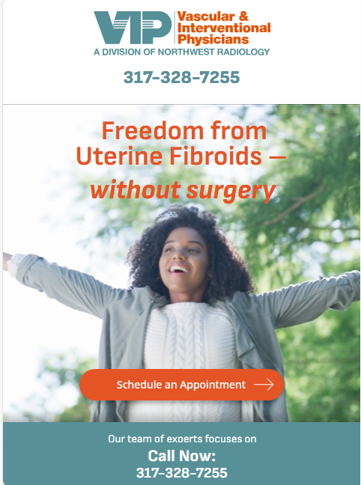
$17,598.50 | $207,710.83 | $0.00 | $22,215.33 | $56,957.38
Beyond Cancer Treatment
UTERINE FIBROID EMBOLIZATION
PROSTATE ARTERY EMBOLIZATION
NATIONAL AVERAGE | NATIONAL HIGH | INDIANA AVERAGE | INDIANA HIGH
$17,598.50 | $207,710.83 | $22,215.33 | $56,957.38
ESTIMATED ASCENSION | VIP/NWR
~$52,000 | ~$20,000

Slide 21
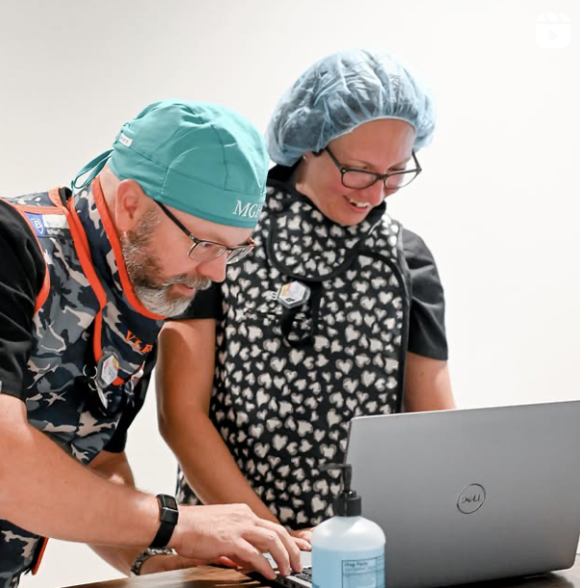
Cost Savings: Insurer, Employer, and Patient
Lower Cost: 30-50% less than hospitals for same procedure by same provider
Lower Overhead: Significantly less overhead than hospitals
Insurer and Medicare Savings: Over 18%+ savings overall when patient's have procedures performed outside the hospital
Savings to Employer and Patient: Same procedure, same provider, easier scheduling, shorter procedure time and recovery, improved patient satisfaction

Slide 22
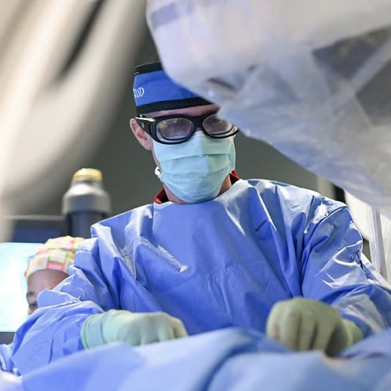
Benefit Design Strategies
Reducing employer health spending for diagnostic radiology imaging and interventional radiology procedures.
Improving patient satisfaction, ease of scheduling, procedure time and outcomes without increasing employer, insurer or patient spending.
Promote access to high-value IR and radiology health services

Slide 23
Strategies and Next Steps
Cost-sharing: Cost differentials to encourage outpatient VIP procedures and NWR imaging at a cost benefit. Increased coverage or lower deductibles for patients if at VIP/NWR.
Consumer-Driven Health Care: Empower or encourage patients to choose VIP and NWR as cost-effective choices. Same study, procedure, and provider at a cost savings to employers, patients and payor.
Make high-level IR procedures more accessible: Educate patients within and outside the Indianapolis area of the cost savings if their procedure is performed outpatient.
Employer Partnerships for procedural savings through VIP, ie Cancer Care (ports, liver directed therapy), Fibroids, Prostate

Slide 24

Joshua Dowell
Jdowell@northwestradiology.com
Vincent Flanders
Vflanders@northwestradiology.com
Indianapolis, Indiana
317-328-7255

