Slide 1


One to One Health
2025

Slide 2
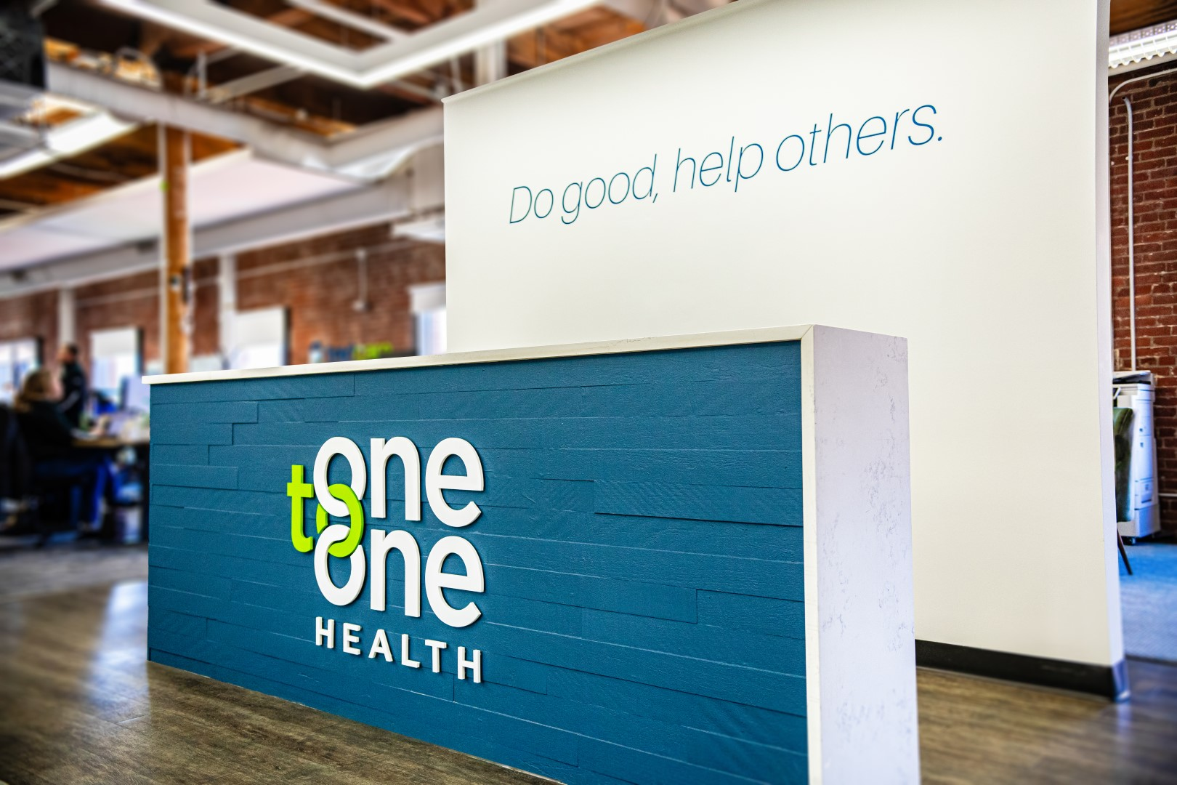








Who we are
405
We believe all Americans deserve access to relationship-based primary care.
Employer Clients
425k
Lives served
37
Who we serve:
Health Centers
50
Patients in
States
94
Net Promoter Score
What we do:
100%
Retention for groups 100+
Employee Health Centers

Slide 3


“Primary Care is the only component of health care where an increase in supply is associated with better population health and more equitable outcomes.”
National Academy of Engineering, Science, and Medicine Consensus Study Report on “Implementing High-Quality Primary Care”
Notes:
Bob

Slide 4






This is healthcare that cares
Advanced primary care for all. Whenever. Wherever.
™
Onsite Clinics
TextCare
TextCare Pro
Primary and acute care, occupational health, chronic condition management, and RX. Hand-picked clinicians invested in your workforce.
Text, talk to, or video chat with your personal, One to One Health care team in <5 min, 24/7. Optimal engagement guaranteed.
A hybrid solution to precision, population health management. Unleash the power of virtual care coupled with a fully-dedicated care team.
Who we serve:

Slide 5












The blueprint for
supporting a healthy employer
Partnership
Initial and ongoing strategy and evolution of service with consultant and employer
Onsite Care.
Health centers offering primary/acute care, condition management, health coaching, mental health, and pediatric care.
Precision Health
A data-driven approach to managing risk, driving provider outreach, and closing care gaps.
Virtual Care
Dedicated TextCare team supporting acute care needs for the whole household.
Navigation.
Dedicated, integrated team to support benefits and in-person care coordination to high-quality, high-value care (COE, Tier 1 network)
RX
Targeted outreach for polypharmacy, GLP1 coaching and pre-authorization program

Slide 6
Boundless care. One partner.
We lead with a “Yes” mentality.
Occupational Health: Fit for duty, pre-employment screenings, ergonomic assessment.
Injury and illness treatment. Immunizations. Drug screening. Emergency response and first aid.
Physical Therapy: Provide preventive care, rehabilitation, and treatment for patients with chronic conditions, illnesses, or injuries. Specialized services for each patient.
Behavioral Health: Provide therapies and counseling that focuses on how emotions and behaviors affect a person's ability to function in everyday life. Integrated with our primary care team.
Network Development: Care doesn’t end once you leave the health center. We believe in appropriate provider-driven, data-informed, high-value referrals. Current collaborations with Garner Health and direct negotiations.
Engaging the unengaged: 38% of employees that had never used any services, nor had a physical in the past year, actively engaged via TextCare to come into the clinic for an in-person wellness visit.
Notes:
Call outs and bigger numbers

Slide 7

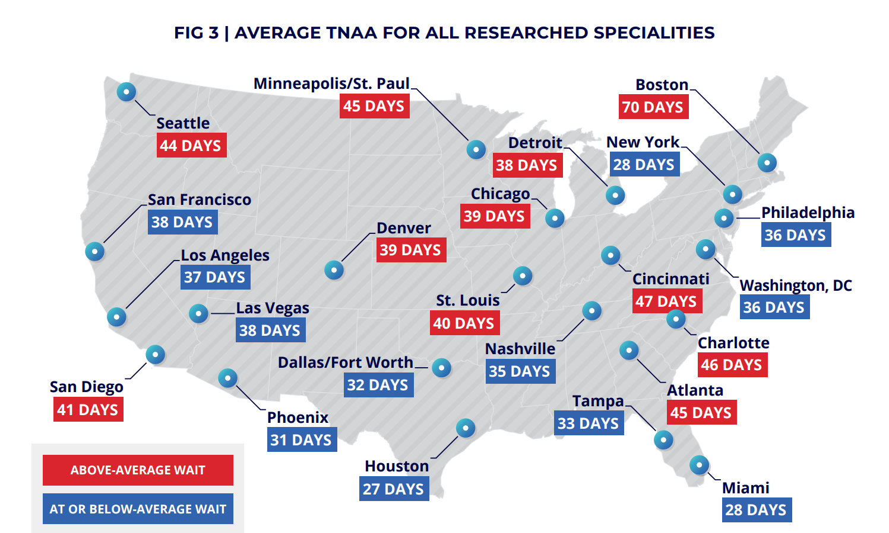
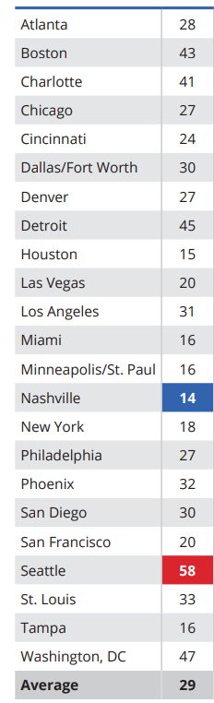

Primary care works, but can you get in?
Primary care access is more challenging than ever.
29*
Day wait for primary care
Notes:
Call outs and bigger numbers

Slide 8
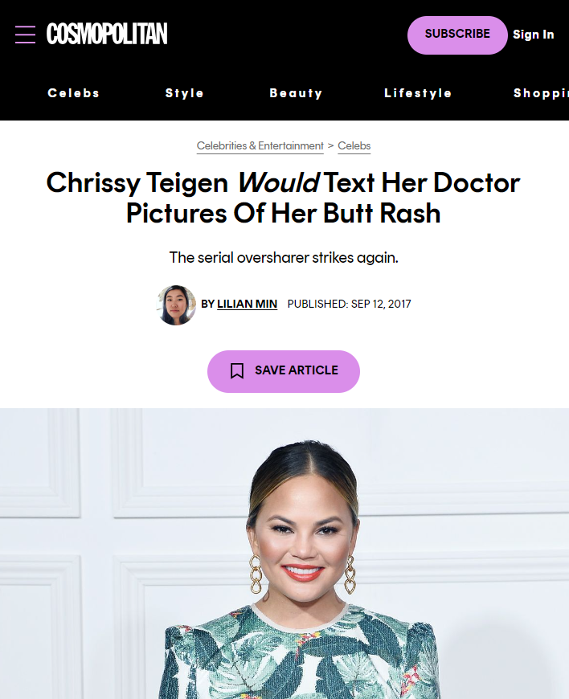
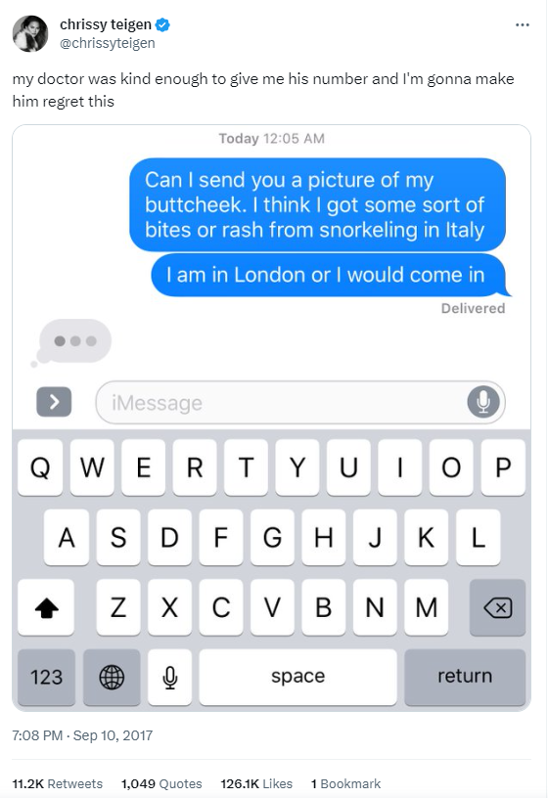

*Unless you’re a celebrity.
Notes:
Call outs and bigger numbers

Slide 9
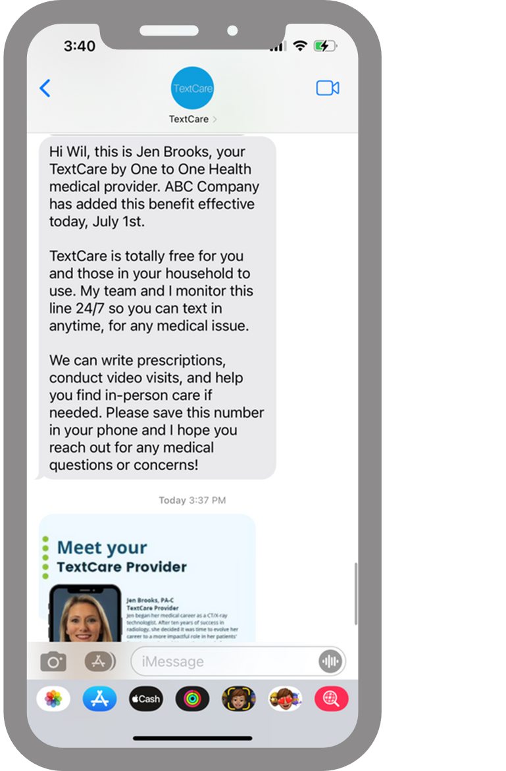
Meet TextCare.
On launch day, employees get a TextCare Welcome from their dedicated provider.
Begin care immediately.
It’s that easy.
No copay.
No clunky registration.
No app to download.
No new password to remember forget.
“I literally can’t imagine life without TextCare.
I’ve used it five times already for myself and my kids.”
TextCare Member, 2024
You’re
welcome.

Slide 10

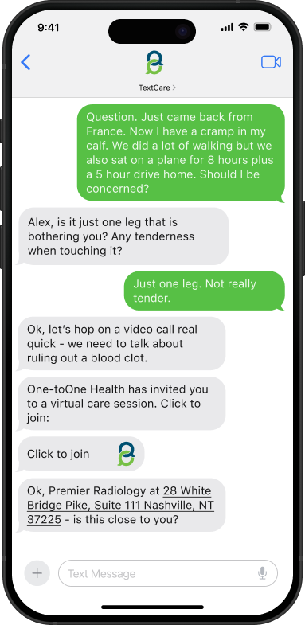
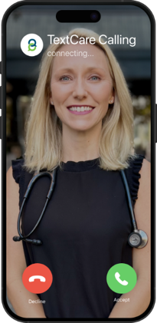
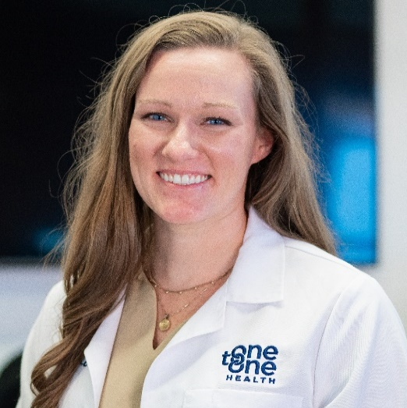




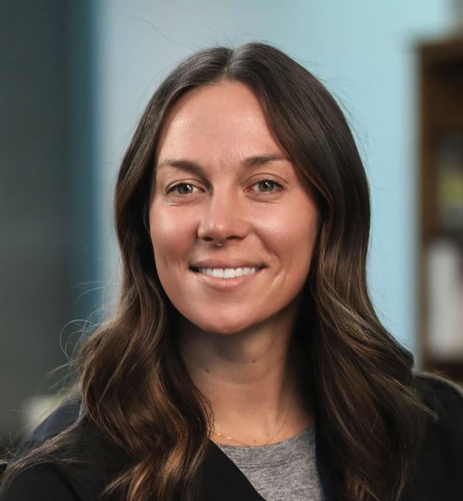


Your care team on your terms.
$0 visits. One monthly membership
(for the entire household)
<5 minutes
24/7
62.3%
First year engagement
Primary Care Provider
The quarterback of your household’s care. Your clinician can help diagnose, treat, and prescribe, as necessary.
5.05
Annual visits, per engaged user
Text
Secure Chat
Video Chat
Call
$1,142
Annual avoided costs, per engaged member
TextCare
calling…
160.4%
First year utilization
Benefits &
Care Navigator
Physician
.
Medical Assistant
Employees will love it. Employees will use it. Guaranteed.
follow-up. every visit. every time.

Slide 11
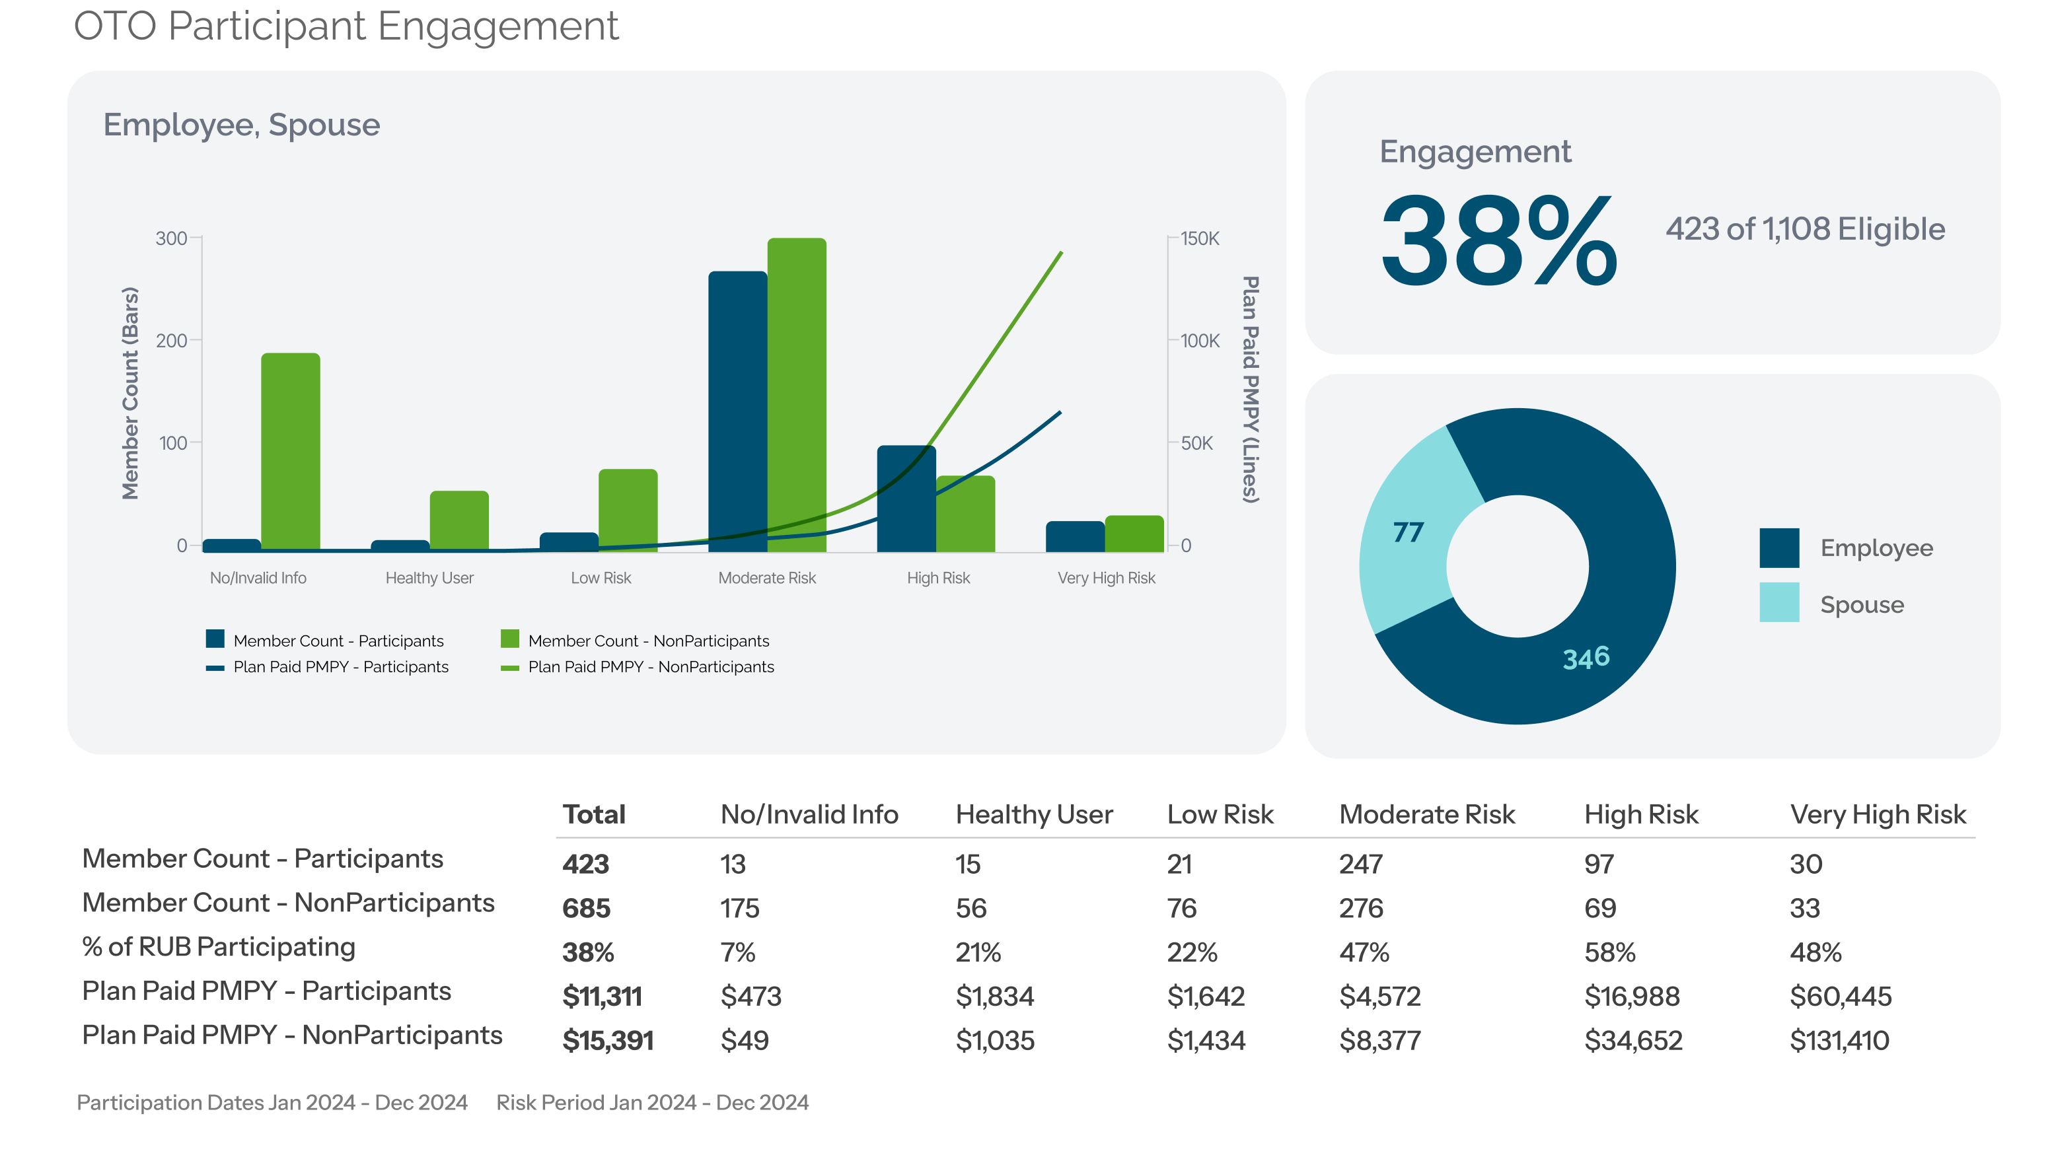
Can virtual care reduce claims spend?
Members engaged with OTO are more cost efficient than nonparticipants.
Continue to promote the value of OTO to increase member engagement and plan savings.

Slide 12
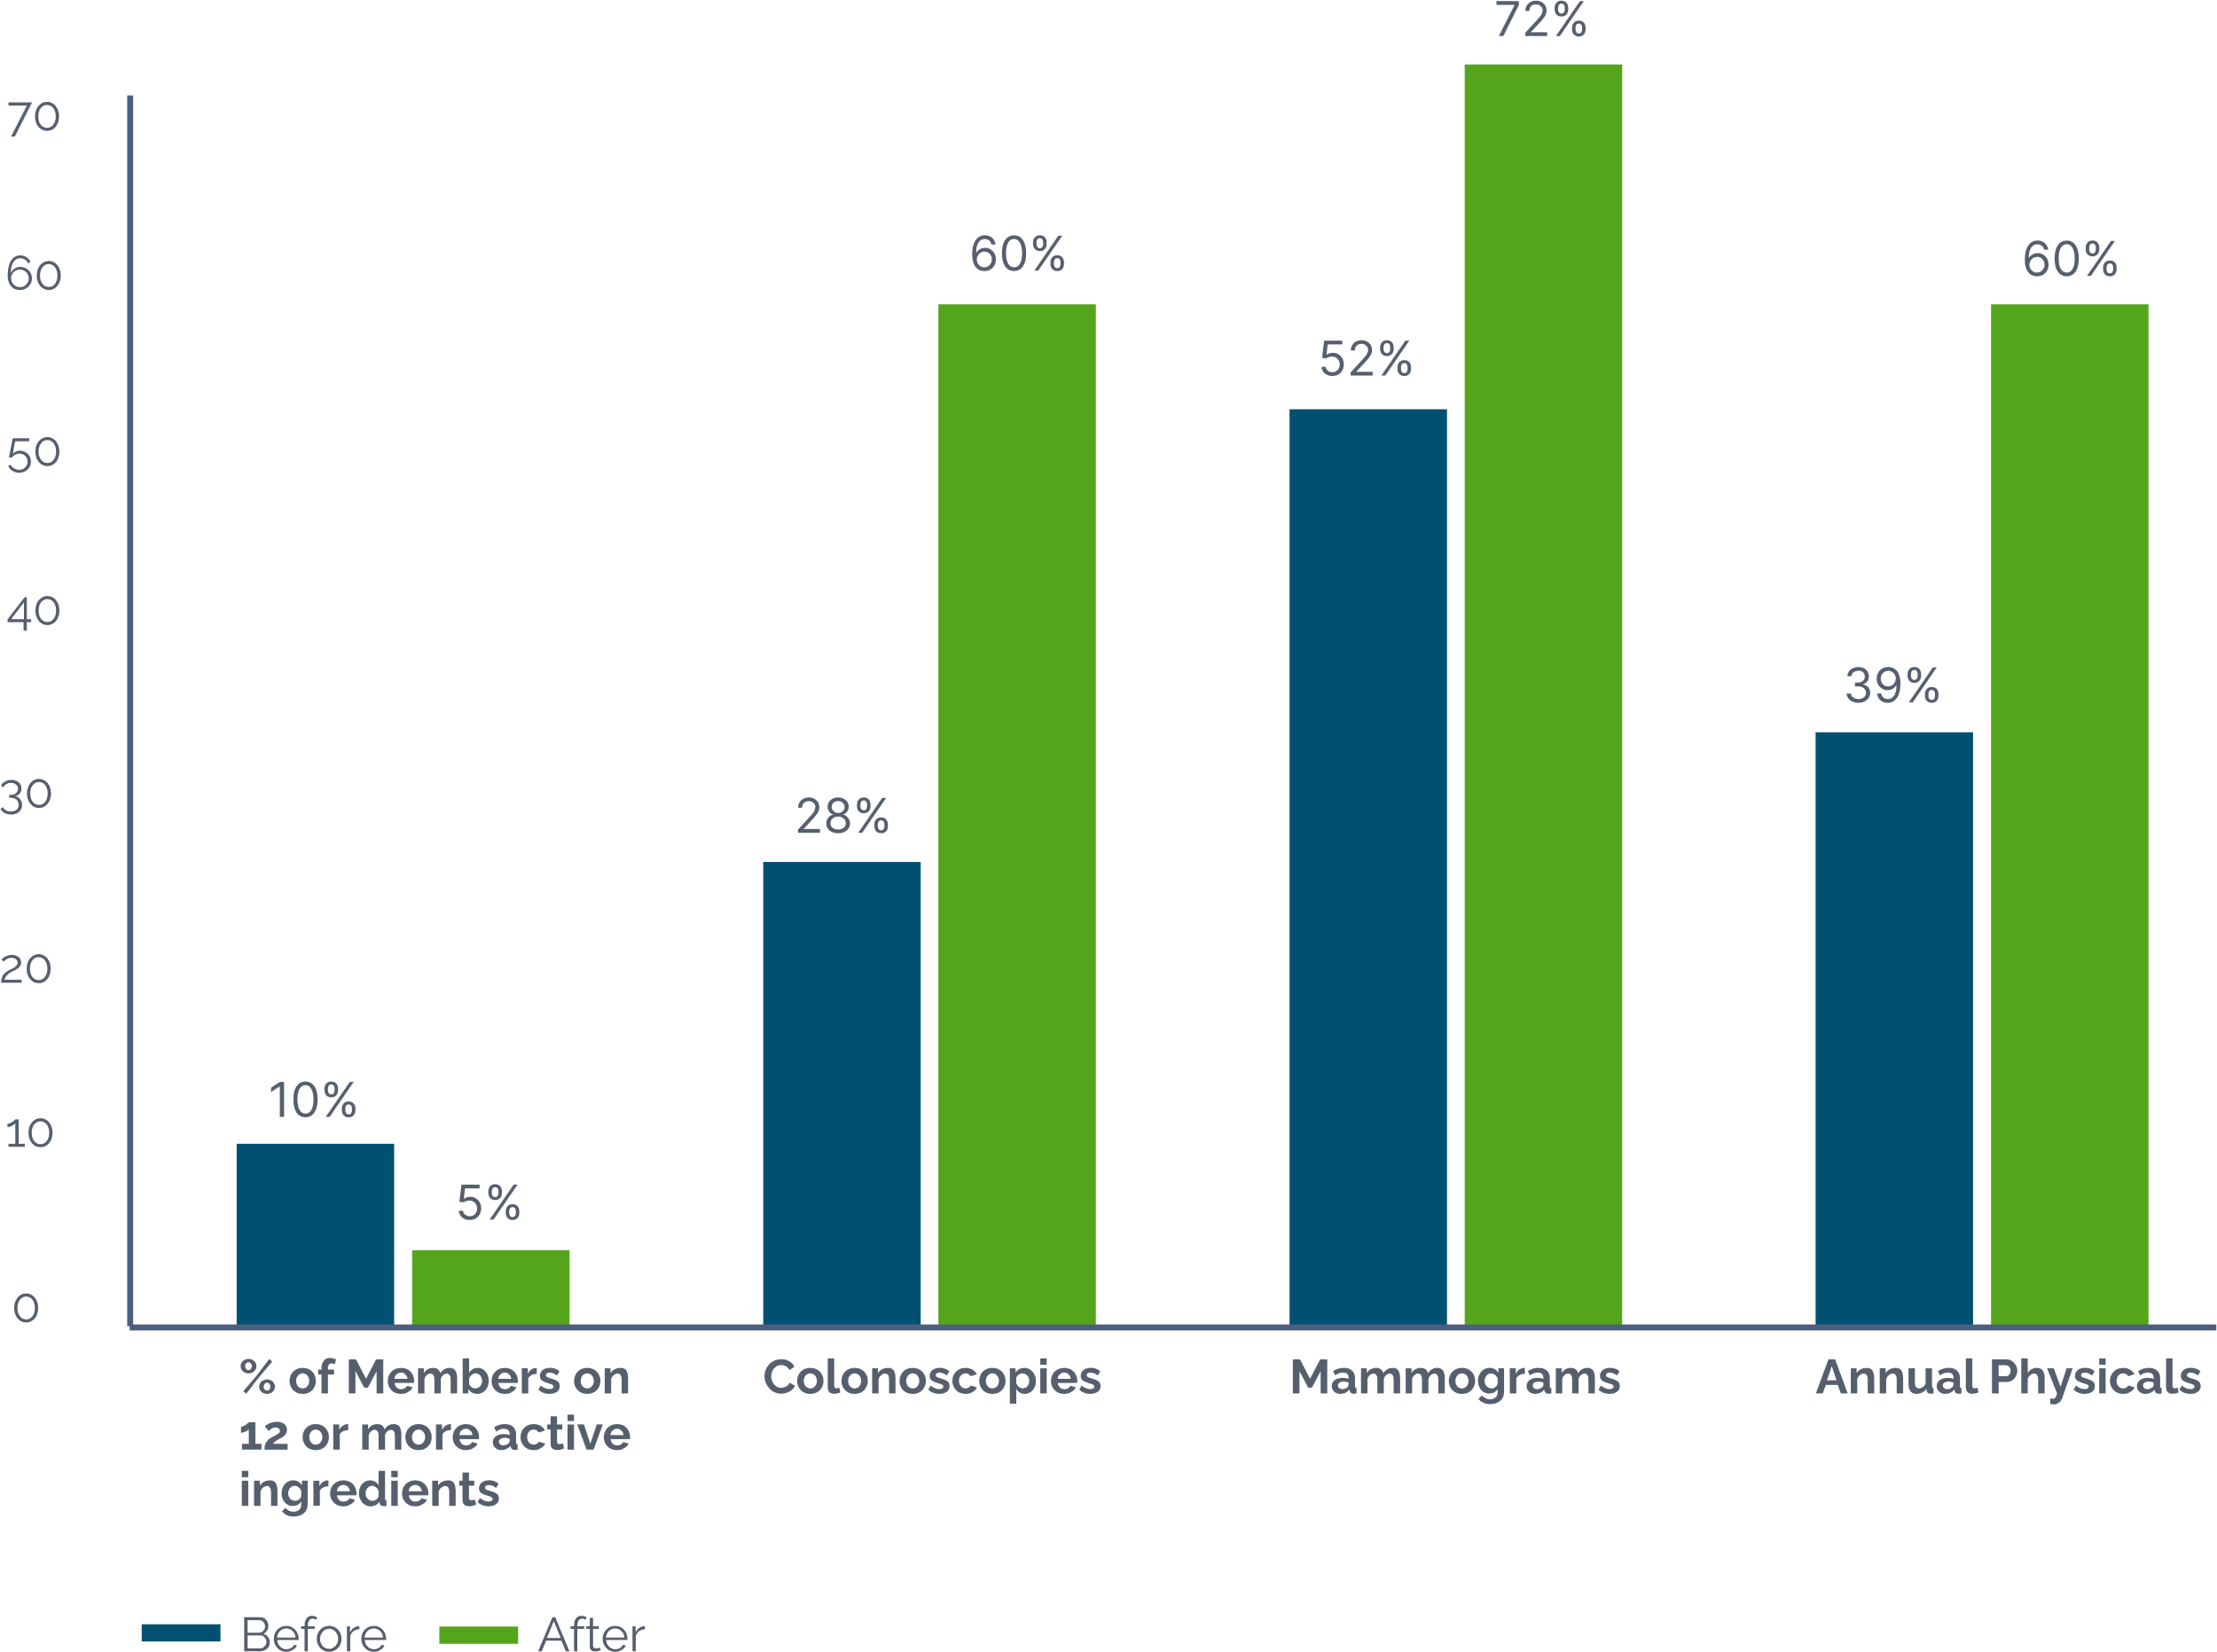
Purdue’s targeted insights cut polypharmacy rates in half and drove major increases in preventive care.
Engagement alone is not enough
Providers move outcomes when armed with prioritized data

Slide 13
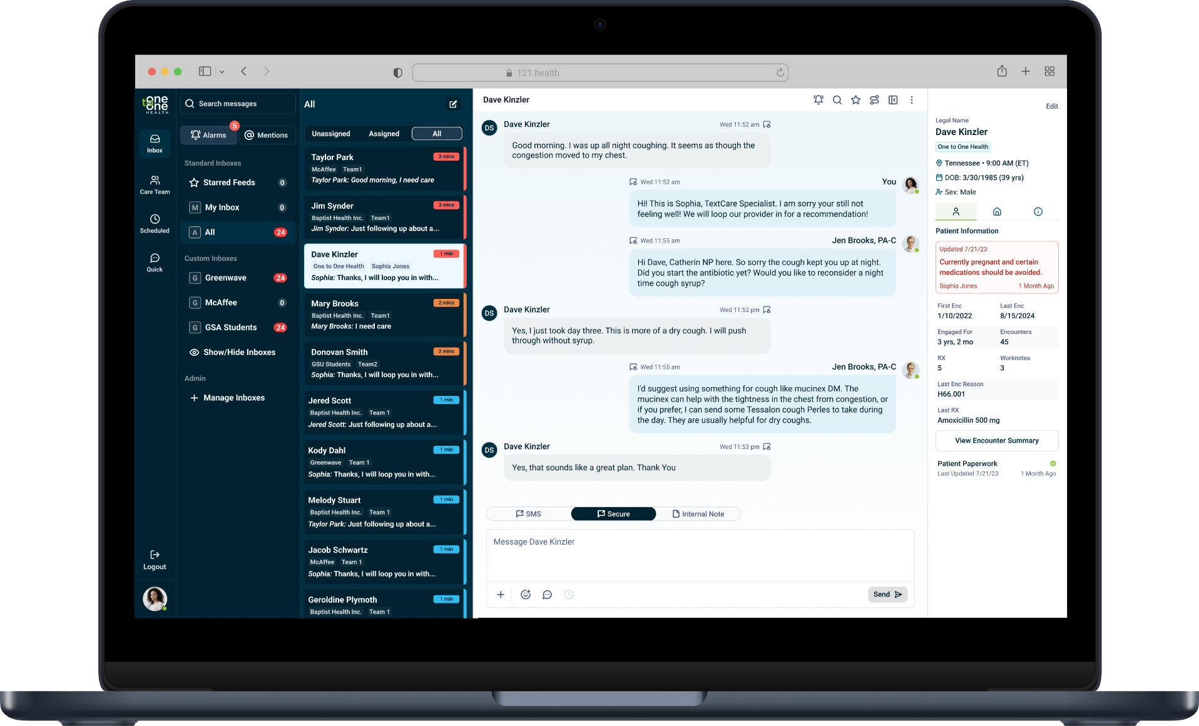
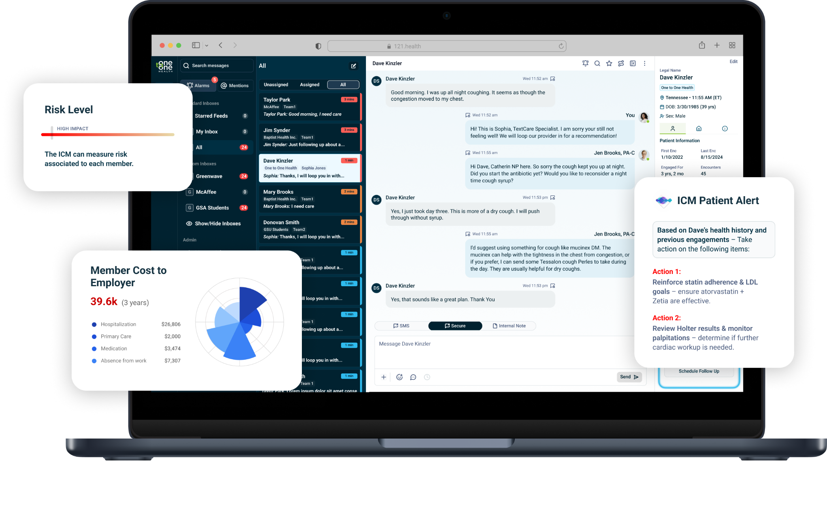



Today, data is siloed from care
Enterprise analytics should inform the point of care
Providers treat based on patient reported history and presentation during that visit
Enterprise claims data is used to report on population health and evaluate specific strategies
With appropriate inputs, LLMs can identify the highest value addressable interventions, prompting providers to proactively raise topics during visits and conduct daily outreach to optimize engagement

Slide 14
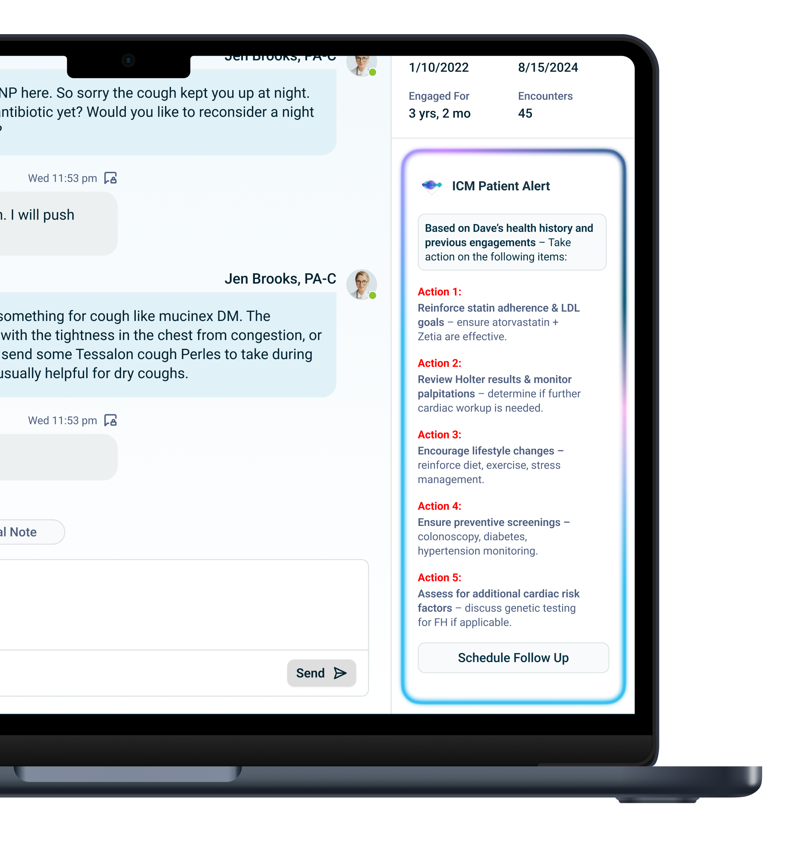
Introducing Intelligent Care Manager
Intelligent Care Manager identifies the highest value addressable interventions, prompting providers to proactively raise topics during visits and conduct daily outreach to optimize engagement

Slide 15
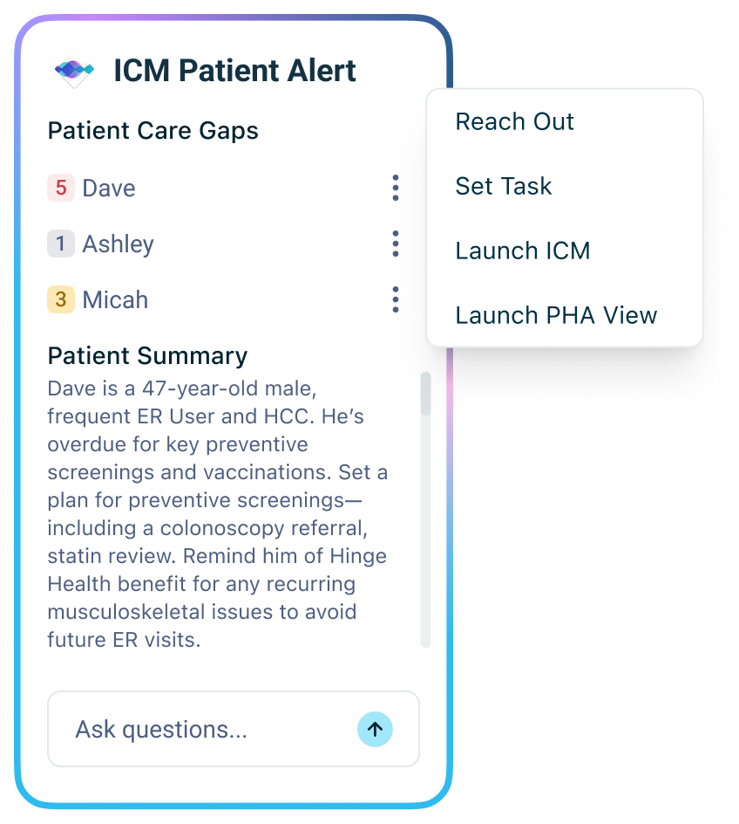
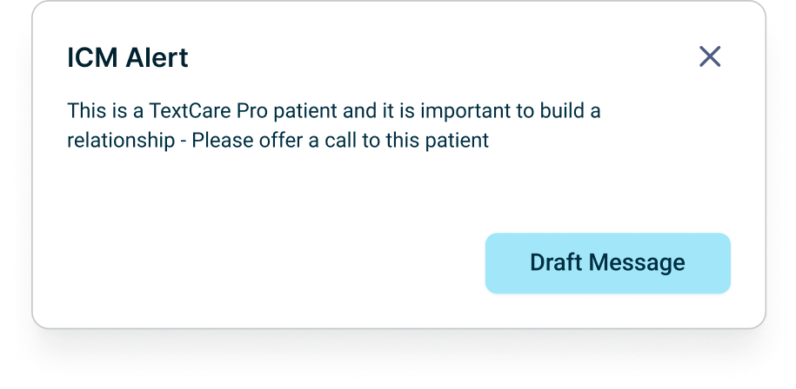
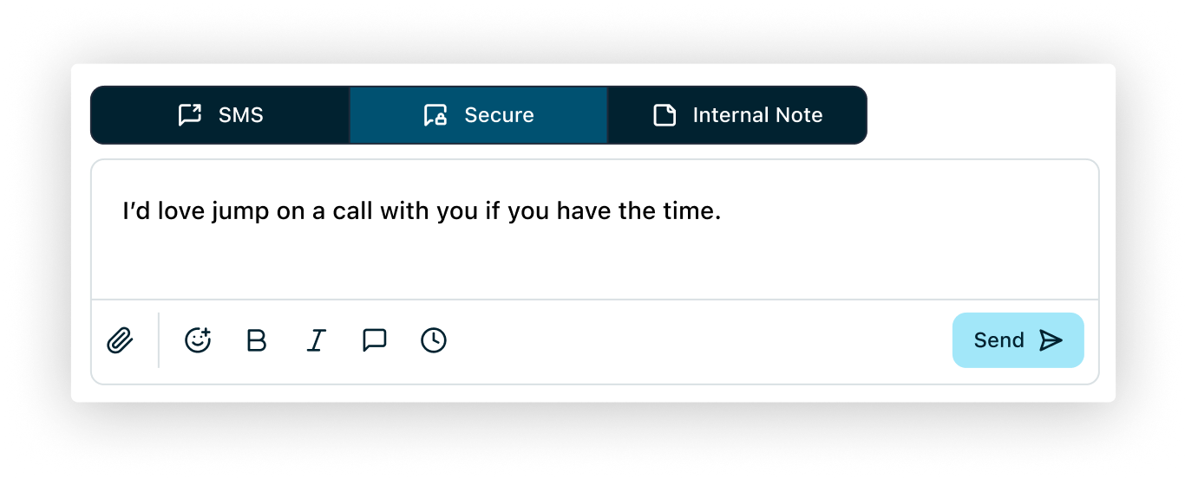
Alerts are only effective if providers use them
The ICM Alert Modal, pops up during a session with a patient.
The message composer autofills a suggested message.
Intelligent Care Manager identifies the highest value addressable interventions, prompting providers to proactively raise topics during visits and conduct daily outreach to optimize engagement

Slide 16
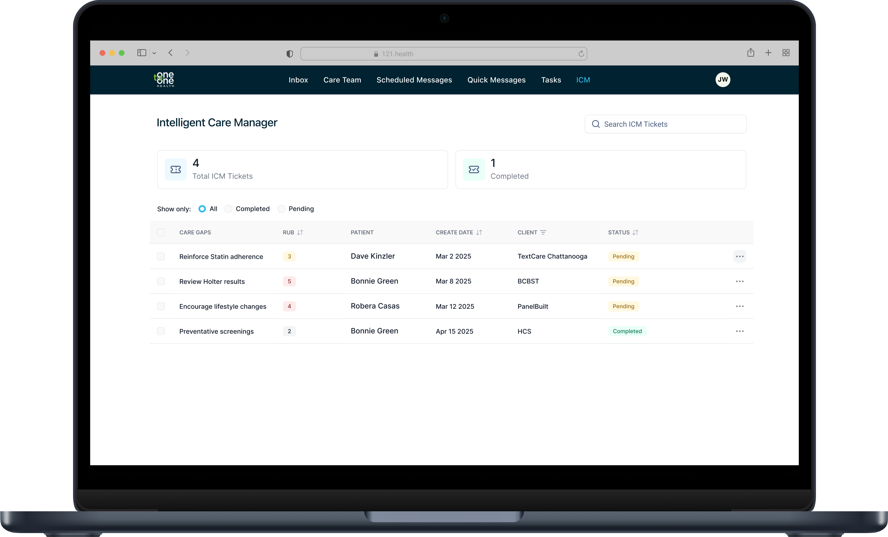
Seamless outreach and tracking, all in one spot

Slide 17

Thank You

