Slide 1

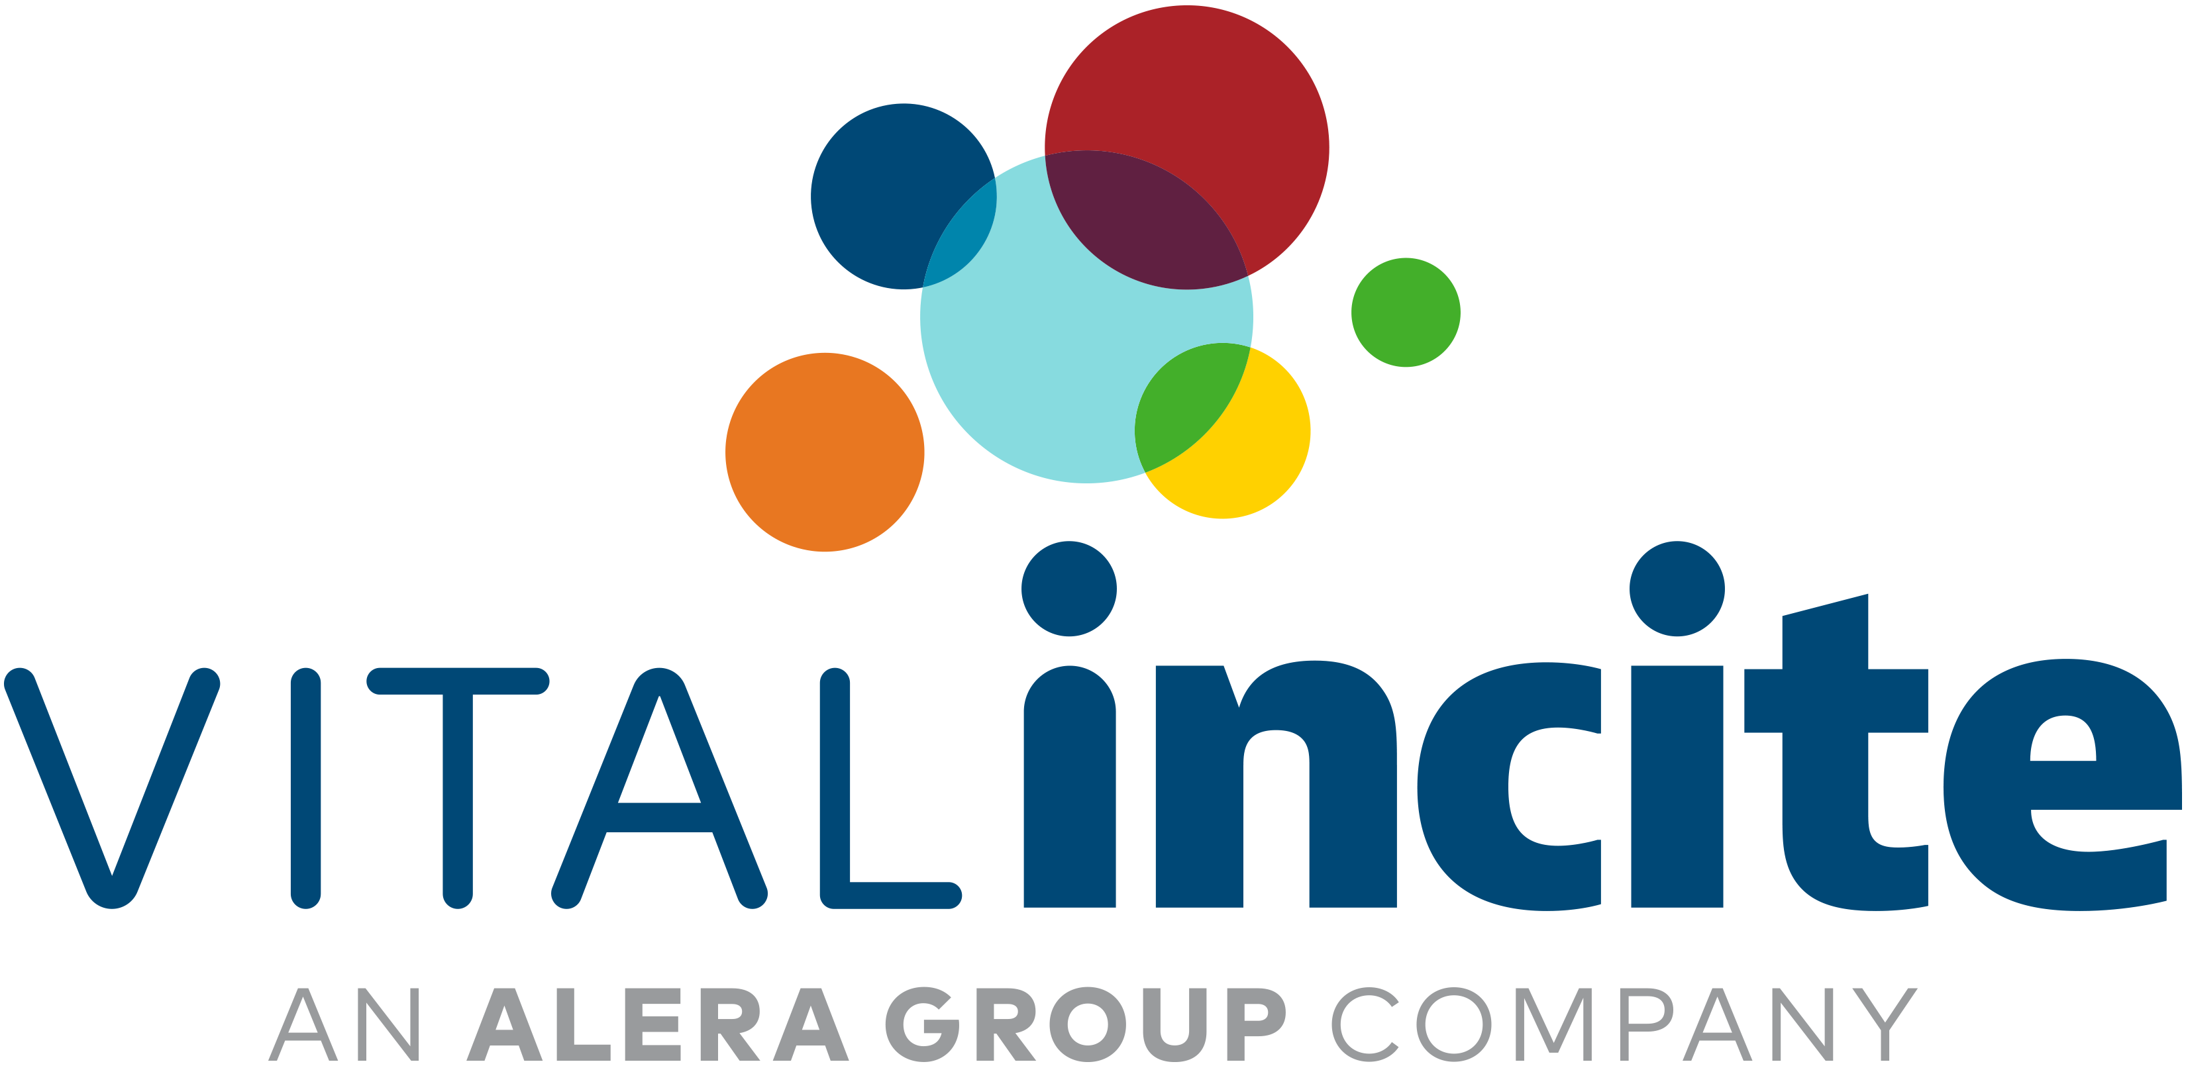
Wellbeing Trends: Reshaping the Business Imperative
Gretchen Day & Andrea Davis
May 14th, 2025

Slide 2
Evolving Workplace Wellbeing: Beyond ROI Metrics
Traditional ROI Metrics
Shift to Human-Centric Wellbeing
Focused on financial returns: reduced absenteeism, healthcare cost savings, productivity gains.
Programs often transactional (e.g., gym discounts, step challenges).
Employee-Centric Mindset: Prioritizing physical, emotional, social, career, community, and financial wellbeing.
Employee Experience: Meaningful work, psychological safety, inclusion.
New Metrics: Engagement, burnout, sense of belonging, retention.
Qualitative Data: Storytelling, pulse surveys, open feedback.
Why the Shift?
ROI often hard to quantify in complex wellbeing domains.
Growing expectations for workplaces to care about people, not just performance.
Emerging research supports a long-term, trust-based approach to wellbeing.

Slide 3
Wellbeing is an Imperative Function of Employee Benefits
EMPLOYER CLIENTS AND EMPLOYEES VALUE WELLBEING
66%
of employers view their health and wellbeing strategy as integral to their workforce strategy
87%
of leaders believe prioritizing employee wellbeing gives them a competitive advantage
93%
of employees consider workplace wellbeing as important as salary
By 2030, the global workforce will be composed of several distinct generations, each with unique characteristics and demands. For example, Gen Z consumers prefer experiential perks and work-life balance over traditional healthcare benefits.
32%
of employees are less likely to be job hunting when they are thriving in their wellbeing
59%
of workers say work-life balance and personal wellbeing are key criteria for considering a new job
15 - 20%
of total payroll in voluntary turnover costs on average due to burnout
1. University of Oxford Workplace Wellbeing and Firm Performance
2. National Business Group on Health 14th Annual Employer-Sponsored Health and Well-Being Survey
3. Gympass State of Work-Life Wellness 2024
4. McKinsey Employer Health Benefits Survey 2024
5. Gallup, Employee Wellbeing is key for Workplace Productivity
Notes:
Wellbeing has shifted from being a 'nice-to-have' to a 'must-have' in the modern workplace
Let's start with some hard numbers. 66% of employers now view their health and wellbeing strategy as an integral part of their overall workforce strategy. This isn't just a trend; it's a fundamental shift in how organizations understand and value their people.
And for good reason. 87% of leaders say that prioritizing employee wellbeing gives their organization a competitive advantage. In today's talent landscape, where attracting and retaining top talent is crucial, a strong wellbeing program is no longer a perk, it's a differentiator.
But it's not just about what employers and leaders think. 93% of employees consider workplace wellbeing as important as salary. That's a staggering statistic. It tells us that employees are actively seeking workplaces that prioritize their holistic health, not just their paychecks.
As we look ahead, by 2030, the global workforce will be a complex mosaic of different generations, each with their own unique needs and expectations.
We're seeing a clear shift in what employees value. Take Gen Z, for example. They're not just interested in traditional healthcare benefits. They crave experiential perks and work-life balance. They want to feel valued as individuals. This means that a one-size-fits-all approach to wellbeing simply won't cut it anymore. We need to be thinking about personalized, flexible, and engaging wellbeing strategies that cater to the diverse needs of our workforce.
We are seeing a direct need for this by the high % of RFPs that come in with at least one question on Wellbeing.

Slide 4
In RFPs Wellbeing is Top of Mind
90%
Describe any effective programs and online programs you provide to your clients that foster employee wellness.
What employee wellness and health incentives do you recommend implementing, if any? How would you evaluate whether these might be a good fit for [COMPANY]? What evidence do you have that these program(s) work?
Can you share Wellness Program benchmarking information? We want to assess program types, incentives, ROI, and demonstrate the importance for employee retention, recruiting, improving health, etc.
of RFPs for broker services have question(s) related to wellbeing services available
Describe your expertise with EAP and mental health benefits, including average utilization by your clients.
Please provide a concrete, real-world example of a client wellness program success story.
What is your firm’s experience and what role does your firm play when it comes to wellness programs?
Notes:
Reference to competitor offerings

Slide 5

Making the Business Case
Employees who strongly agree that their employer cares about their wellbeing are:
71% less likely to report experiencing a lot of burnout
3x more likely to be engaged at work
5x more likely to strongly advocate for their company as a place to work and to strongly agree they trust the leadership of their organization
https://www.gallup.com/workplace/404105/importance-of-employee-wellbeing.aspx.aspx

Slide 6

Culture eats strategy for breakfast.
- Peter Drucker (Management Consultant)

Slide 7
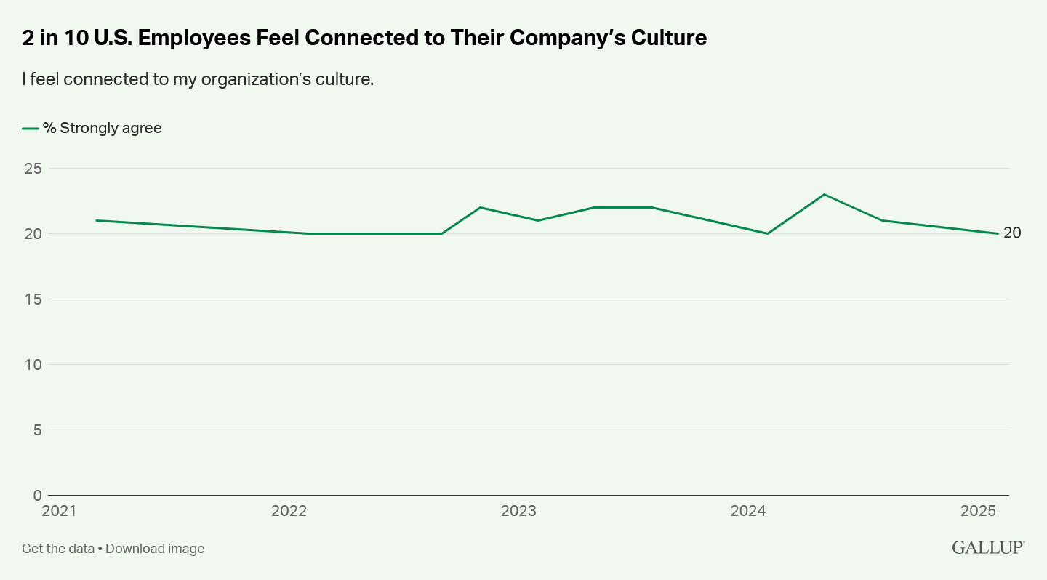
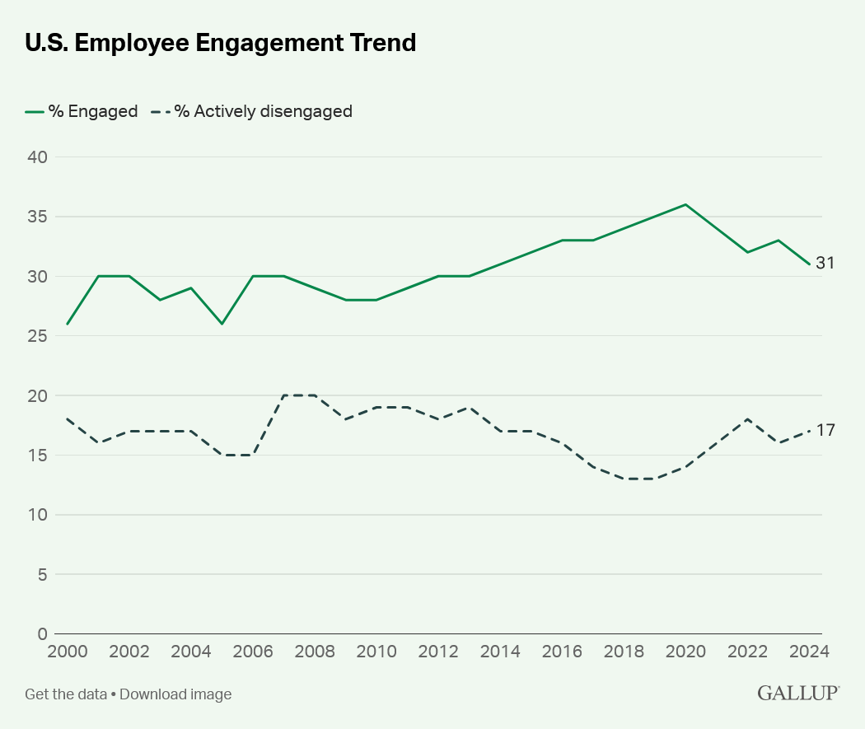
Belonging
Key trends:
94% of workers crave a sense of belonging¹, but only 50% of workers feel a sense of belonging at work.²
Lower levels of belonging are associated with poorer health, stress, and loneliness.³
Stronger levels of belonging are associated with greater life satisfaction and better general health.³
  Workers who feel a strong sense of belonging at work are 2.5 times less likely to feel burned out.³
1 American Psychological Association, (2023, April), 2023 Work in America Survey: https://www.apa.org/pubs/reports/work-in-america/2023-workplace-health-well-being
2. SHRM (2024, May 1). Worker Mental Health Challenges Put Productivity at Risk: https://www.shrm.org/in/executive-network/insights/worker-mental-health-challenges-productivity-risk-hr
3. American Immigration Council. (2024). The Belonging Barometer: https://www.americanimmigrationcouncil.org/sites/default/files/research/thebelongingbarometer_revisededition_june2024_1.pdf

Slide 8
Conversation Prompts
How do you see employee belonging impacting things like job satisfaction, retention, and employee performance/ productivity?
What actions is your company taking to make employees feel included in the Company and its success?
How do you currently assess whether employees feel they belong in the workplace? Are there any particular metrics, feedback systems, or surveys in place?

Slide 9

Women's Health
Key trends:
Biological differences and disease prevalence can disproportionately impact women. ¹
Women often shoulder the majority of caregiving, leading to delayed healthcare for themselves. ²
The U.S. maternal mortality rate, particularly for Black women, is alarmingly high compared to other developed nations. ³
Women are asking for quality reproductive care from fertility to maternal health to menopause, and all life stages in between.
1 Gebreyes, K., Radin, J., Dhar, A., Bhatt, J., Gerhardt, W., & Korenda, L. (2024, September 10). What’s causing US women to skip or delay medical care? Retrieved from Deloitte Website: https://www2.deloitte.com/us/en/insights/industry/health-care/why-women-skip-or-delay-health-care.html
2. The Guardian Life Insurance Company of America. (2023). Standing Up and Stepping In: A modern look at caregivers in the U.S. retrieved from https://connect.guardiangroupbenefits.com/l/503851/2023-12-15/6yw1b6/503851/1702675399bBkGiG78/Guardian_12th_Annual_WBS_Standing_Up_and_Stepping_In_1215.pdf
3. Gunja. M., Gumas, E.D., Masitha, R., & Zephyrin, L. (2024, June 4). Insights into the U.S. Maternal Mortality Crisis: An International Comparison. Retrieved from The Commonwealth Fund Website: https://www.commonwealthfund.org/publications/issue-briefs/2024/jun/insights-us-maternal-mortality-crisis-international-comparison

Slide 10
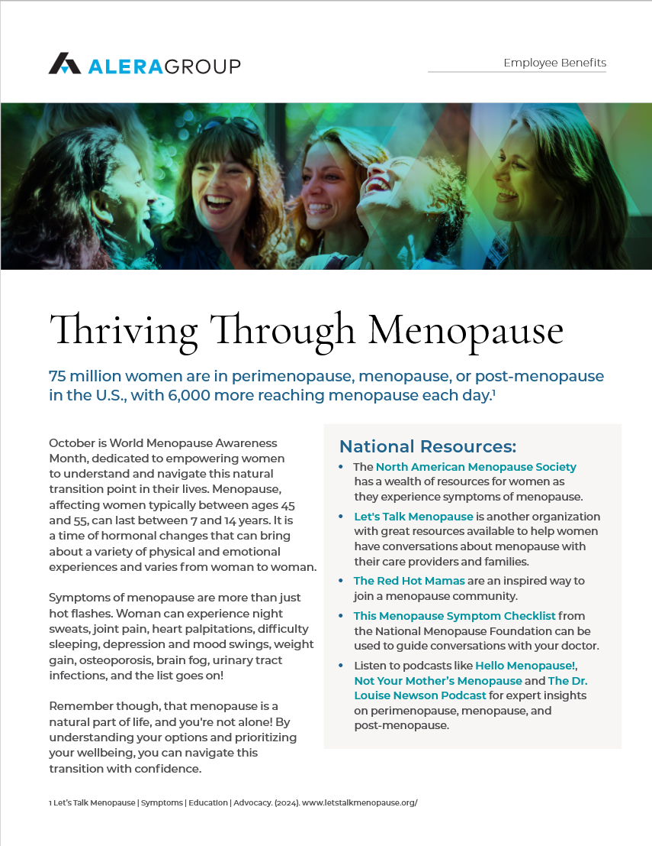
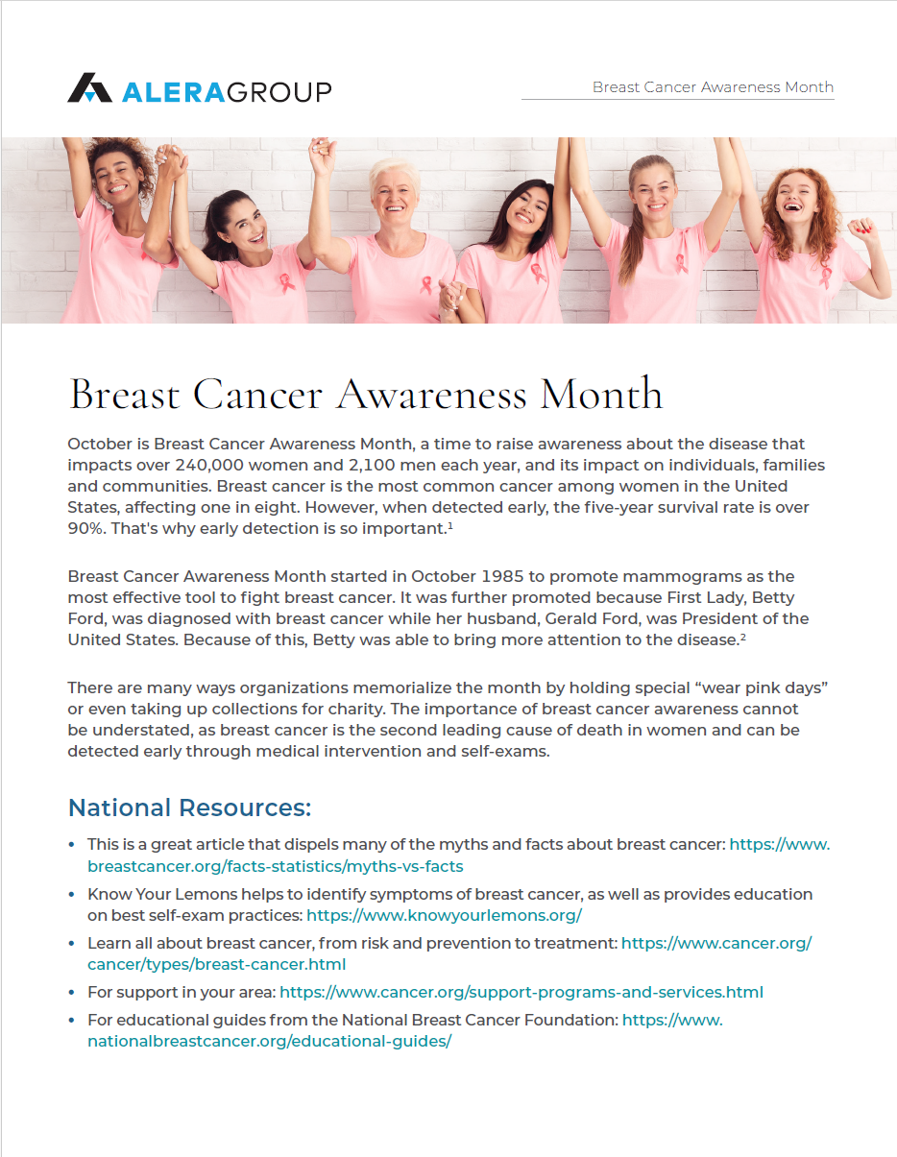
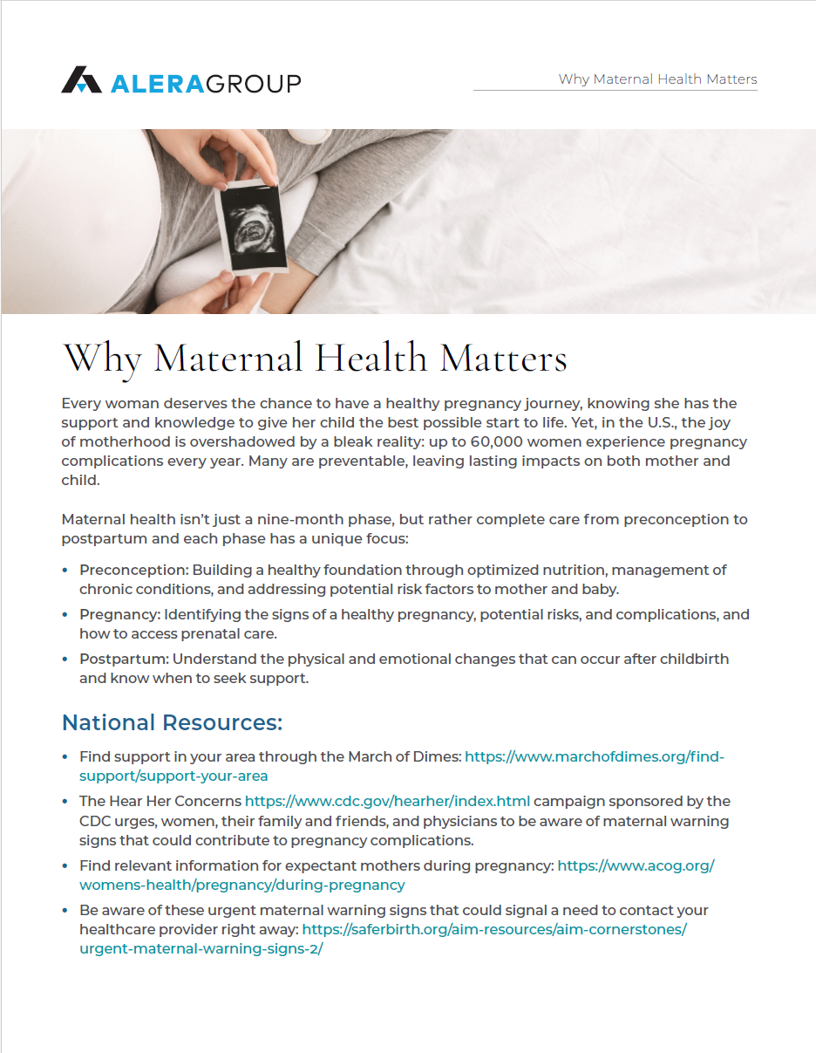
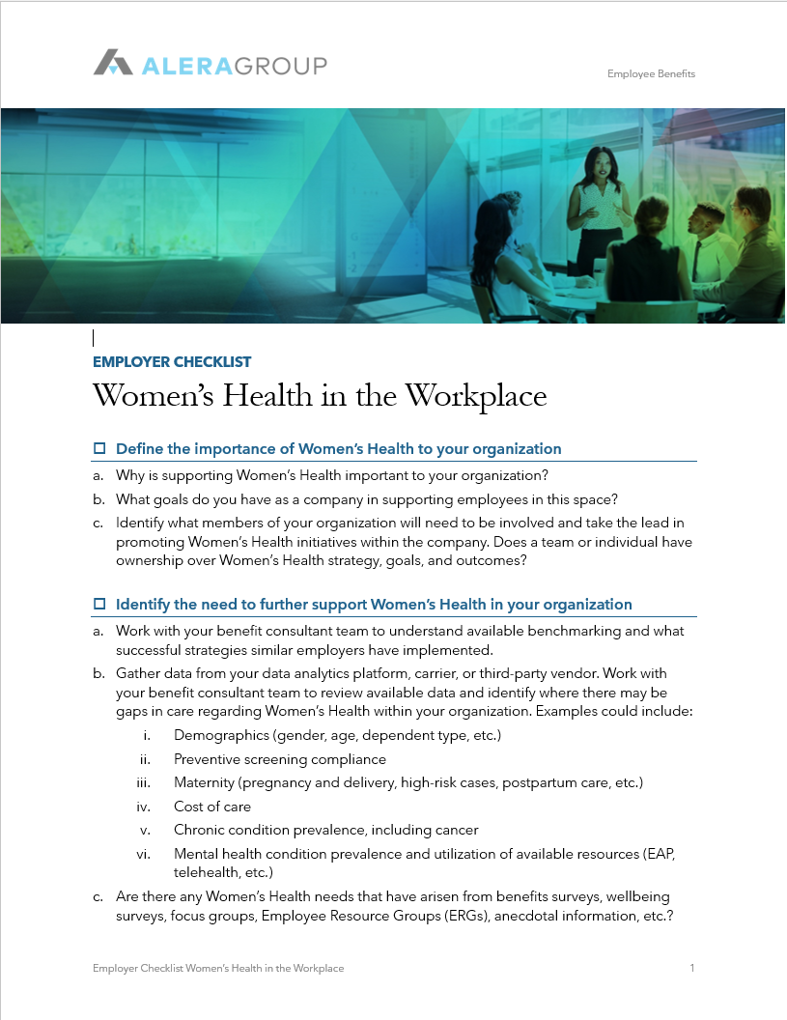
Conversation Prompts
Why is supporting Women’s Health important to your organization?
What goals have you set or would you like to set as a company in this space?
Do you have a strategy or any solutions in place that support Women’s Health?
What Women’s Health or Women’s Health-adjacent needs might be important to your population?
Have your recently evaluated your workplace policies for support of Women’s Health topics?

Slide 11




Empowering Women’s Health
Employer Strategies
Growing Carrier partnerships
3rd Party Solutions
  Menopause Care
  Caregiving
  Fertility
  Lactation Support
Evolution of Breast Cancer Screening and Women’s Health Screenings
Culturally Supportive Maternal Care Models
Flexible work or leave policies
Telehealth and digital health tools
Financial
Wellbeing
Healthy
Aging
Chronic Conditions
Maternal Health
Perimenopause & Menopause
Reproductive Health & Family Planning
Mental
Health
Caregiving

Slide 12

Aging & Inclusion
Key trends:
Only 39% of adults feel socially and emotionally connected with others, meaning over half of adults are disconnected and isolated.
1 in 5 employees report feeling lonely at work.
65% of the workforce is expected to be millennials and Gen Z in the next 5 years.
Employers are developing succession planning strategies to help stabilize knowledge retention.
1. Hadley, C. N. (2024, November). We're still lonely at work. Retrieved from Harvard business review website: https://hbr.Org/2024/11/were-still-lonely-at-work
2. Generational differences in the workplace [infographic], https://www.Purdueglobal.Edu/education-partnerships/, Purdue global, Accessed Dec. 6th, 2024.

Slide 13
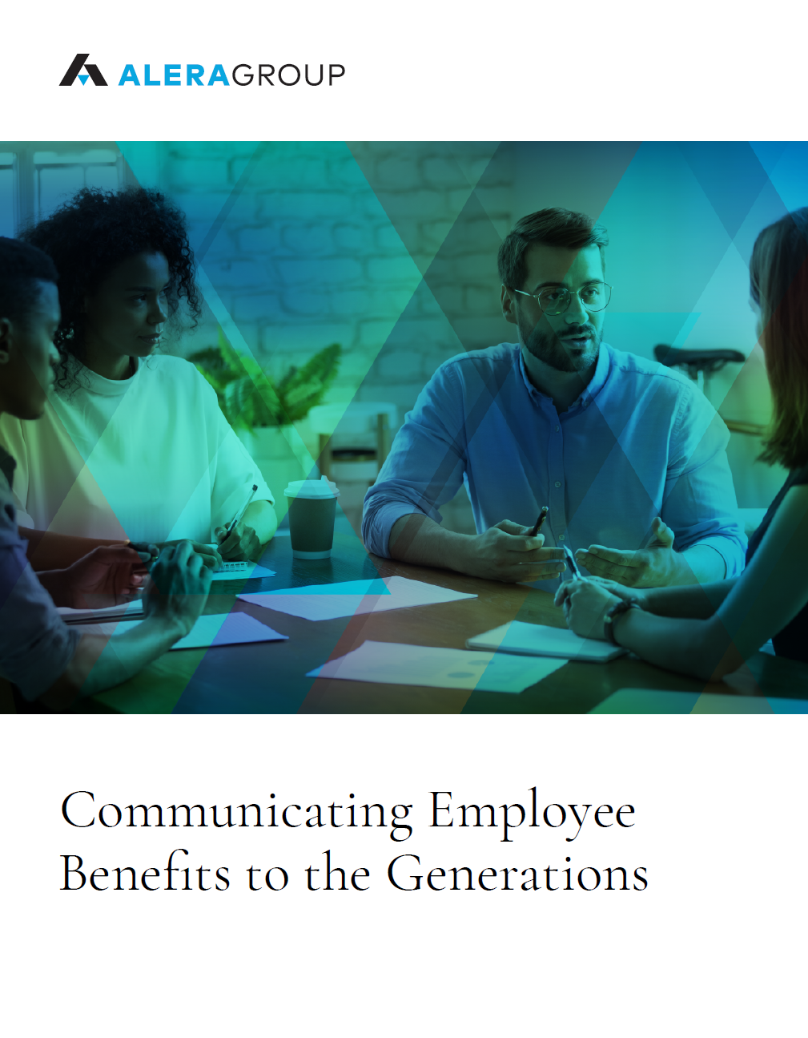
Conversation Prompts
How are you adapting your benefits strategy to align with a changing generational mix in your workforce?
What strategies or solutions do you have in place to help build connection and inclusion at work?
Do you have a peer mentoring or apprenticeship strategy in place to support retention and connection?
Do you have solutions in place to support employees as they explore retirement?
  Long-Term Care Planning
  Medicare
  Wealth Management
  Succession Planning
  https://cloud.aleragroup.com/individual-coverage/

Slide 14
Supporting a Multigenerational Workforce
Individual
Planning for Workplace Longevity
Supporting younger demographics
Staffing for growth and retention
Workforce development
Expertise Retention
Knowledge retention and sharing across workforce generations
Creation of efficiencies by combining knowledge and technology
Culture Shifts
Appreciation of the value and wisdom each unique generation brings to the workplace environment
Policies and culture to prevent ageism
Engagement strategies catered to each unique generation
Interpersonal
Organization

Slide 15
Align Benefit Strategies to What Generations Need Most
BABY BOOMERS Before 1965
Optimistic | Competitive | Team-Oriented Motivated by: Company loyalty, teamwork, duty Communication Style: phone, face-to-face, meetings, fairs
GENERATION X 1965 - 1980
Flexible | Informal | Skeptical | Independent Motivated by: Life balance, personal/professional interests Communication Style: phone, face-to-face
MILLENIALS 1981-2000
Competitive | Civic- and Open-Minded | Achievement Oriented Motivated by: Responsibility, their manager, unique work experiences Communication Style: IM, texts, and email
GENERATION Z 2001 - 2020
Global | Entrepreneurial | Progressive | Less Focused Motivated by: Diversity, personalization, creativity Communication Style: social media, texts, IMs
Desired Benefits:
    Caregiving benefits
    Comprehensive traditional benefit plan options
    Retirement benefits and
    healthcare planning
    Workplace flexibility and
    transition planning
    LTC Planning
    Lifestyle planning
Desired Benefits:
    Caregiving benefits
    Comprehensive traditional benefit plan options
    Financial planning assistance
    Flexible scheduling
    Remote work benefits
    Retirement benefits and
    healthcare planning
    LTC planning
    Lifestyle planning
Desired Benefits:
    Community service / sabbaticals Continuous learning education
    Family leave and childcare benefits
    Fertility benefits
    Financial planning assistance
    Flexible PTO and vacation
    Mental health resources
    Remote work benefits
    Student loan repayment and tuition savings programs
Desired Benefits:
    Financial planning assistance
    Flexible work
    Holistic health and
    well-being benefits
    Mental health benefits
    Mentoring opportunities and learning management tools
    Parental leave options
    Professional development resources
    Tuition reimbursement
Sources:
https://www.purdueglobal.edu/education-partnerships/generational-workforce-differences-infographic/
https://dpath.com/wp-benefits-strategies-multi-generational-workforce/

Slide 16
Longevity
Evolving Health Models
Alzheimer's and Dementia Screening
Functional or Lifestyle Medicine Care Models
Metabolic Health and Nutrition, paired with gut microbiome
Evolving Cancer Screening Tools (Bexa, Prenuvo, Auria, etc.)
Personalized supplements
Broadening virtual care delivery models
AI-supported transformations
Key Trends
In the U.S., a notable gap persists between lifespan (77.5 years) and healthspan (63.9 years), highlighting the need to prioritize both quantity and quality of life.
Key wellbeing practices like daily movement and activity, stress management, improved nutrition, and social connection are essential to longevity.
The future of health is increasingly personal. Personalized care models (e.g. nutrition, biotechnology, and personalized medicine) continue to evolve.
1. Arias E, Kochanek KD, Xu JQ, Tejada-Vera B. Provisional life expectancy estimates for 2022. Vital Statistics Rapid Release; no 31. Hyattsville, MD: National Center for Health Statistics. November 2023. Link: https://dx.doi.org/10.15620/cdc:133703
2. World Health Organization 2025 data.who.int, Healthy life expectancy at birth (years) [Indicator]. Link: https://data.who.int/indicators/i/48D9B0C/C64284D
Notes:
It takes about 17 years for new standards in healthcare to be adopted. (NIH) - https://pmc.ncbi.nlm.nih.gov/articles/PMC6717691/ (Research suggests that on average, it takes up to 17 years for only 14% of published evidence to translate into practice)

Slide 17
Conversation Prompts
How are your benefits supporting healthy aging for your employee population?
01
Do you have a robust strategy that incorporates holistic wellbeing themes?
02
How are you future-proofing your benefits strategy?
03
What are the biggest health and wellbeing challenges your employees currently face?
04
What barriers prevent your employees from prioritizing their health and wellbeing?
05

Slide 18








Substance Use and Mental Health
5%
5% OF ADULTS AND 13% OF YOUTH REPORTED EXPERIENCING THOUGHTS OF SUICIDE IN THE PAST YEAR.¹
1 IN 4
59%
13%
ALMOST ONE IN FOUR ADULTS CURRENTLY LIVE WITH A MENTAL ILLNESS¹
OF THOSE WITH A MENTAL ILLNESS DID NOT SEEK CARE BECAUSE OF COST²
8.7%
47%
47% OF EMPLOYEES KNOW ABOUT THEIR COMPANY’S MENTAL HEALTH SERVICES, BUT ONLY 38% WOULD BE COMFORTABLE USING THEIR COMPANY’S SERVICES.⁴
43%
OF WORKING ADULTS IN THE U.S. HAVE A CURRENT ALCOHOL OR ILLICIT DRUG USE DISORDER.³
OF WORKERS TYPICALLY FEEL TENSE OR STRESSED OUT DURING THE WORKDAY.⁵
38%
1. https://www.mentalhealth.gov/basics/mental-health-myths-facts
2. 2024-State-of-Mental-Health-in-America-Report.pdf
3. Frone MR, Casey Chosewood L, Osborne JC, Howard JJ. Workplace Supported Recovery from Substance Use Disorders: Defining the Construct, Developing a Model, and Proposing an Agenda for Future Research. Ocup Health Sci. 2022 Dec 5;6(4):475-511. doi: 10.1007/s41542-022-00123-x. PMID: 37206918; PMCID: PMC10193449. Link: https://pmc.ncbi.nlm.nih.gov/articles/PMC10193449
4. https://www.mhanational.org/mind-workplace
5. U.S. workers adjust to the changing nature of employment. Highlights from the 2024 Work in AmericaTM Survey, https://www.apa.org/pubs/reports/work-in-america/2024
Notes:
Mental Health America 2023 State of mental Health in America Report
Recognize that we have a lot barriers to connecting those who need support with the right tools and resources to get the help and support they need.

Slide 19
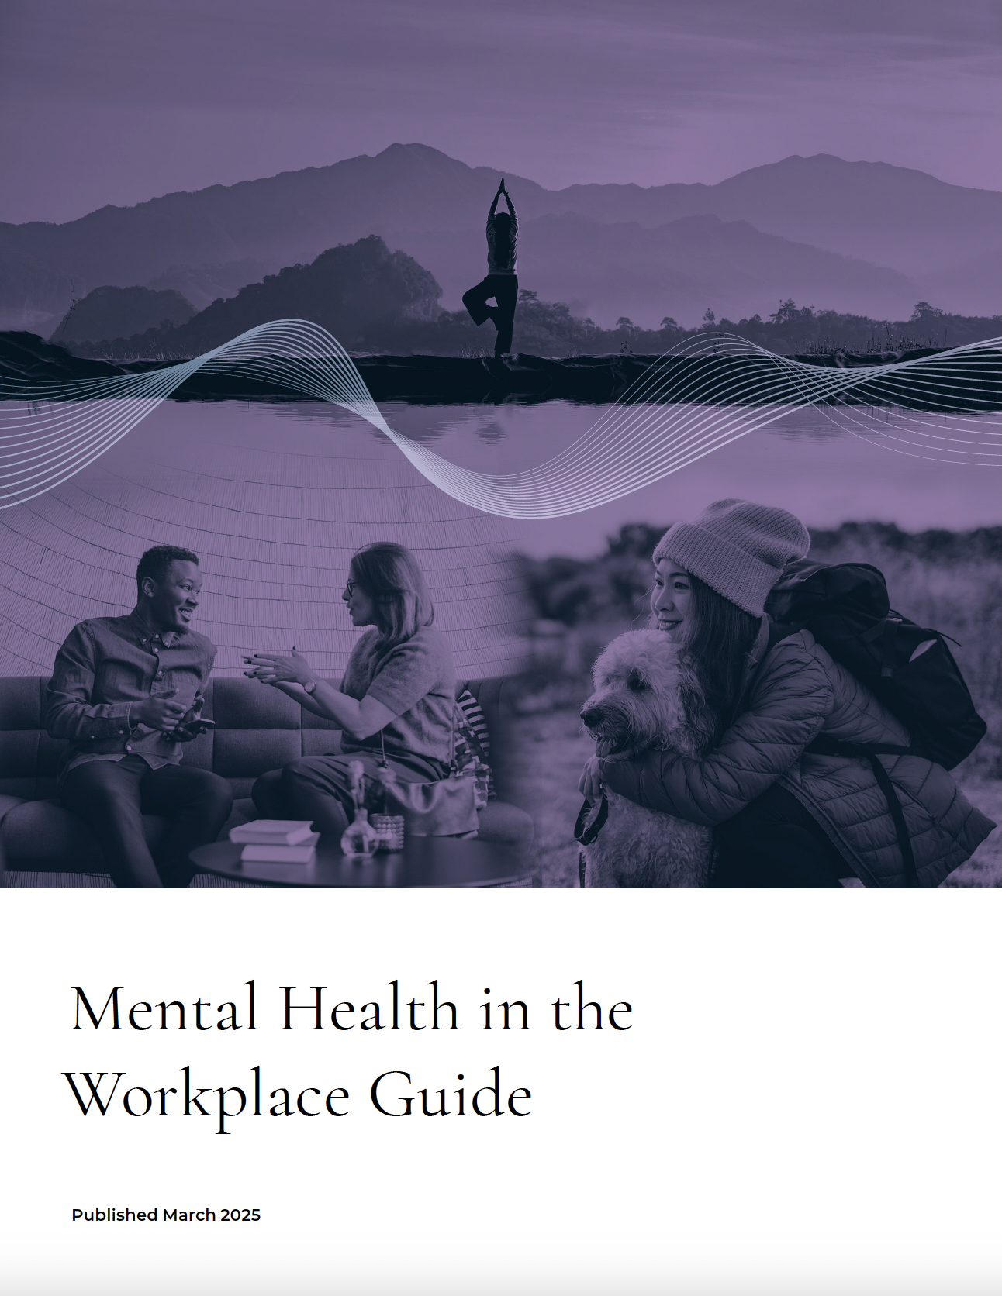
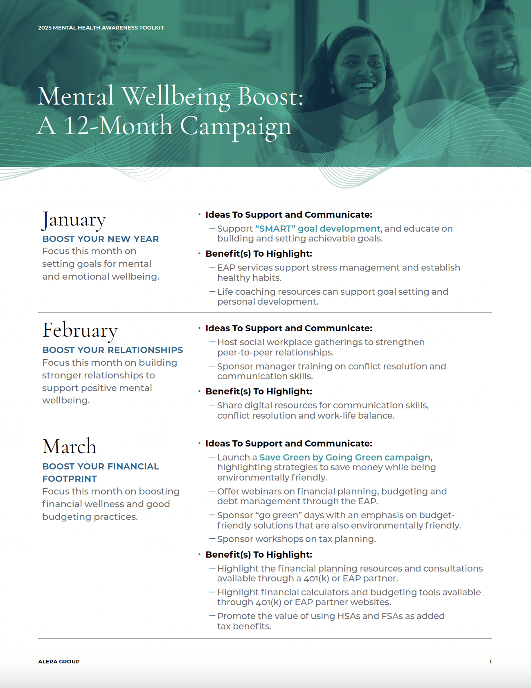
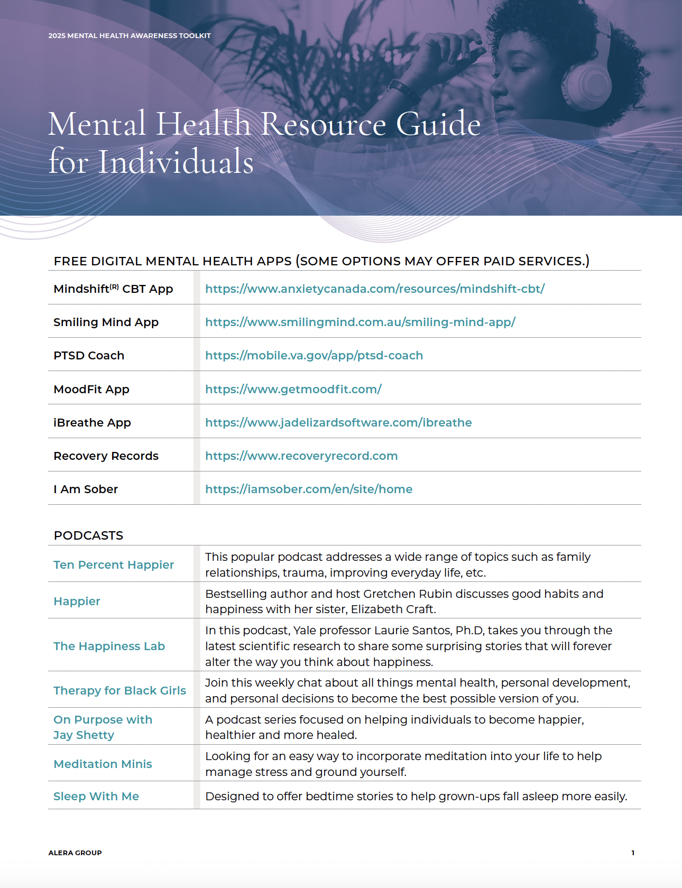
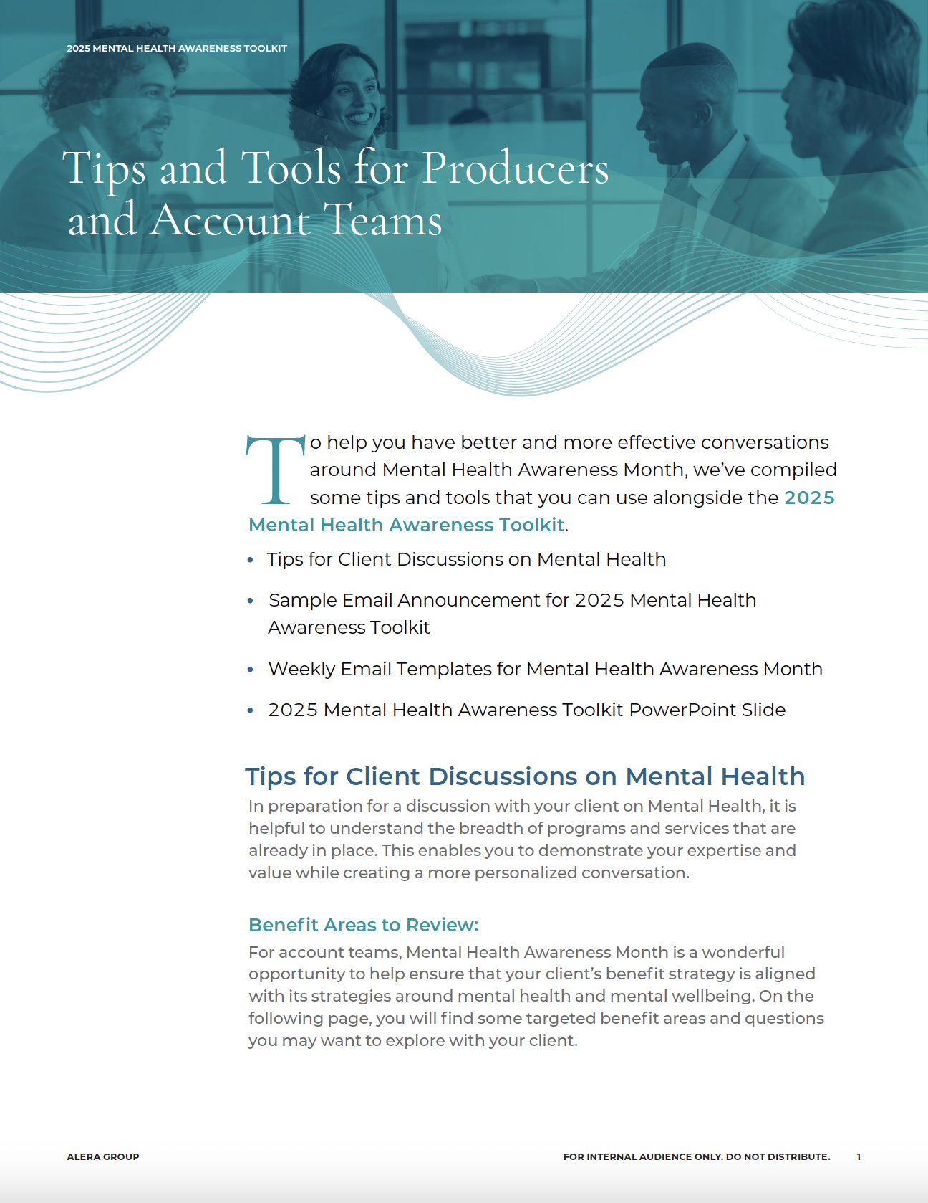
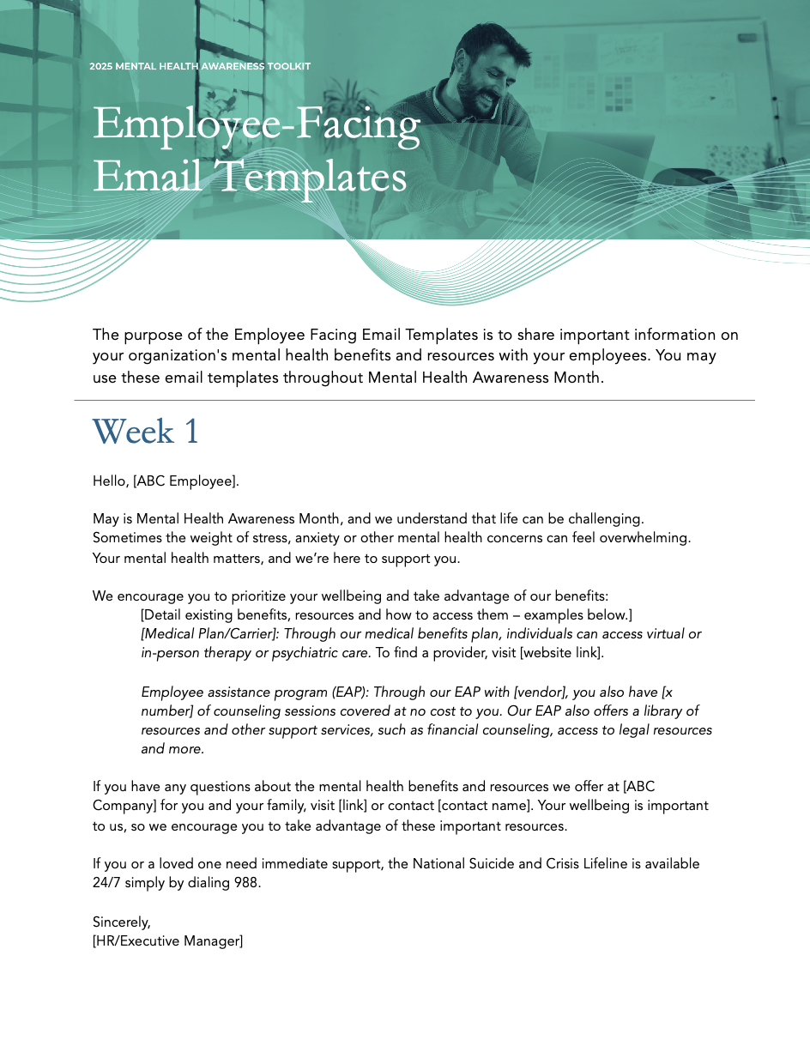
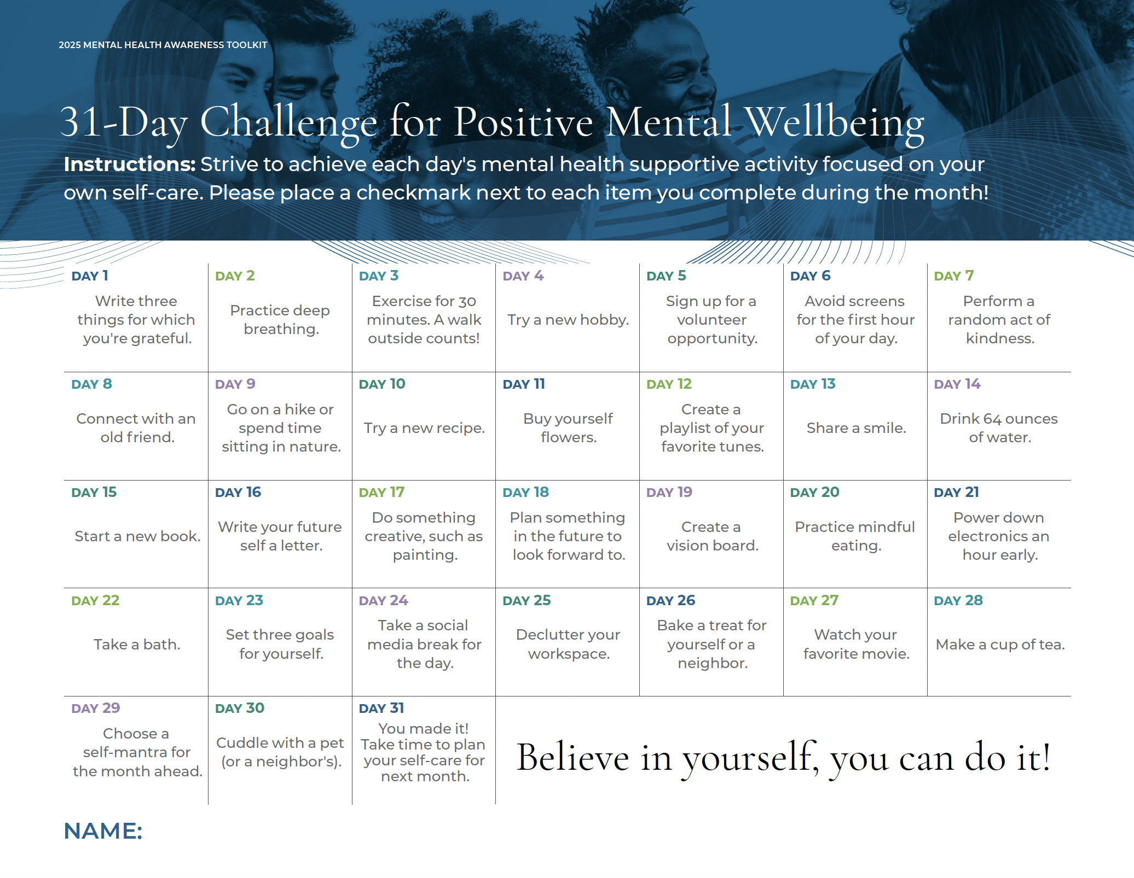
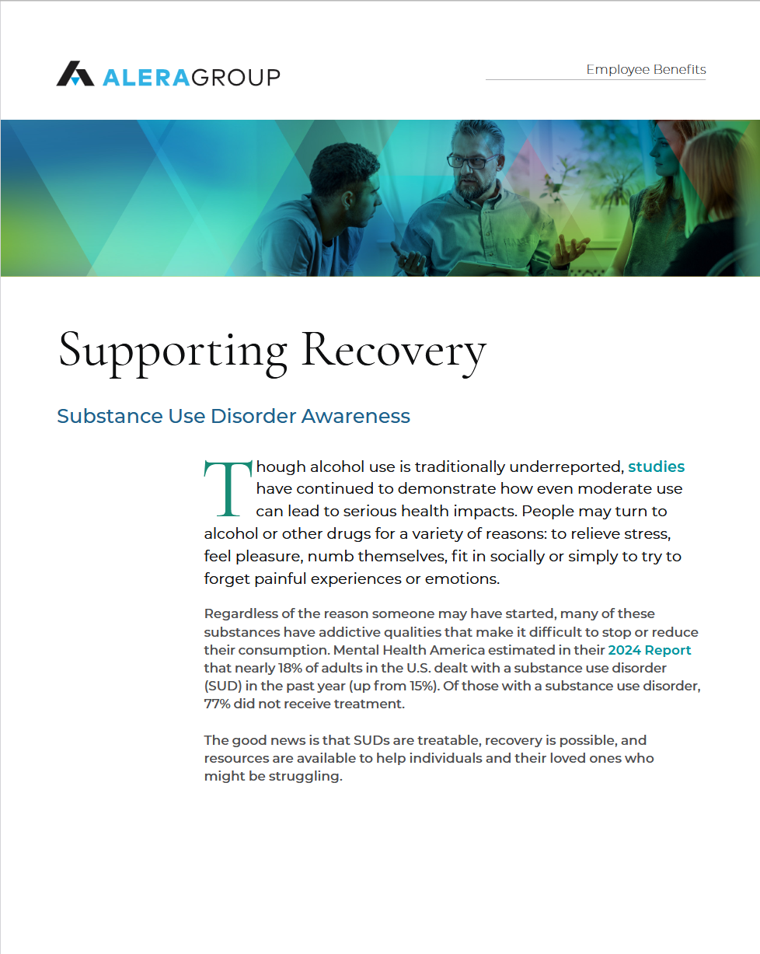
Conversation Prompts
As you look at your benefit offerings, do you feel that there are gaps where additional mental health resources would be valuable to your employees?
Do your leaders and managers receive training to recognize and address employee wellbeing concerns? Are they equipped and confident in providing appropriate resources to employees who need support?
Are employees well-informed about the mental health and substance use resources your organization provides? Do they understand how to access these resources, and do they feel safe in doing so?
2025 Mental Health Awareness Toolkit: https://bit.ly/mhatoolkit25
Notes:
Each year, Alera Group launches a comprehensive Mental Health Awareness Toolkit. This toolkit aims to empower employers as they strive to cultivate a thriving and supportive workplace. This years toolkit features:
A newly designed Mental Health Workplace Guide,
New Virtual Backgrounds,
Mental Health-theme video content,
A year-long Mental Wellbeing Boost campaign, and
A 31-day employee challenge.
Visit the post on ARCH (search mental health toolkit) to find all the tools you need to share this toolkit with clients and prospects including sample email templates, zoom backgrounds, tips for client/prospect discussions on mental health, and more.

Slide 20








Supporting Mental Health & Substance Use
Employer Strategies
Access and Timeliness
Growing Carrier partnerships
3rd Party Solutions
  Enhanced EAPs
  Mental Health & Substance Use Platforms
  Navigation Support
Training and Education
Employee Resource Groups and Peer Networks
Supportive policies
Non-stigmatizing language
Stigma
Engagement and Community
Cost
Training
Policies
Culture
Communications

Slide 21

Your ideas and insights help to drive future wellbeing conversations, toolkits and resource development!

Slide 22
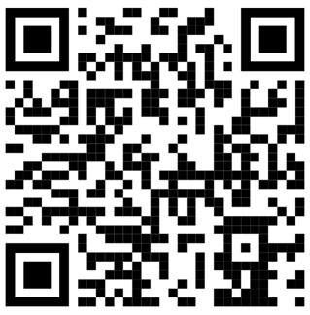
Contact
Andrea Davis
andrea.davis@aleragroup.com
646.732.8754
Gretchen Day
gretchen.day@aleragroup.com
302.228.8892
Wellbeing Inbox
wellbeing@aleragroup.com

