Slide 1
Mental Health Trends 2024
Kaycee DeGabriele and Lee Williams
May 14, 2025

Slide 2
MENTAL HEALTH
Overall Trends
Mental health prevalence has continued to increase from 2021 (+25%) now impacting 197 per 1,000 members (medical claims data).
Most notable increase seen has been anxiety, the most prevalent condition, which increased from 67 per 1,000 members in 2021 to 87 per 1,000 members in 2024.

Slide 3
MENTAL HEALTH
Overall Dependent Type and Age Group Trends
Mental health condition prevalence was relatively comparable among all dependent types from 2021-2023.
In 2024, prevalence significantly increased among EE/spousal population when compared to children.
Increase in the diagnosis of mental health conditions has been seen year over year among member 18+ and under 18 years of age.

Slide 4
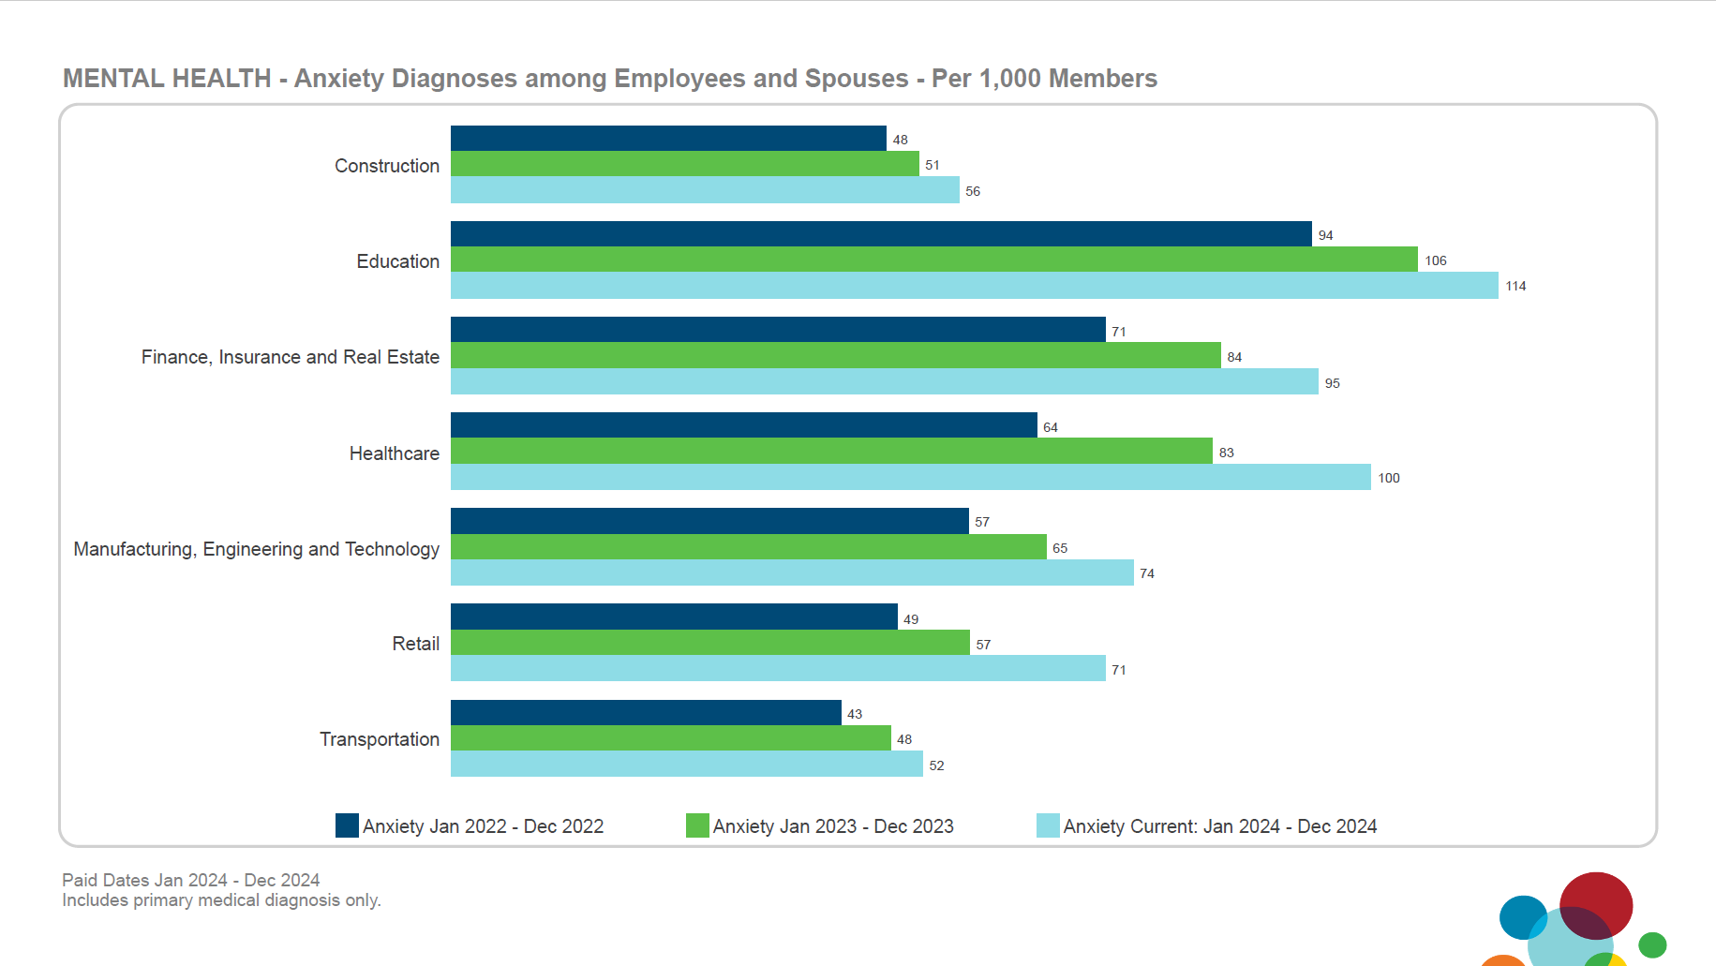

Slide 5
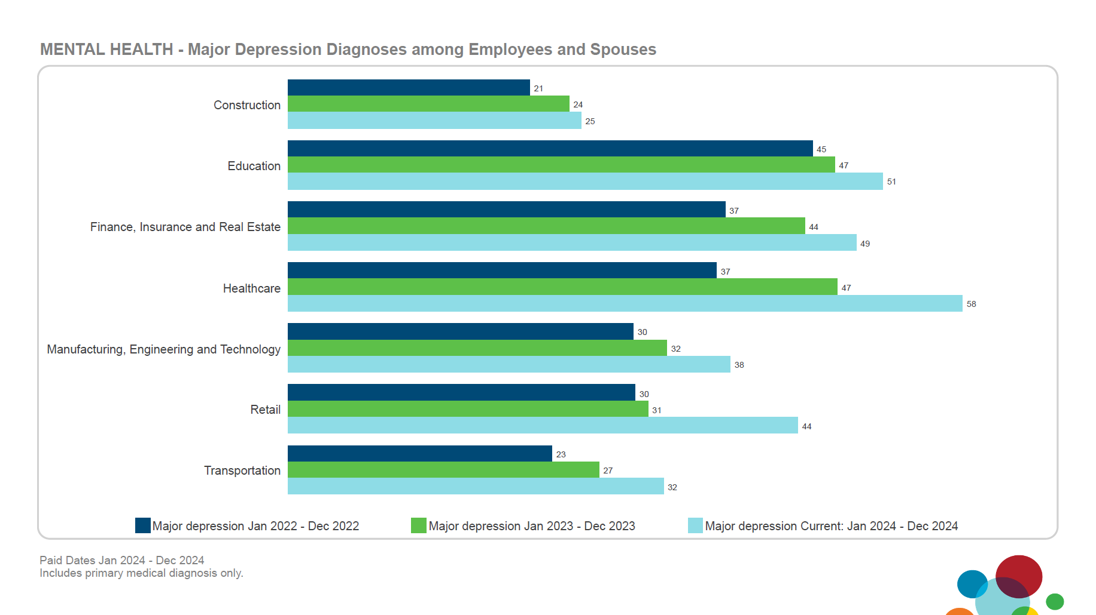

Slide 6
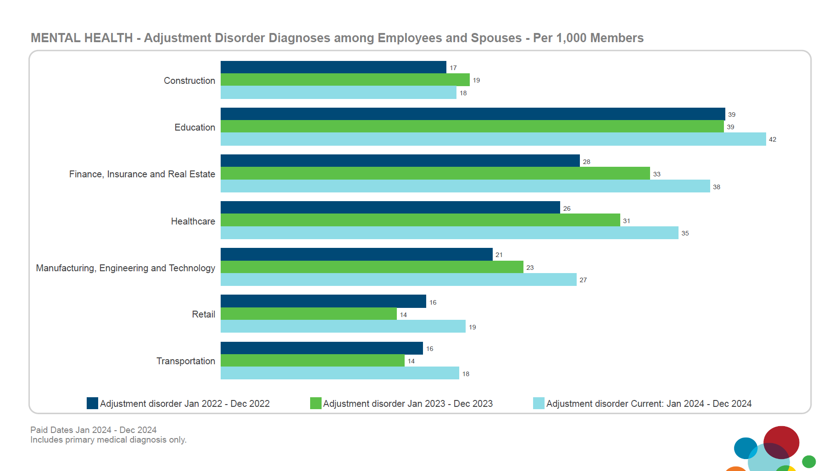
Intentional and regular promotion of mental health topics and resources may help to improve acceptance, address shame and encourage members to seek help before conditions escalate.

Slide 7
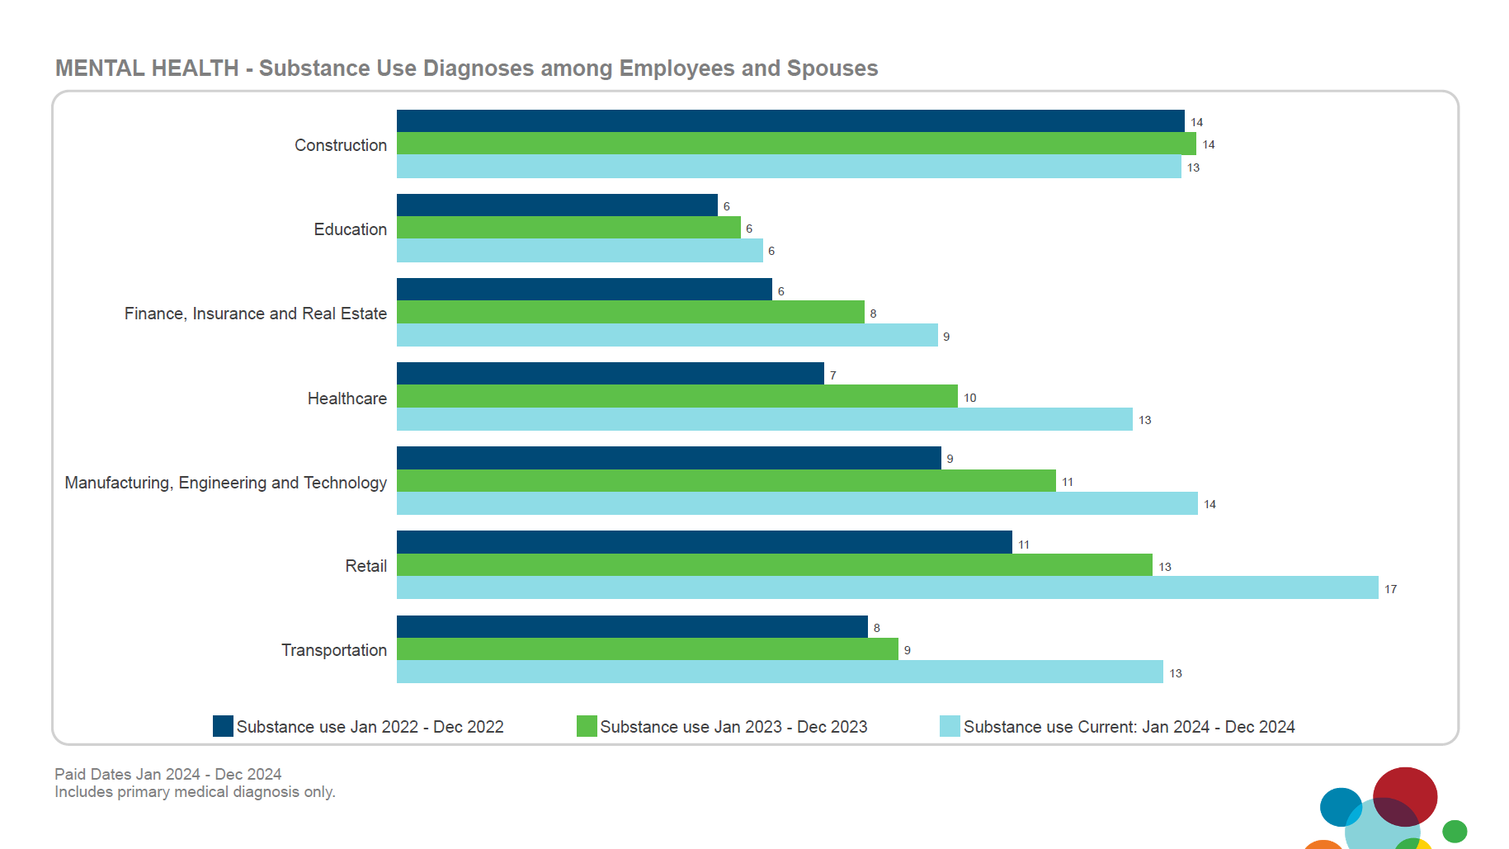
Integrating HR files with job title information may provide additional insight into the units of an organization experiencing the highest prevalence of mental health diagnoses.

Slide 8
MENTAL HEALTH
Out Of Network Utilization and Cost Trends
Substance Abuse Out of Network claims are the most expensive individual diagnosis driven by Inpatient and Rehabilitation facility costs.

Slide 9
MENTAL HEALTH
In 2024, BCBSTX experienced a 313% increase in PMPM costs and a 114% increase in Mbrs per 1,000 utilization for Out of Network Mental Health claims.
Out Of Network Utilization and Cost By Carrier

Slide 10
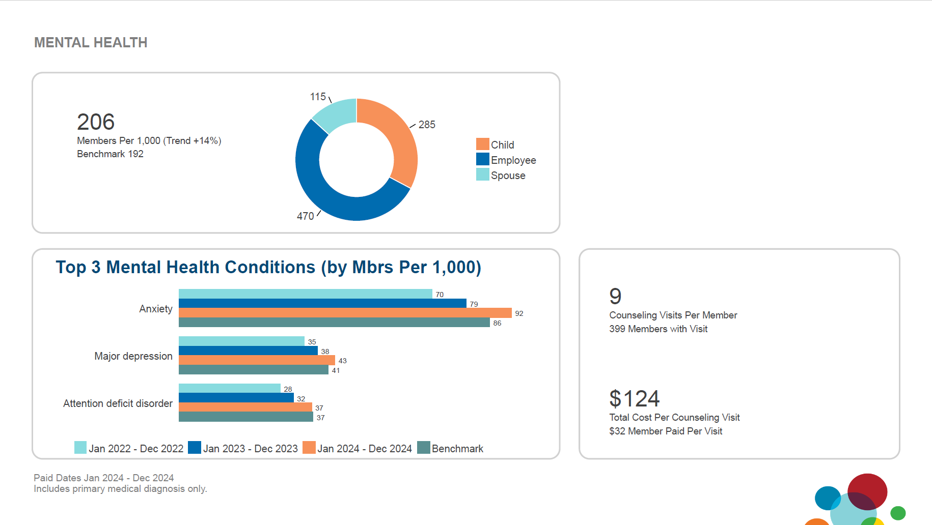
- Example Report Exhibit
The population’s mental health diagnostic prevalence has increased since 2022 and is above benchmarks for anxiety and major depression.
Overall prevalence of mental health diagnoses is above benchmarks.
Utilize a home mailer to education spouses and dependents about available EAP resources.

Slide 11
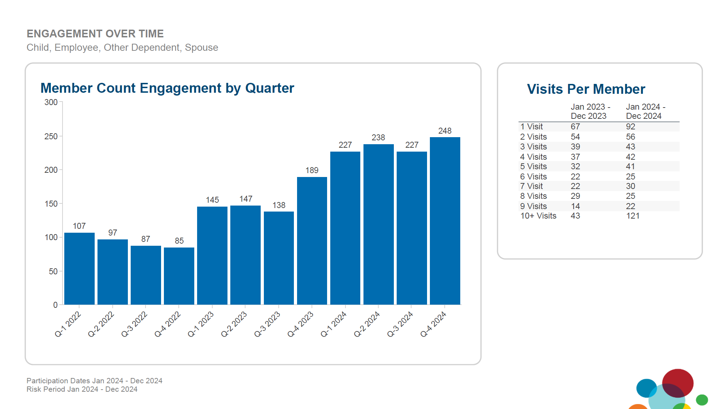
Average of 6.6 visits per member
3,416 visits total visits (2023= 2,236 visits)
Avg. plan visit cost $81= Plan savings ~$277k
Avg. mbr visit cost $50= Member Savings ~$171k

