Slide 1
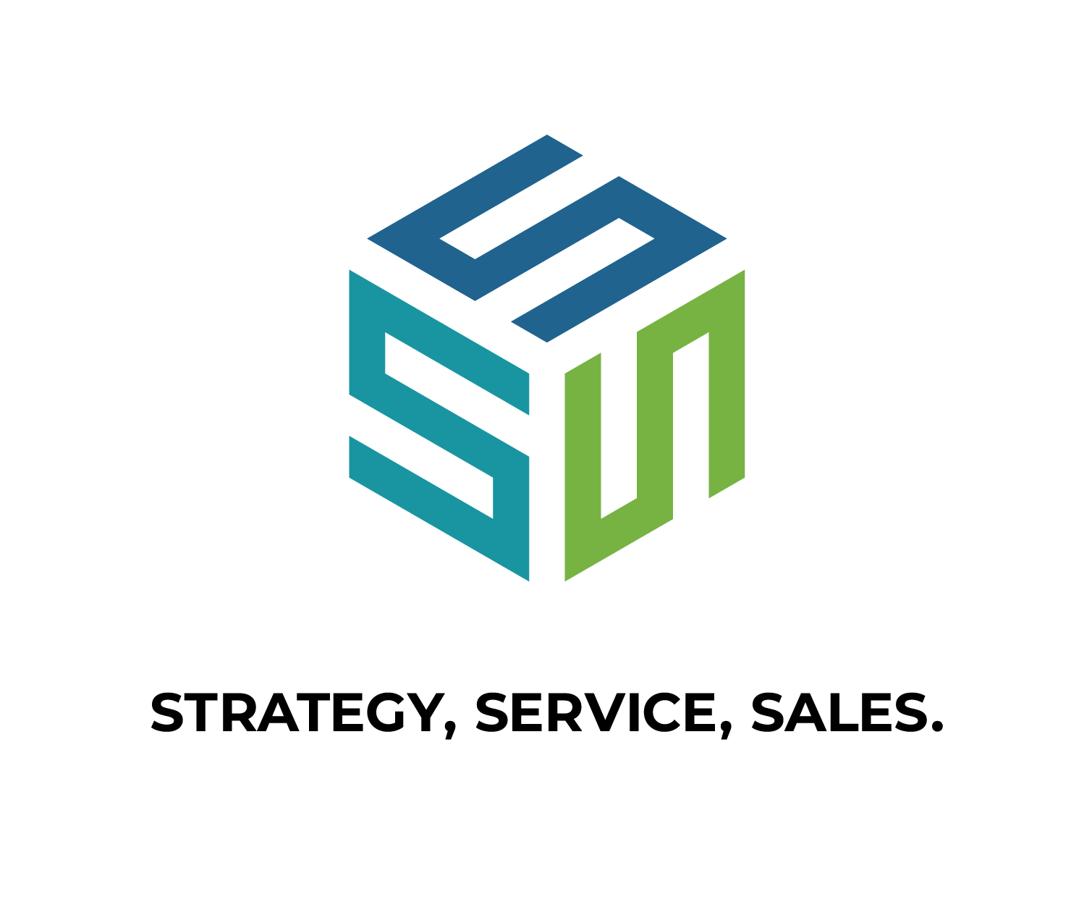
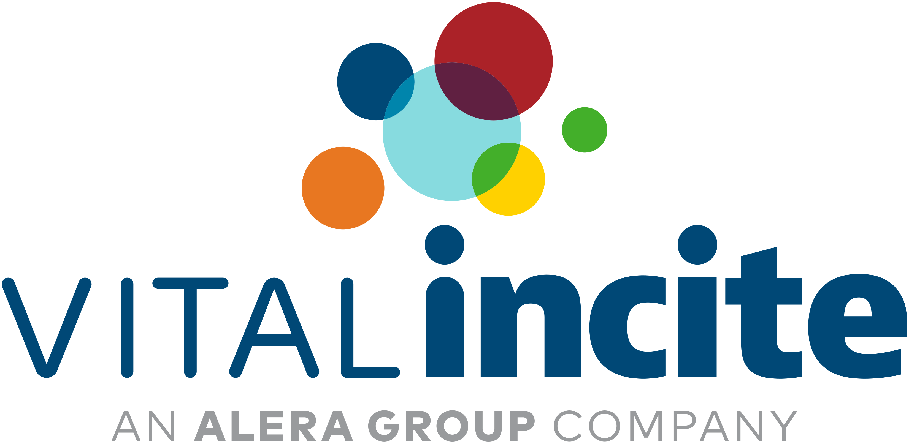
Musculoskeletal
Trends and Strategic Approaches to Musculoskeletal Spend
Andrea Lausch, PT, DPT

Slide 2
Unpacking the Impact of MSK on Plan Spend
2024 Top 5 MEDC | Plan Paid PMPM | Mbrs per 1000
General Health | $65 | 734
Musculoskeletal | $58 | 294
Malignancies | $38 | 33
Cardiovascular | $37 | 217
General Surgery | $34 | 197
In 2024, MSK was the second highest medical cost driver for Vital Incite’s book of business.
MSK Surgeries were the top procedure driver of spend driven by spine and total joint replacements.
2024 Top 5 EDC | Plan Paid PMPM | Mbrs per 1000
Musculoskeletal disorders | $11 | 86
Degenerative joint disease | $11 | 35
Low back pain | $8 | 87
Fractures (excluding digits) | $6 | 22
Acute sprains and strains | $4 | 50
Spine and other surgical procedures
Total Joints
Accidents?
Repetitive Injuries

Slide 3
Steady Climb: MSK Prevalence and Costs Trends
MSK Mbr/1000 Trend | 2021 | 2022 | 2023 | 2024
Musculoskeletal | 280 | 287 | 292 | 294
MSK Plan Paid PMPM Trend | 2021 | 2022 | 2023 | 2024
Musculoskeletal | $53 | $56 | $56 | $58
MSK prevalence and spend continue to steadily rise. This is not a one-year issue, it’s a trend.
High prevalence + rising costs = Need for strategic considerations
Notes:
Clients with MSK programs have lower MSK PMPM compared to clients without a MSK program.
Trends inpatient outpat trends and what’s driving inpat. Per 1000 and cost
Compare total joints to imaging to PT/chiro costs
PT preventative care-talk to Mary about what the ACA does allow
LBP research industry

Slide 4
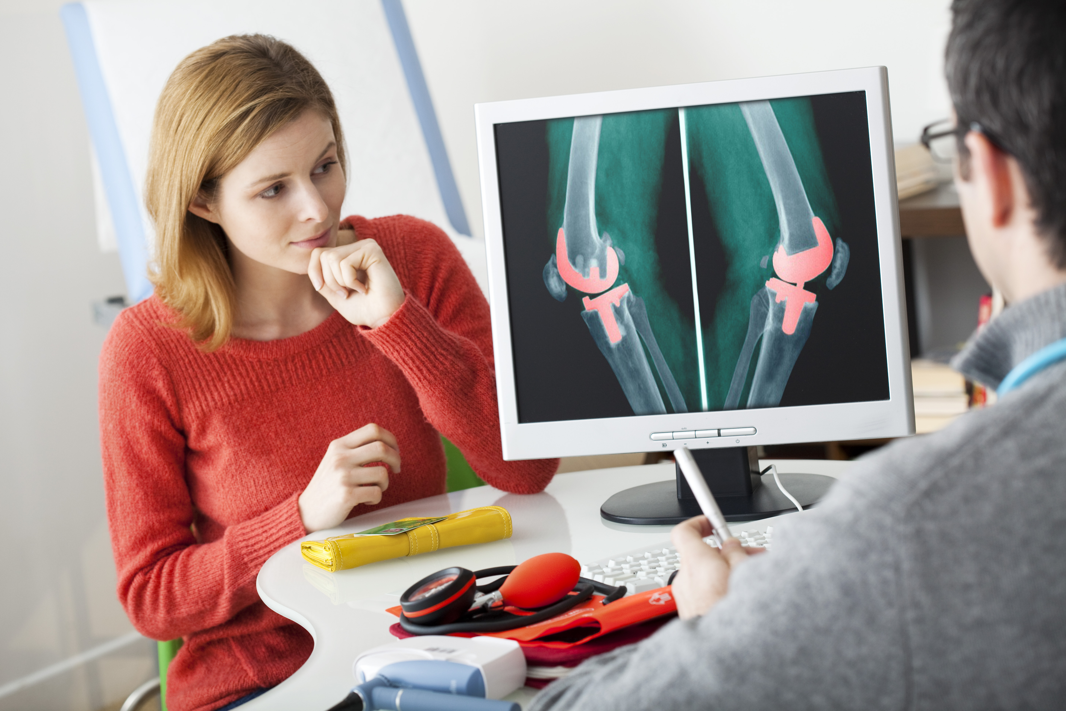
Market trends shaping the Future of Musculoskeletal Care
Expansion of Digital Health Solutions and integration of Artificial Intelligence in Physical Therapy
Emphasis on Non-Surgical Therapies
A shift toward conservative care (physical therapy, chiropractic care, regenerative medicine (PRP, Stem cell, Biologic products (placental), etc).
Advancements in Total Joint Surgeries
Orthopedic Devices, Smart Implant, and innovative surgical advancements
Notes:
Nonsurgical therapies: These therapies offer less invasive options and aim to provide effective treatments with fewer risks and more cost efficiently than surgery.
Digital Health Solutions: In-Clinic Care + Digital Home-Exercise Platform with Care Navigation; The program is designed to increase at-home exercise adherence, improve member outcomes, and prevent unnecessary hospitalizations and downstream adverse effects and associated costs
Surge fueled by the rising prevalence of MSK disorders and the demand for personalized, remote patient management solutions.
Digital solutions play a key role in managing MSK conditions and enhancing patient outcomes.
AI-powered solutions and remote therapeutic monitoring offer personalized exercise routines and pain management advice via apps, reducing waiting times for patients.
Artificial Intelligence (AI) and Machine Learning
Advancement: AI and machine learning are being integrated into joint surgery planning, helping surgeons to predict outcomes, optimize implant choice, and plan for patient-specific considerations. AI-based systems are also improving post-operative monitoring by predicting complications before they arise.
Impact on Costs and Outcomes:
Outcomes: Improved surgical planning, reduced complications, and more personalized treatment plans.
Costs: AI and machine learning tools can initially be costly, but their potential to improve surgical precision, reduce errors, and lower complication rates can ultimately result in long-term cost savings.
Conservative care vs Surgery: One year follow up outcomes for conservative care such as PT or chiropractic care vs surgical care shows similar outcomes, but lower cost associated with conservative care.
Biologics and Regenerative Medicine
Advancement: Emerging therapies, such as platelet-rich plasma (PRP) and stem cell injections, are being explored as treatments to delay or enhance the outcomes of total joint replacements. These biologics may help with tissue healing, reducing inflammation, or even improving cartilage regeneration.
Impact on Costs and Outcomes:
Outcomes: Potentially faster recovery and better long-term joint function.
Costs: While biologics can be expensive, they may reduce the need for future surgeries and revisions, resulting in long-term savings. However, more research is needed to determine their overall cost-effectiveness.
🩸 1. Platelet-Rich Plasma (PRP) Therapy
What it is: Concentrated platelets from the patient's own blood.
Common uses: Tendinopathies (e.g., tennis elbow), osteoarthritis, ligament sprains, muscle injuries.
Mechanism: Platelets release growth factors that promote tissue healing.
🧬 2. Stem Cell Therapy
What it is: Use of mesenchymal stem cells (MSCs), typically harvested from:
Bone marrow (BMAC: Bone Marrow Aspirate Concentrate)
Adipose (fat) tissue
Common uses: Cartilage repair, osteoarthritis, disc degeneration, soft tissue injuries.
Mechanism: MSCs may differentiate into cartilage, bone, or other tissues and modulate inflammation.
💉 3. Prolotherapy (Proliferative Therapy)
What it is: Injection of an irritant solution (often dextrose) to stimulate the body’s healing response.
Common uses: Chronic ligament or tendon injuries, joint instability.
Mechanism: Induces mild inflammation to promote tissue repair and strengthen connective tissue.
🧪 4. Amniotic/Placental Tissue Products
What it is: Biologic products derived from donated placental tissue, rich in growth factors and cytokines.
Common uses: Tendon injuries, joint degeneration.
Mechanism: Anti-inflammatory and regenerative properties, though these are typically not live-cell therapies.
🧱 5. Autologous Conditioned Serum (ACS) / IRAP
What it is: Blood is processed to increase anti-inflammatory cytokines (e.g., IL-1Ra).
Common uses: Osteoarthritis, joint inflammation.
Mechanism: Modulates the inflammatory response in joints.
🧫 6. Extracellular Vesicles / Exosomes (emerging/experimental)
What it is: Cell-derived vesicles that carry signals between cells.
Potential use: Similar to stem cells but without live cells—being researched for orthopedic repair.
🧍 7. Tissue Engineering / Scaffolds
What it is: Bioengineered scaffolds (often biodegradable) sometimes combined with cells or growth factors.
Common uses: Cartilage repair, meniscus or ligament reconstruction.
Mechanism: Provides a framework for new tissue growth.
Growth in Orthopedic Devices and Smart Implants improving outcomes
Minimally invasive surgeries
Robotic-Assisted Surgery
Custom and Patient-Specific Implants
Improved Implant Materials
Smart devices
Development of Enhanced Recovery pathways
Streamlined outpatient procedures and early physical therapy.

Slide 5
Other Factors Contributing to Rising MSK spend
Rising Healthcare costs
Aging workforce
New hire injuries
Obesity/chronic conditions
Anxiety/depression
Sedentary lifestyles
And more…
Notes:
Digital Health Solutions:
Surge fueled by the rising prevalence of MSK disorders and the demand for personalized, remote patient management solutions.
• Digital solutions play a key role in managing MSK conditions and enhancing patient outcomes.
The global digital health market for MSK care is projected to grow from USD 4.4 billion in 2024 to USD 11.6 billion by 2030.
AI-powered solutions and remote therapeutic monitoring offer personalized exercise routines and pain management advice via apps, reducing waiting times for patients.
Conservative care vs Surgery: One year follow up outcomes for conservative care such as PT or chiropractic care vs surgical care shows similar outcomes, but lower cost associated with conservative care.
Biologics and Regenerative Medicine
Advancement: Emerging therapies, such as platelet-rich plasma (PRP) and stem cell injections, are being explored as treatments to delay or enhance the outcomes of total joint replacements. These biologics may help with tissue healing, reducing inflammation, or even improving cartilage regeneration.
Impact on Costs and Outcomes:
Outcomes: Potentially faster recovery and better long-term joint function.
Costs: While biologics can be expensive, they may reduce the need for future surgeries and revisions, resulting in long-term savings. However, more research is needed to determine their overall cost-effectiveness.
Artificial Intelligence (AI) and Machine Learning
Advancement: AI and machine learning are being integrated into joint surgery planning, helping surgeons to predict outcomes, optimize implant choice, and plan for patient-specific considerations. AI-based systems are also improving post-operative monitoring by predicting complications before they arise.
Impact on Costs and Outcomes:
Outcomes: Improved surgical planning, reduced complications, and more personalized treatment plans.
Costs: AI and machine learning tools can initially be costly, but their potential to improve surgical precision, reduce errors, and lower complication rates can ultimately result in long-term cost saving
7. Artificial Intelligence (AI) and Machine Learning
Advancement: AI and machine learning are being integrated into joint surgery planning, helping surgeons to predict outcomes, optimize implant choice, and plan for patient-specific considerations. AI-based systems are also improving post-operative monitoring by predicting complications before they arise.
Impact on Costs and Outcomes:
Outcomes: Improved surgical planning, reduced complications, and more personalized treatment plans.
Costs: AI and machine learning tools can initially be costly, but their potential to improve surgical precision, reduce errors, and lower complication rates can ultimately result in long-term cost savings.
Growth in Orthopedic Devices and Smart Implants improving outcomes
The orthopedic devices market is projected to surpass USD $65.79 billion in 2025 and reach USD $92.42 billion by 2033
Minimally invasive surgeries
Robotic-Assisted Surgery
Custom and Patient-Specific Implants
Improved Implant Materials
Smart devices
Development of Enhanced Recovery pathways
Streamlined outpatient procedures and early physical therapy.

Slide 6
Traditional Pathway vs Evidence-Based, Value Stream Approach
Research shows PT First vs. primary care or specialist visits this leads:
>50% total cost savings
reduces MRI use from 42% to 6%
Cuts prescription use by 73%
Keeps 94% of patients at work.
The traditional MSK care model lacks evidenced-based design, driving up costs through unnecessary services.
Virginia Mason Example For a Pathway For Low Back Pain Management McDonald, P. A., Mecklenburg, R. S., & Martin, L. A. (2015, July). The Employer-Led Health Care Revolution. Retrieved from https://hbr.org/2015/07/the-employer-led-health-care-revolution
Notes:
Reduce risk of injury
Minimize engagement in the healthcare system
Reduce direct/indirect costs associated with musculoskeletal injury.
For groups with higher MSK and/or high Occ Health spend, an onsite PT prevention and wellness program can be very cost effective.
Partnering with a provider in which a PT is onsite allows PTs to evaluate work demands and conditions and perform post offer preemployment screens or annual PT physicals to catch emerging conditions early and provide education on how to prevent MSK injuries, further reducing the risk of injury.
When onsite is not an option or for plan members not onsite these screens or this type of education may be done through telehealth or in office visits.
If minor injuries develop, prevention programs allow PTs to quickly teach strategies to promote tissue healing and reduce complications.
Lastly, they can triage plan members and employees to other medical providers as needed or begin early intervention PT to minimize further engagement in the healthcare system.
Decreased Downstream Healthcare costs with:
Early access to PT within days to weeks of symptom onset or injury
Direct PT vs MD referral
Evidenced Based Care adherent to Clinical Practice Guidelines
Research supports that when PT starts within days to weeks of injury the likelihood of additional MD visits, major surgery, injections, opioid medications, and advanced imaging decreases by nearly 50% and reduces subsequent health care costs of over $2700 compared to starting PT after 30 days.
When patients directly access PT it reduces visits by 27% than when referred by a physician.
When care is adherent to clinical practice guidelines, research has found a cost savings of over $1300 per episode of care.
Fritz, JM Primary care referral of patients with low back pain to physical therapy: impact on future healthcare utilization and costs. Spine 25 2114-21
Better Outcomes Associated with Early Physical Therapy for Injured Workers with Low Back Pain, WCRI Study | WCRI (wcrinet.org)
Pendergast J et al. A comparison of health care use for physician-referred and self-referred episodes of outpatient physical therapy. Health Serv Res. 2012 Apr;47(2):633-54. doi: 10.1111/j.1475-6773.2011.01324.x. Epub 2011 Sep 23.
Fritz JM et al. Physical therapy for acute low back pain: associations with subsequent healthcare costs. Spine (Phila Ps 1976) 2008 Jul 15;33(16):1800-5. Physical therapy for acute low back pain: associations with subsequent healthcare costs - PubMed (nih.gov)

Slide 7
Is High MSK Spend Driven by Overuse or High-Cost Services?
Procedure
Cost Range
Utilization
MRI
$300-$9,000
>41Mbr/1000
Total Joint Replacements
$15k-$99k
Pain Rx
$4 - $4400
>86Mbr/1000
Physical Therapy
$85 - $700
6-24 visits
Chiropractic
$25-$300
6-50 visits
ER
$1,960
34 Mbr/1000
Notes:
PT 9 visits average in 2024, $134/visit
CT: $1,061
X-ray: $107
Chir: $66/visit and average of 12 visits

Slide 8
Musculoskeletal Risk Reduction Strategies
Prevention
Ergonomics, Job Function Matching Body Mechanic Education
Stretching Programs
Workplace Exercise and Strength Training
Early intervention, First Aid
Early Conservative care (PT First)
Site of Service
Partnerships with High-Value, Cost-Effective Providers
Notes:
Prevention and Early Conservative Care Goal: Reduce the risk of injury and Minimize engagement in the healthcare system and decreased downstream healthcare costs and promote a value-based care pathway.
For groups with high prevalence of MSK and/or high Occ Health reportable injuries and spend, an onsite PT prevention and wellness program can be very cost effective.
Partnering with a provider in which a PT is onsite allows PTs to evaluate work demands and conditions and perform post offer preemployment screens
If minor injuries develop, prevention programs allow PTs to quickly teach strategies to promote tissue healing and reduce complications.
Ergonomic Analysis/Job Description Development
Industrial Ergonomics
Office Ergonomics
Job Function Matching
Return to Work (Fit for Duty) Testing
Stay at Work (Fit for Duty) Testing
Pre-Work Stretching Program
Employee MSK Prevention Training
Body Mechanics
Ergonomic Awareness
Job Task Specific
Wellness Programs
Screens through Onsite Clinic (Wellness initiative)

Slide 9
Musculoskeletal Risk Reduction Strategies
Virtual or Digital MSK programs
Onsite/Direct Contract Rehabilitation
Targeted MSK Solutions
Surgical
Steerage/Cost Efficiency
Surgical Centers of Excellence
Notes:
Virtual or Digital MSK Program:
Positives
Plan members: Reduces barriers to care immediate access, no time away from work or home to participant, no OOP costs
Great option for an employer in a rural community or one with employees spread out across a region or the country
Low cost and great results for low complexity MSK issues
Able to provide prevention, early acute management education to minimize progression of a condition.
Cons
Some cases need hands on care. Programs cost-efficient high-quality refer members to in person care or onto other specialty providers if needed.
Programs often have a PEPM pay structure.
Onsite/Direct Contract Rehabilitation
Pros
Drives members toward lower cost first contact conservative care
Reduces barrier of traveling to offsite locations with higher cost and financial barriers to the member.
Able to vet the high-quality providers
Providers learn the culture of the company, build trust and relationship with EEs, understand physical work/job demands of EEs, and align goals to provide cost-efficient high-quality care and prevent unnecessary injuries or referrals outside of the Rehab service. Can steer care to preferred providers when referring outside.
Flexibility: Can start small with limited hours, i.e. 10 hours/week and expand as needed.
Cons:
Need a dedicated space
Steerage/Cost Efficiency-Surgical
Pro
Most surgeries do not need a COEs to have high-quality outcomes, local communities often have high quality providers available for routine MSK surgeries.
Options:
Direct Contract with local providers for total joints and other MSK surgeries: Incentivize use of providers covering OOP expenses and/or incentive dollars and covering travel expenses if the provider is out of town and requires an overnight stay.
No direct contract and steer members toward preferred providers offering incentive dollars to have procedures at those locations.
Con
Need to establish/manage the direct contract
Potential for overuse reducing financial barriers.
Surgical COE
Value considering this option if there are not local providers to create steerage toward or for high-cost spine surgeries.

Slide 10
Musculoskeletal Risk Reduction Strategies
Acuity of Care Considerations
Virtual or Digital MSK programs
Onsite Rehabilitation
Steerage/Cost efficiency
Surgical Centers of Excellence
Notes:
Virtual or Digital MSK Program:
Positives
Plan members: Reduces barriers to care immediate access, no time away from work or home to participant, no OOP costs
Great option for an employer in a rural community or one with employees spread out across a region or the country
Low cost and great results for low complexity MSK issues
Able to provide prevention, early acute management education to minimize progression of a condition.
Cons
Some cases need hands on care. Programs cost-efficient high-quality refer members to in person care or onto other specialty providers if needed.
Programs often have a PEPM pay structure.
Onsite/Direct Contract Rehabilitation
Pros
Drives members toward lower cost first contact conservative care
Reduces barrier of traveling to offsite locations with higher cost and financial barriers to the member.
Able to vet the high-quality providers
Providers learn the culture of the company, build trust and relationship with EEs, understand physical work/job demands of EEs, and align goals to provide cost-efficient high-quality care and prevent unnecessary injuries or referrals outside of the Rehab service. Can steer care to preferred providers when referring outside.
Flexibility: Can start small with limited hours, i.e. 10 hours/week and expand as needed.
Cons:
Need a dedicated space
Steerage/Cost Efficiency-Surgical
Pro
Most surgeries do not need a COEs to have high-quality outcomes, local communities often have high quality providers available for routine MSK surgeries.
Options:
Direct Contract with local providers for total joints and other MSK surgeries: Incentivize use of providers covering OOP expenses and/or incentive dollars and covering travel expenses if the provider is out of town and requires an overnight stay.
No direct contract and steer members toward preferred providers offering incentive dollars to have procedures at those locations.
Con
Need to establish/manage the direct contract
Potential for overuse reducing financial barriers.
Surgical COE
Value considering this option if there are not local providers to create steerage toward or for high-cost spine surgeries.

Slide 11
The Case for Incentivizing Place of Service

Slide 12
Factors Influencing Inpatient vs. Outpatient Total Joint Arthroplasty
1. Patient age, comorbidities, and social disparities impact site of service.
Advanced age (65+),
higher BMI (>30),
multiple chronic conditions (4+)
more social disparities.
2. Surgical techniques, late-day surgeries, and anesthesia practice make
Notes:
Risk Assessment and Prediction Tools help determine appropriate surgical setting.
Evaluate patient mobility, support system, and overall health.
Late-day surgeries may result in inpatient stays, arriving at post anesthesia care unit after 12:00pm
Resources
Health Policy and Economics Volume 38, Issue 9, P1568-1662; Sep 2023. Patient Designation Prior to Total Knee Arthroplasty: How Can Preoperative Variables Impact Postoperative Status?
Primary Hip and Knee Arthroplasty Volume 37, Issue 11 P2140-2148. RAPT Score Predicts Inpatient Vs Outpatient Status and Readmission Rates After IPO Changes for Total Joint Arthroplasty: An Analysis of 12,348 Cases.
European J Of Orthopaedic Surgery and Traumatology V 34, P2413-2419 (2024). Assessing social disparities in inpatient vs outpatient arthroplasty: a in-state database analysis
https://midamortho.com/outpatient-vs-inpatient-total-knee-replacement-surgery-tkr/
https://www.arthroplastyjournal.org/article/S0883-5403(23)00455-2/abstract
https://www.arthroplastyjournal.org/article/S0883-5403(22)00588-5/abstract?utm_source=chatgpt.com
Social disparities: https://link.springer.com/article/10.1007/s00590-024-03922-w?utm_source=chatgpt.com
https://josr-online.biomedcentral.com/articles/10.1186/s13018-023-03750-4
https://midamortho.com/outpatient-vs-inpatient-total-knee-replacement-surgery-tkr/

Slide 13
Case Example: Ford Meter Box
Industry: Manufacturing, Waterworks Products
Location: Wabash, Indiana (rural community)
Problem: High MSK spend and Prevalence
Solution:
Steerage Strategy: Direct contract with Ft. Wayne facility for MSK Surgeries.
Incentive: Deductible and Out-of-Pocket expenses paid by employer
Covers mileage for appointments (60 miles away)
Covers hotel stay and 2 meals if surgery is before 10am
Onsite Rehabilitation: ATC
ATC started at 20 hours/week
Expanded hours to 40 hours/week as the value of the program warranted expansion.
Early intervention/Acute care management, Prevention (Ergonomics, Body Mechanics, Physical Activity promotion), steerage to PT or other cost-efficient providers as needed.
Notes:
2020 was start of Host Care program

