Slide 1
Alera Sales Strategies
Mary Delaney
All Alera Team Members

Slide 2
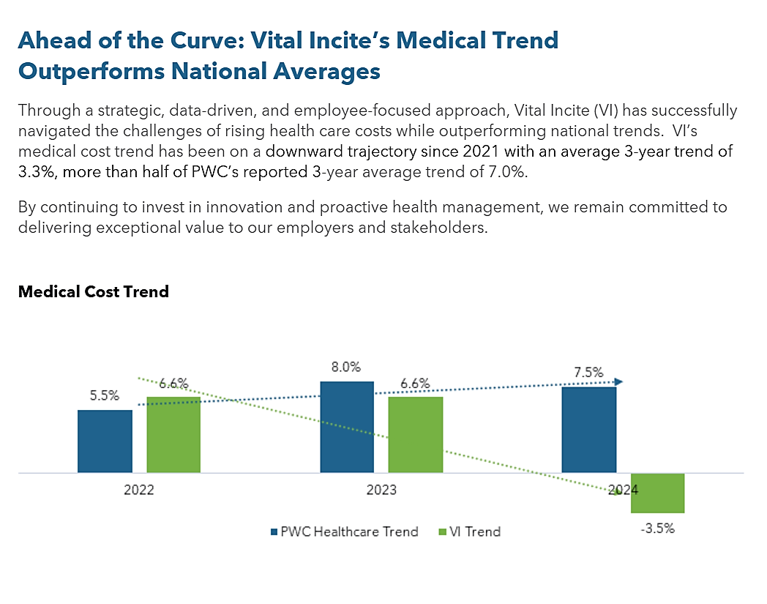
Levering Objective Data Matters
Data-driven, strategic, employee focused approach
Navigate the ever-changing challenges in health plan management objectively
The impact: Alera’s VI trend 3.3%, PWC’s tend 7%

Slide 3
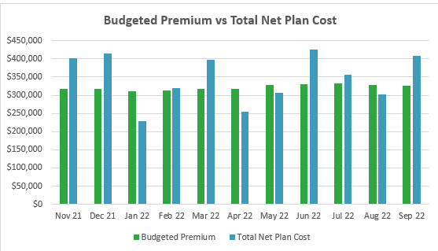
Definition of Success Vital Incite
Success for Employers
Improve plan spend
Improve risk migration
Improve EE appreciation
Feel comfortable in their decisions- Fiduciary Responsibility
Success for Advisors
Advisors feel fully supported to make stronger strategic changes
Employers’ decisions come easier
Confidence in their relationship with clients
Growth of Alera
Notes:
Tell the story about Bill’s small client- <100 ee wellness plans, so expensive. They make $1M per employee- these people are important. Some may have analytics.. But is it solving for what you need? Are they able to drill into the detail to answer the questions, find the right strategy, or even explain, in detail what happened and is what they paid for correct? How will you protect them moving forward?
You don’t move forward without objective information. That information is generated by Vital Incite.

Slide 4
Do our goals match?
Success for Employers
Improve plan spend
Improve risk migration
Improve EE appreciation
Feel comfortable in their decisions- Fiduciary Responsibility
Success for Advisors
Advisors feel fully supported to make stronger strategic changes
Employers’ decisions come easier
Confidence in their relationship with clients
Growth of Alera

Slide 5
Vital Incite’s Efforts

Slide 6
Who do we market to…
Large employers that do not have one relationship with an Advisor
Do not market where we have an Alera office other than general prospect marketing
Support Alera prospects
Responding to RFP questions
Finalist presentations
Offer other things to support Alera
References

Slide 7
National Presentations
Clients Love Recognition

Slide 8
Alera Hosted Events
February
South Carolina
CFO Council
March
Alera Group Employee Benefits Symposium
Alera- Midwest
June
Employee Benefits Summit for Georgia Employers’ Assoc.
January
HR Roundtable
Alera- GA & TN

Slide 9
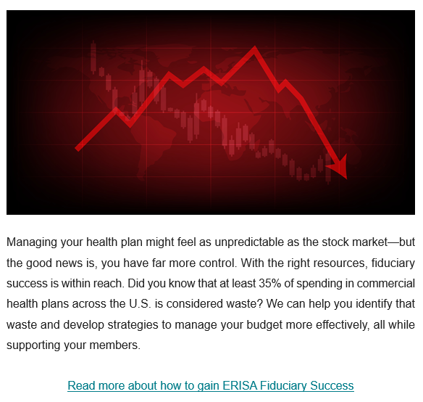
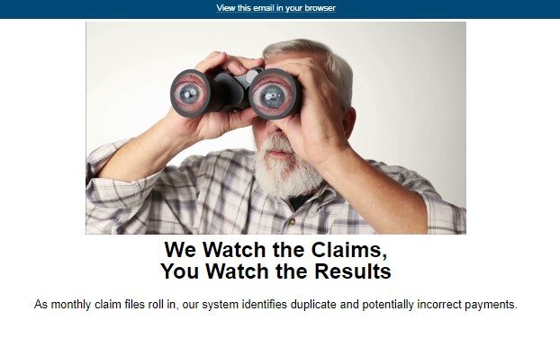
Catch the Attention of Prospects- Monthly Prospect Ads
ER Prospect List
Communicate activity to Alera offices
Increases name recognition
mseeley@vitalincite.com

Slide 10
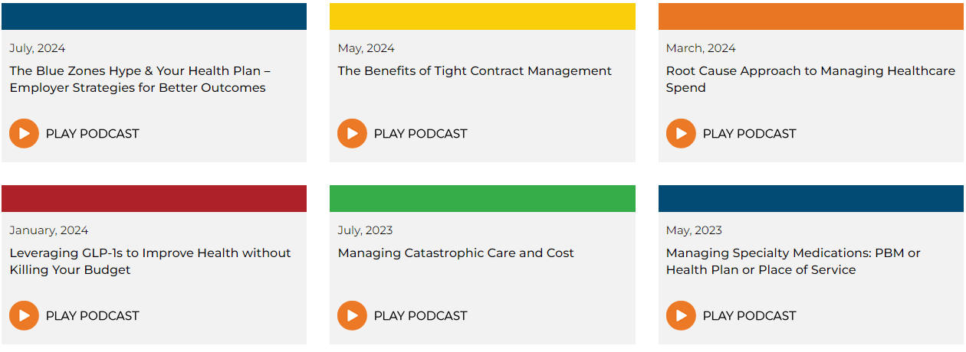
Catch the Attention of Prospects- Podcast
mseeley@vitalincite.com

Slide 11
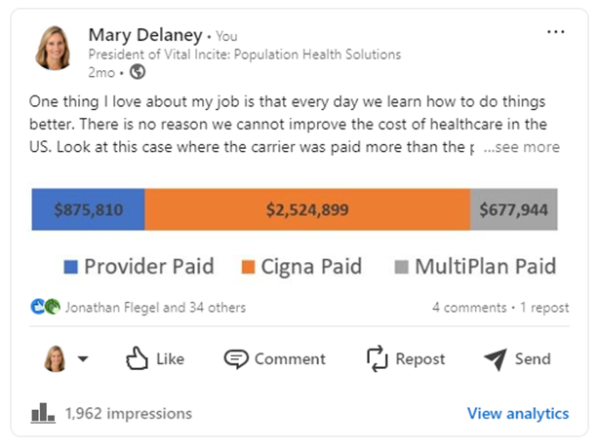
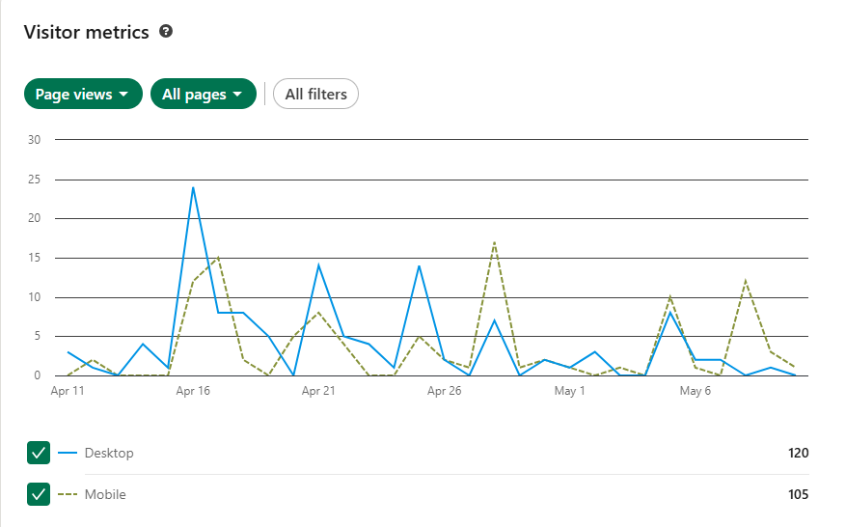
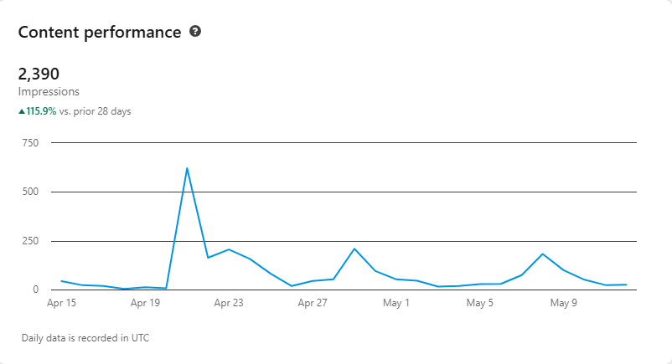
Catch the Attention of Prospects- LinkedIn
mseeley@vitalincite.com

Slide 12
Catch the Attention of Prospects- Case Studies

Slide 13
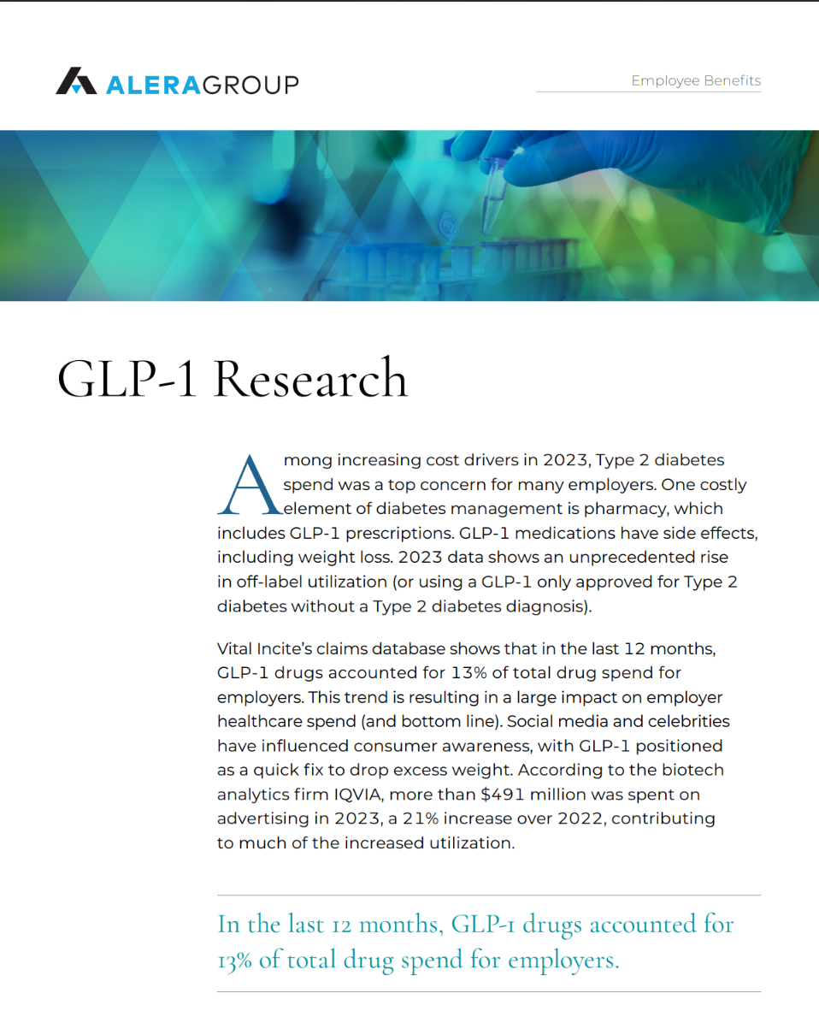
White Papers
Potential White Papers or Slides by Industry

Slide 14
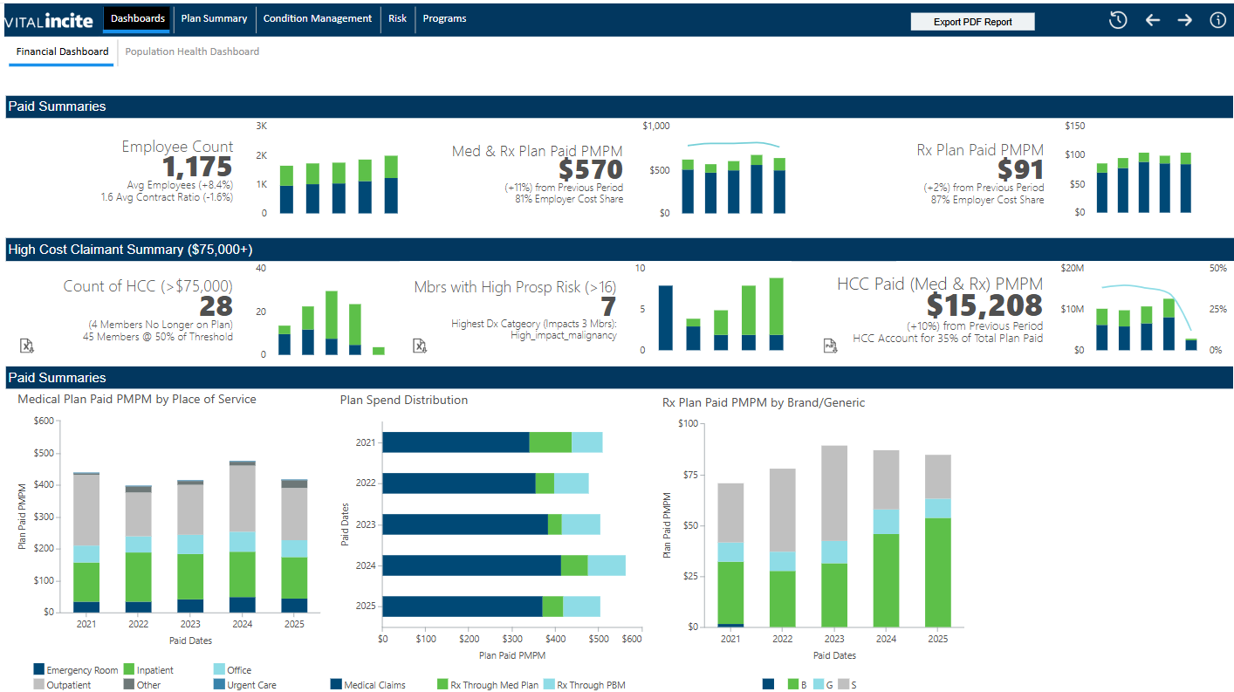
Vital Incite - Dashboard

Slide 15
Vital Alerts

Slide 16
Stop Loss Arrangements
Symetra
Granular
Berkley
in progress
Stealth- Amwins

Slide 17
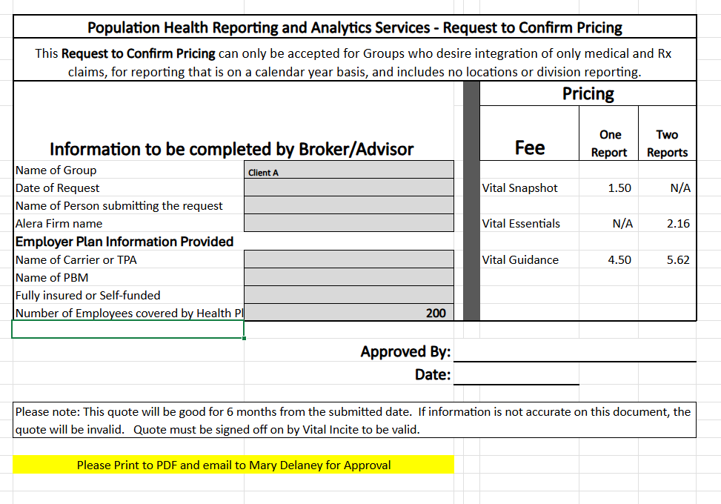
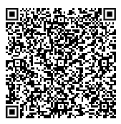
Quick Quote for Smaller- Less Complex Cases

Slide 18
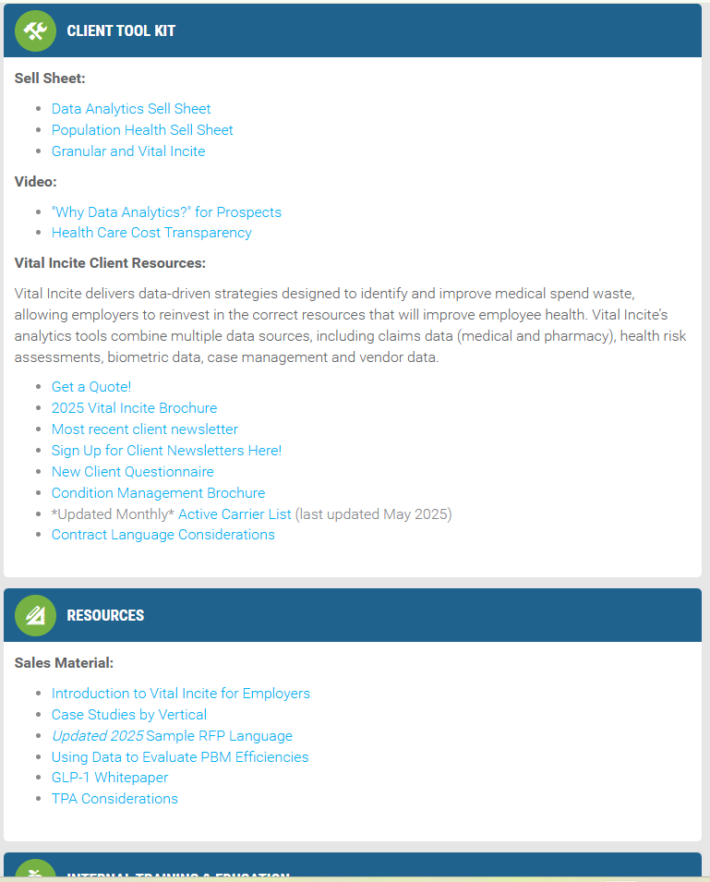
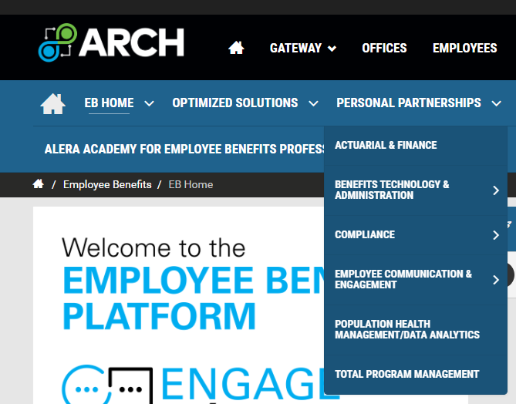
ARCH RESOURCES
mseeley@vitalincite.com

Slide 19
S3 Events
Help us think outside the box and differentiate Alera

Slide 20
Create strategies that will be unique to Alera
Unique Access to Meds
Bring Vendor Solutions downmarket
Radiology opportunities
Relationship with Claims Auditing company
Creating an Alera Wellness Philosophy
Create efficiencies for pharmacy efforts
Alera Trend Report
Video Clips

