Slide 1
Trends in Cancer

Slide 2
Cancer diagnosis
Cancer prevalence continues to increase, with the largest jump from 2020 to 2021. In 2020, 2.8% of members had a cancer diagnosis compared to 3.1% in 2024.
Gradual increases in skin and breast cancer contribute to rising trend.

Slide 3
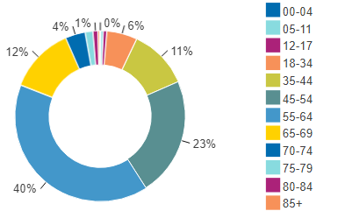
Cancer by age
Cancer ID by Age
Ages 45-64 account for 63% of members identified with cancer.
Cancer prevalence and risk begin to increase at age 45.
While composing a smaller proportion of cancer identification, from age 70 prevalence and risk jump drastically.

Slide 4
Cancer timeline- top diagnosis across age bands
USPSTF
recommended
cervical cancer screening
USPSTF
recommended
colon cancer screening
0 - 17
18 - 44
45 - 54
55+
Leukemia
Kidney
Lymphomas
Skin
Cervical, Uterine
Lymphomas
Skin
Breast
Breast
Skin
Colorectal
Skin
Breast
Prostate
USPSTF
recommended
breast cancer screening
USPSTF recommendations align with top cancer diagnosis patterns across the age band continuum.
In all age bands over age 55, skin, breast, and prostate cancer are the top three diagnosis groups.

Slide 5
Cancer screening compliance
2024 Cancer Screening by
Annual Physical Compliance
 | Compliant with Physical | Not Compliant with Physical
Mammogram | 69% | 33%
Cervical screening | 64% | 34%
Colonoscopy | 85% | 35%
Breast cancer prevalence increased 18% from 2020 to 2024, with a 13% jump from 2020 to 2021.
Mammogram compliance increased 26% from 2020 to 2021 likely resulting in the increased diagnoses.
Across cancer screening types, compliance is higher for members that have had their annual physical.

Slide 6
Cancer cost trend
Risk among members with cancer increased 5% from 2021 compared to 2024.
Since 2021, PMPY spend for those with cancer has increased almost 21%, influenced by greater spend across all claims types.
Rx through Medical and PBM are key drivers of cancer cost trend with PMPYs that increased 22% and 35%, respectively.

Slide 7
Cancer cost trend- J Codes
Treatments for malignancy comprise 47% of all J code spend.
At $106M, J code spend related to cancer has increased 52% since 2021 ($70M). Service count increased 39% in this same timeframe.
Average cost per service is higher across 8 of top 10 J codes in 2024.
J Code Key
J9271 | Keytruda
J9299 | Opdivo
J9144 | Darzalex
J9306 | Perjeta
J9228 | Yervoy
J9358 | Enhertu
J9173 | Imfinzi
J2506 | Neulasta
J9042 | Adcetris
Q5107 | Mvasi

Slide 8
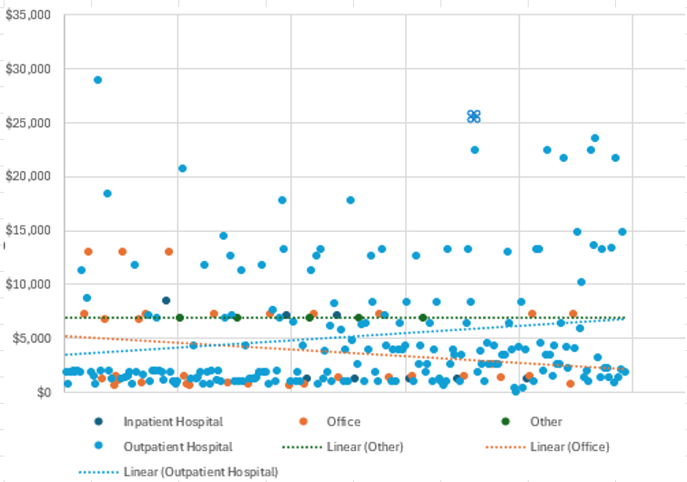
Site of Service Impact on Cancer Treatment Cost
J2506 - Neulasta
In 2024, Neulasta accounted for $2.7M in spend. Total cost decreased 22% from prior, however, service count was 38% lower.
High prevalence of treatments clustered between $2,500 - $5,000, however some outliers as high as $28k.
Over the course of 2024, treatment cost trend in office settings was more efficient, while cost efficiency in outpatient hospitals deteriorated.
These excess payments targeted for inclusion in Vital Alerts and VI Payment integrity detail. Vital Oversight team will support for claims in excess of 1.5 of appropriate pricing (Green dot linear line).

Slide 9
Cancer cost trend- Rx
Malignancy drugs make up 8% of all Rx spend.
Members taking Rx for cancer have increased by 28% since 2021, while the total cost for cancer drugs has increased 71% in the same timeframe.
Of top 10 Rx for cancer, total cost per quantity is comparable for most drug types except for Imbruvica.
Verzenio total cost is 62% higher in 2024 ($6.6M), influenced by a 46% increase in members taking this drug.

