Slide 1




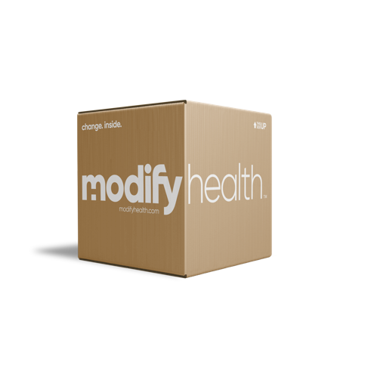
Changing lives by making Lifestyle Medicine
simple and sustainable.

Slide 2

If you had one vehicle for the rest of your life, how would you care for it?

Slide 3
Lifestyle Medicine Is Personalized Care to Address Root Cause Issues
5 levers of a healthy lifestyle
Prevent & reverse
Behaviors that people engage in daily that
impact health positively or negatively
Physical Activity
Nutrition
Sleep
Obesity
Type 2 Diabetes
Heart Disease
High Blood Pressure
Stress Management
Substance Free
Osteoporosis
Gut Health
Respiratory Illness
Cancer

Slide 4








ModifyHealth Lifestyle Medicine Program
Uniquely Designed to Drive Engagement and Sustainable Results
Advanced Telehealth
Medically Tailored Meals
Certified Lifestyle Medicine Physicians
Registered
Dietitians
Remote Monitoring
Medically Tailored Meals

Slide 5


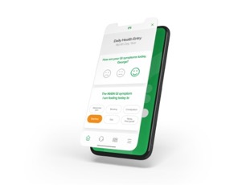

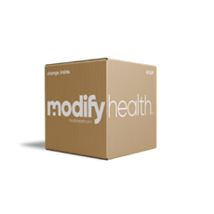
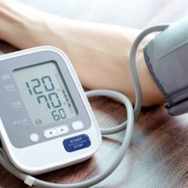
An Engaging & Effective Platform
MD and RDN Coaching
Medically Tailored Meals
Digital Engagement
Remote Monitoring

Slide 6
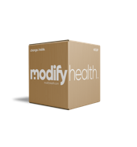


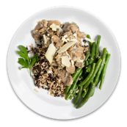




Supporting Impactful Disease States
Low Fodmap
Mediterranean
Gluten-free
Heart
Friendly
Diabetes Friendly
Renal
Friendly
Produce Boxes
IBS
IBD
FGID
NAFLD
IBD
Obesity
Celiac disease
Non-celiac
gluten sensitivity
CHF
Hypertension
Cardiovascular
disease
Diabetes
Pre or “borderline” diabetes
Kidney Disease
Sustainability
6

Slide 7





ModifyHealth
Evidenced Based, Sustainable Results

Slide 8



Innovative Food as Medicine Study
Supports Adventist Health’s value-based care programs
Type 2 Diabetes, CHF/HPT, and IBS
Longitudinal 2-year study
400+ patients
Sustained weight loss of 5.5% 6 months post-program
Supports Adventist Health’s value-based care programs
Type 2 Diabetes, CHF/HPT, and IBS
Longitudinal 2-year study
400+ patients
Increased engagement from 20% to 90%+
Target members with an A1c > 9.0
8 weeks of medically tailored meals w/ RDN support
116 patients
81% lost weight, 95% lowered A1c, 80% lowered BMI
Average A1c improvement of 1%
Target patients with diabetes or hypertension
20-week program with medically tailored meals and RDN support, including resources an ongoing support
45% of participants had maintained <5% weight loss at 40 weeks.
Study found decreased levels of markers for heart disease and diabetes at 8 weeks and further improvement at 40 weeks.
Notes:
Adventist – Sustained weight loss of 5.5% 6 months post program
Cigna – increased engagement from 20% to 90%
Centene – Average A1c improvement of 1%
U of MI – 85% Improved IBS-SSS by ≥50 points
Valley Health – Pull something from study

Slide 9
Innovative GLP-1 Step Therapy Program
Employers and the Dilemma
Some want to offer GLP-1’s for obesity
Almost all want to reduce cost and exposure
Many are being asked for lifestyle medicine options

Slide 10


GLP-1 Step Therapy Sequence
PBM
Primary Care
Provider
GLP Prescription
Outcome A
Sustainable lifestyle changes, no GLP’s
Cost Savings
$12,000+/yr
Virtual Lifestyle
Medicine
Group
12 Week
FIT Program
Outcome B
Approved NPIs
Lifestyle Medicine Group manages ongoing GLP use
Cost Neutral
Lifestyle Foundation

Slide 11
FIT™ Lifestyle Program
Blue Zones - A Different Value Model
Phase 1
1
2
3
4
5
6
Week 1
Week 2
Week 3
Week 4
Week 5
Week 6
10
10
10
7
Foundation
MEALS
MEALS
MEALS
MEALS
Foundation
Foundation
Foundation
Immersion
Immersion
Finding Your Why
& Body Awareness
Weekly training videos/ exercises
Listening To
Your Body
Weekly training videos/ exercises
Group session/Webinar
Fueling and Moving
For Energy
Weekly training videos/ exercises
Group session/Webinar
The Power
Of Connection
Weekly training videos/ exercises
Group session/Webinar
Thriving In Your Environment
Weekly training videos/ exercises
Group session/Webinar
Recharge Your
Body & Mind
Weekly training videos/ exercises
Group session/Webinar
MD Visit
RD Visit
Scale Delivery
RD Visit
RD Visit
Phase 2
7
8
9
10
11
12
Week 7
Week 8
Week 9
Week 10
Week 11
Week 12
7
7
Immersion
MEALS
MEALS
Immersion
Transition
Transition
Transition
Transition
Noticing
The Wins
Weekly training videos/ exercises
Group session/Webinar
Setting Yourself
Up For Success
Weekly training videos/ exercises
Group session/Webinar
Unlocking Your
Inner Signals
Weekly training videos/ exercises
Group session/Webinar
Rolling with
Life’s Changes
Weekly training videos/ exercises
Group session/Webinar
Looking Back,
Moving Forward
Weekly training videos/ exercises
Group session/Webinar
Your Health
Journey Ahead
Weekly training videos/ exercises
Group session/Webinar
MD Visit
RD Visit
RD Visit
RD Visit
MD Visit
© ModifyHealth | CONFIDENTIAL

Slide 12
A Personalized Food as Medicine Platform Drives Critical Areas
Member Engagement
Sustainable Outcomes
Member Satisfaction

Slide 13
GLP-1 Program
Ongoing app utilization
Continued MD oversight
Unlimited RDN coaching
Discounted meals
Remote patient monitoring (optional)
FIT Program
Sustainability
Plan
3 MONTHS
13

Slide 14



Let’s Build Something Great, Together.

