Slide 1
A Mental Health Partner You Can Count On

Slide 2
10x
Higher engagement than traditional EAPs
Redefining ‘Quality Careʼ For 13M People Worldwide
That’s nearly 1 in 10 employed people in America,
the brands you love trust Spring
76+
Member NPS
92%
Members clinically improve after engaging in care
4:1
Up to $4 saved for every
$1 spent, guaranteed*
*Based on studies conducted in the US. Principles apply globally.

Slide 3
The Best Care, No Matter Where You Are
Helping leading organizations evolve their workplace culture with better mental health care
Self-Guided Digital Exercises
Dynamic Assessment & Personalized Care
Work Life Support Community Support Care Navigation
Full-Spectrum Care
(Coaching, Therapy, & Medication* to Specialty*, Complex Care)
Manager Training, Consultations & Referrals
Critical Incident Support & Rapid Response
LOA & Disability Support*
Proven Engagement Strategies
SpringLife
For individuals and families
SpringWorks
For managers and people leaders
On-Demand Performance Data & Insights
Embedded Workplace Care Team
24/7 Crisis Support
*Available to US only

Slide 4
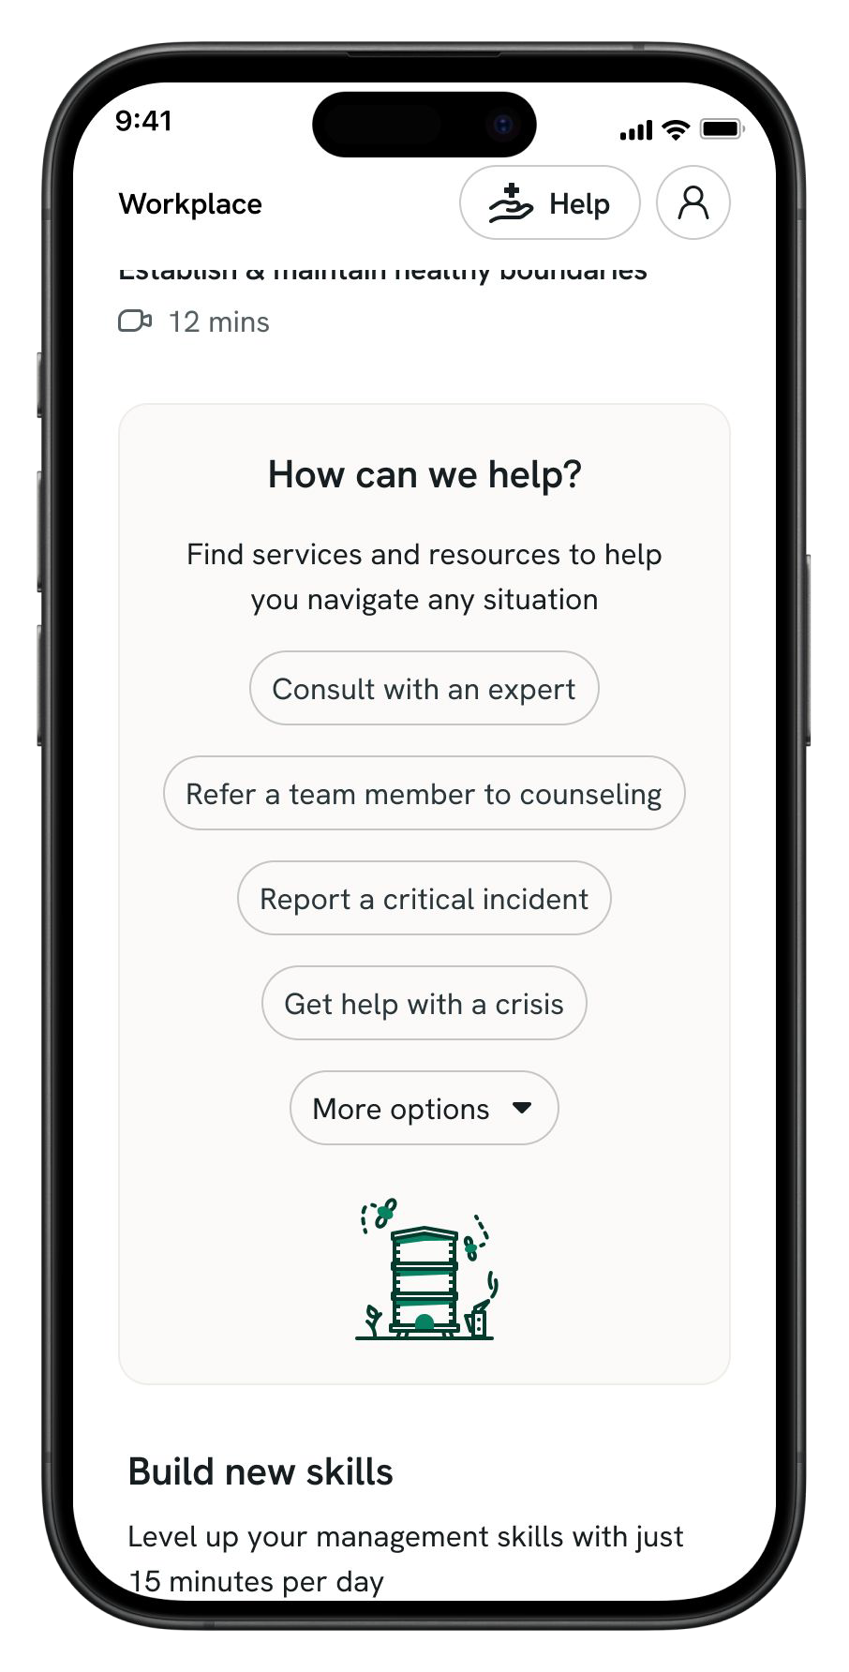
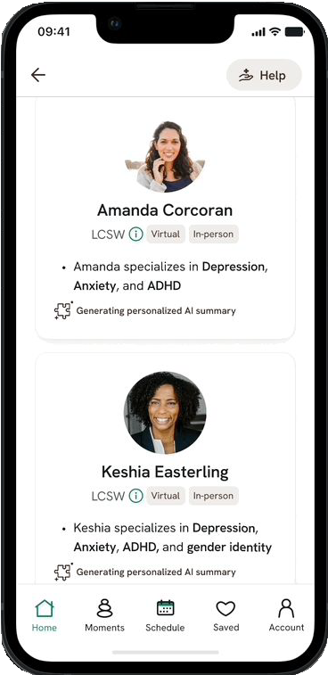
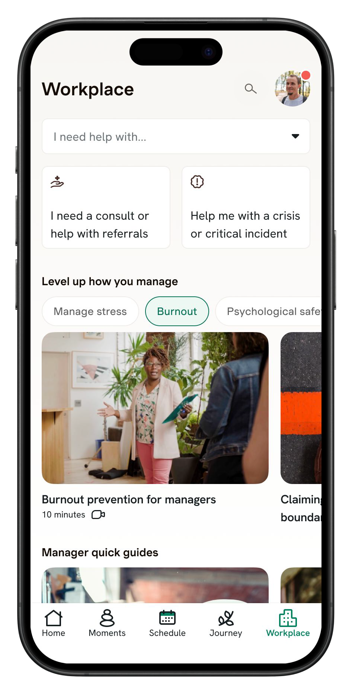
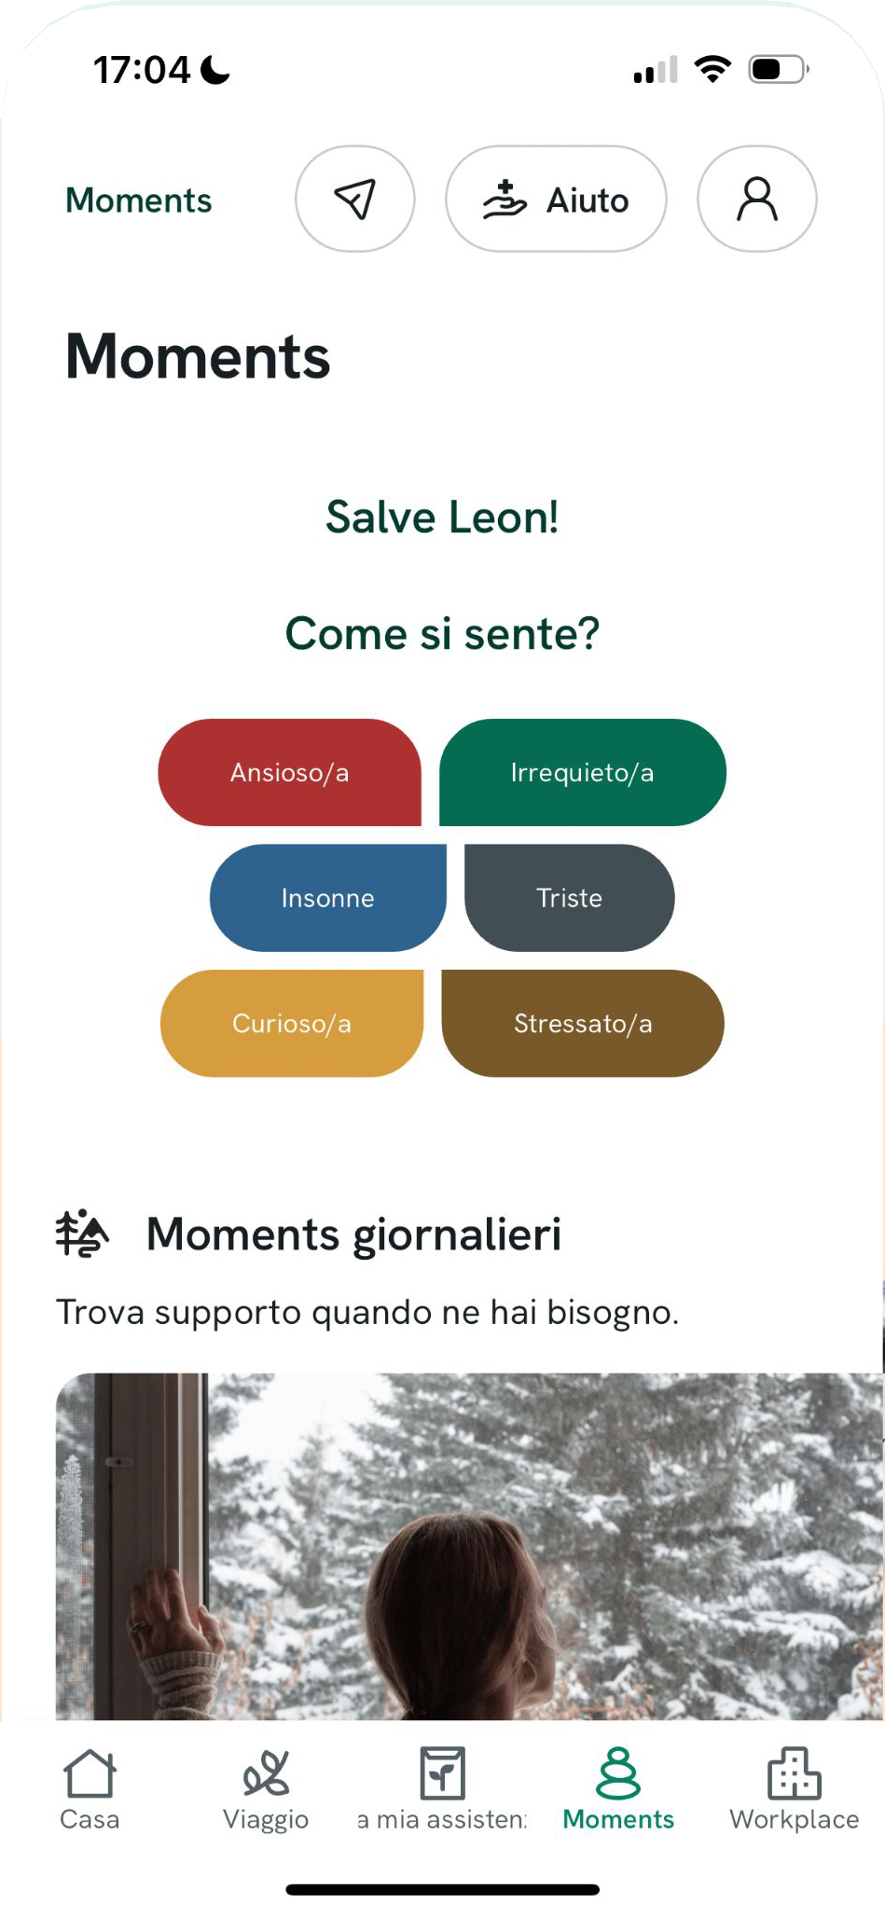
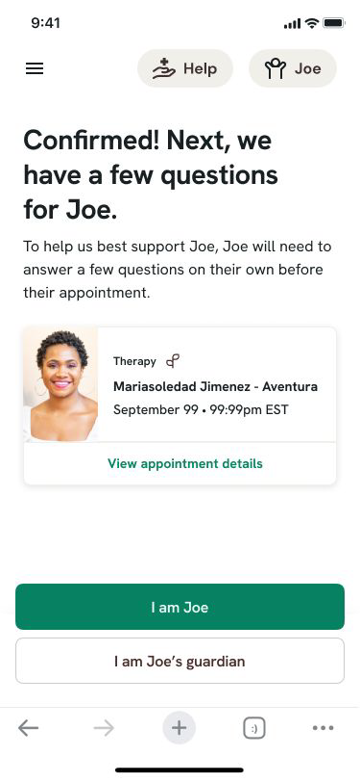
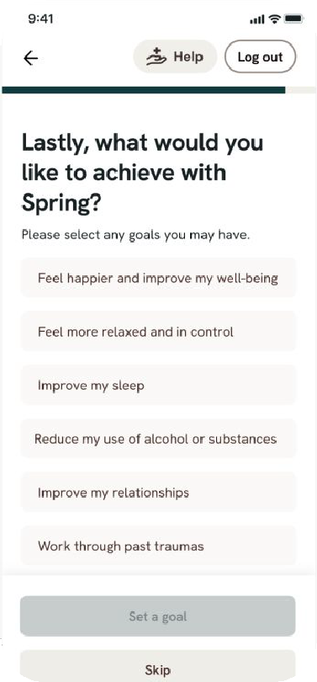
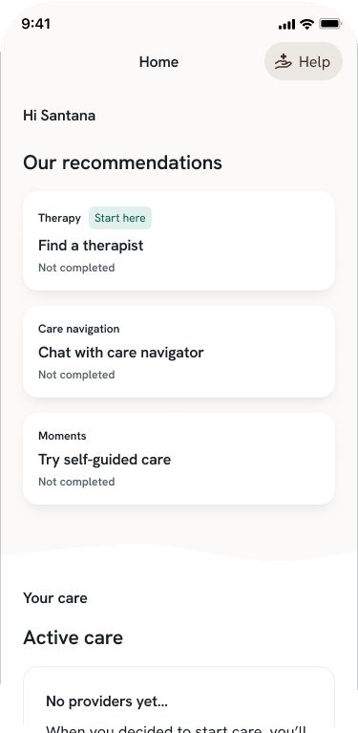
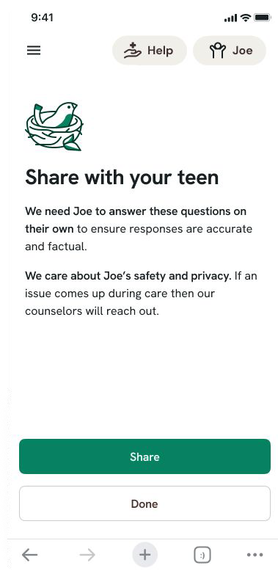
Easy & Reliable Access In 1 Day Or Less
No voicemails, no emails, no waiting—personalized care in just a few clicks
More Accurate Care
Easy To Find & Book
Smart Provider Matching
A Program For Everyone

Slide 5
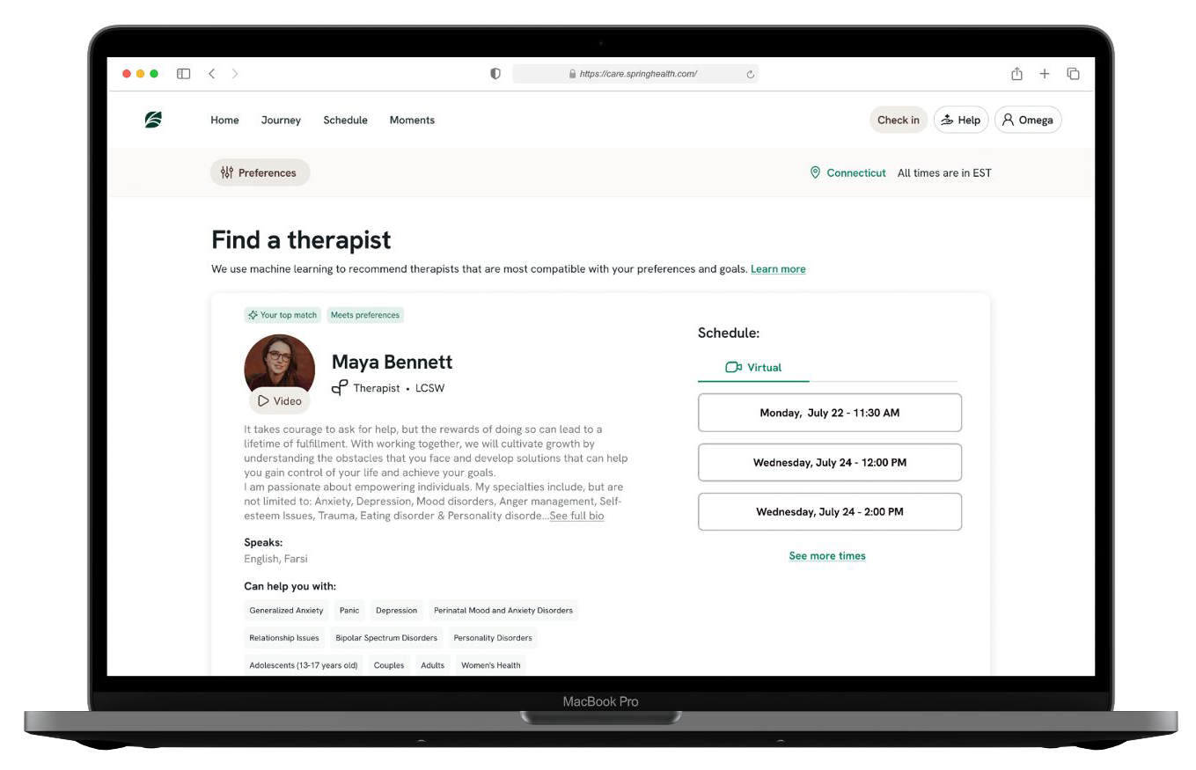
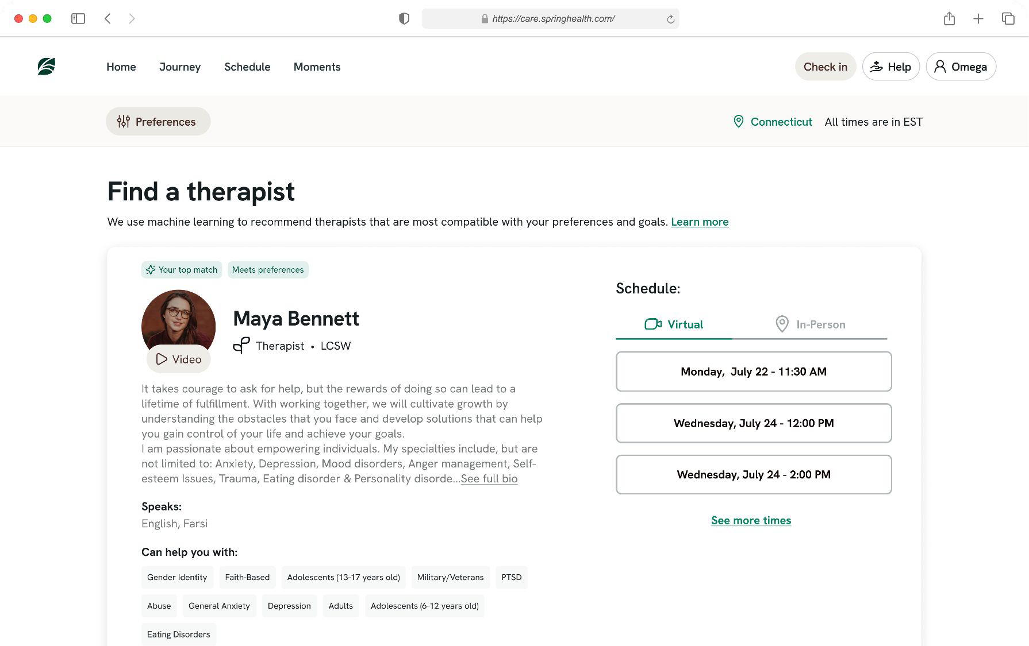
The Care You Want For The People You Love
A diverse and comprehensive network, built from the ground up
Consistent member experience in 57* languages
High-performing, diverse network,
47% BIPOC
Video intros and free 15 min. consults
100% in-platform scheduling for all appointments, with 11,000+ providers, in-person or virtual
100+ languages and dialects
Every specialty, condition, or need
for ages 0+
*By end of 2025

Slide 6
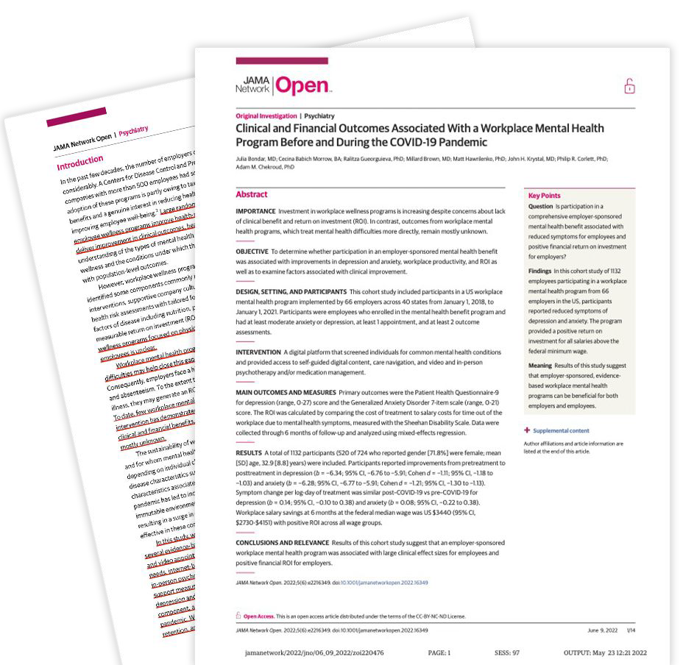
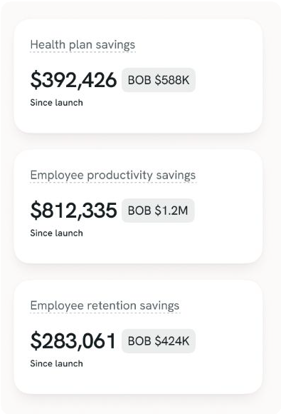
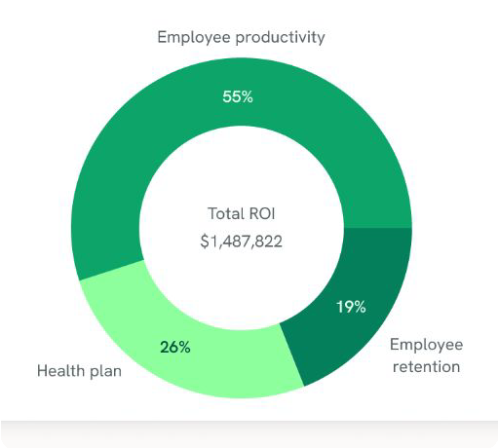
Care That Works For You
The industry’s number one clinical and ﬁnancial outcomes
Patient-Centered Care
Continuous Quality Improvement
Confidentiality and Privacy
Integrated, Holistic Care
Caregiver and Family Involvement
Proven Methodology
Community Resource Integration
Outcomes Measurement
Cultural Sensitivity
Shorter Recovery Time
5.9 weeks on average to remission compared to 13.1 weeks for another
innovative EAP competitor
Proven Net ROI
Up to 41 ROI on health plan spend guaranteed, with real-time visibility into savings and spend in Atlas
Highest Accreditation
CARF Accreditation for clinical quality and crisis response across 300 standards
marking true clinical excellence
Based on studies conducted in the US. Principles apply globally.

Slide 7
Any questions?
Thank you!
© Spring Health 2024 | Proprietary / Trade Secret / Confidential

