Slide 1
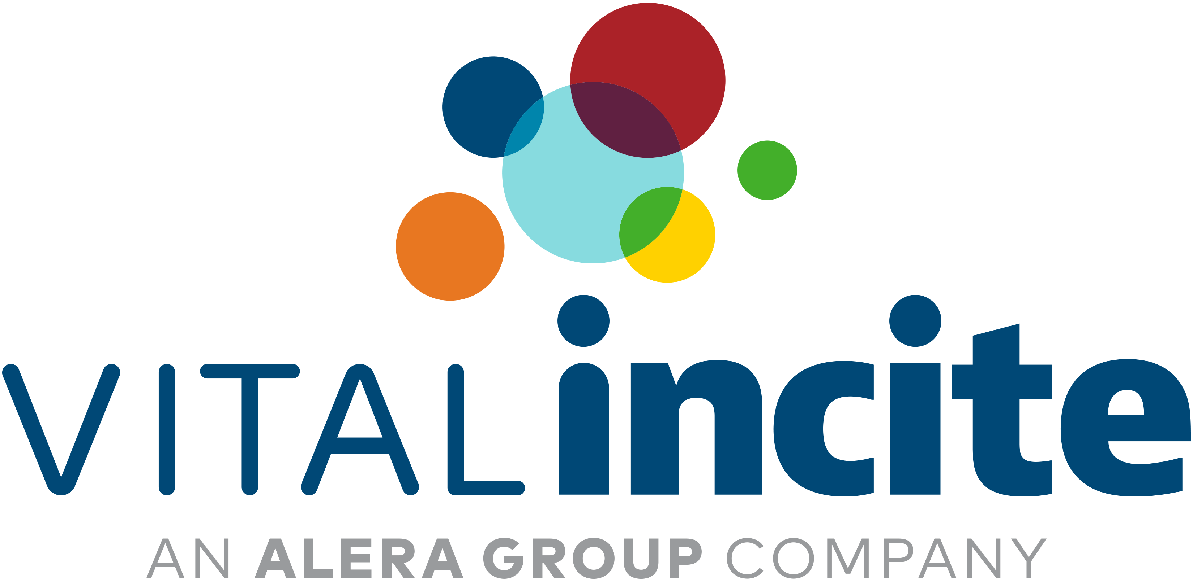
All Things Pharmacy Year End Trends, Need to Know Items, Future Strategies
Kaycee DeGabriele, Bob Eisendrath, Amanda Manley, Mary Delaney

Slide 5
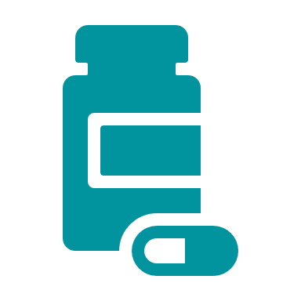
GLP-1 Medications
18% of pharmacy spend was for GLP-1 medications
14% in 2023
9% in 2022
21% of VI Groups had utilization of GLP-1 medications approved for weight loss
5% of pharmacy spend was for weight loss GLP-1 medications
2% in 2023
1% in 2022

Slide 6
GLP-1 Medications

Slide 7
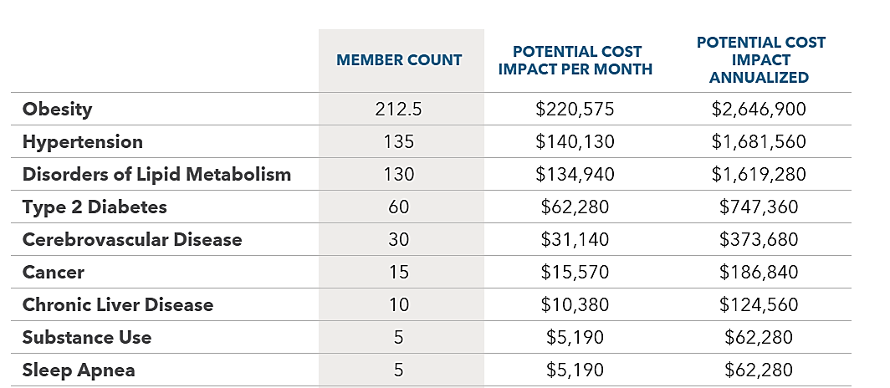
GLP-1 Analysis 500ee life group

Slide 8
Notes:
Mounjaro and Wegovy were $0 in 2021 and quick jumped to the top 5
Mounjaro- nearly $1,100 per month
Wegovy- nearly $1,400 per month
Humira saw a drop in 2024 when biosimilar use began

Slide 9
Humira Biosimilars
Humira 40MG/.4ML, Q2 | Average Cost per Claim | Biosimilar Hyrimoz | Biosimilar Yusimry
Discounted Price | $6,778 | $1,302 | $634
Rebate | ($4,707) | -- | --
Net Cost to Plan | $1,738 | $1,302 | $634
Annual Cost to Patient | $24,852 | $15,624 | $7,611
37% Savings
69% Savings
Notes:
This is an example for a PBM that has a biosimilar strategy and also provides rebates on a claim line level which allows us to have a net cost comparison

Slide 10
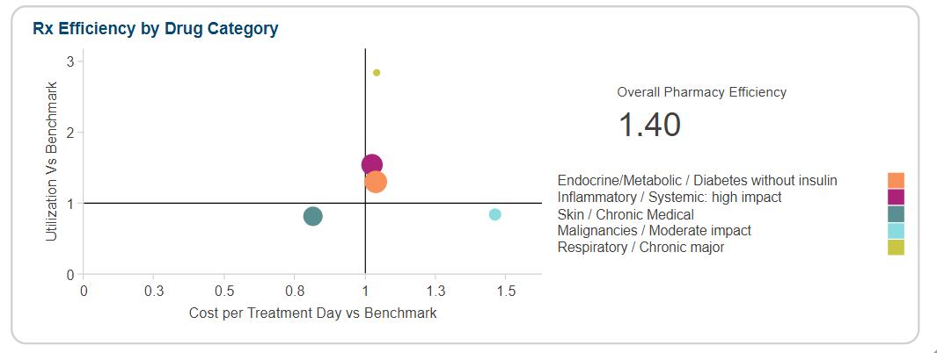
Humira Biosimilars
Notes:
This is an example of a self funded employer that has a PBM with integrated rebates
Discuss even for fully insured groups we can show the rebates they could expect to receive given their drug mix if they were to move self funded
In the rebate comparison have removed generics and are only considering the brand and specialty medications

Slide 11
NADAC
 | % NADAC
Brand | 97%
Specialty | 97%
Generic | 219%
Notes:
See the mark up in generics but accounts for a small portion of spend
When we see mark up of 250% or more on generics we look into a strategy like the Cost Plus program

Slide 12
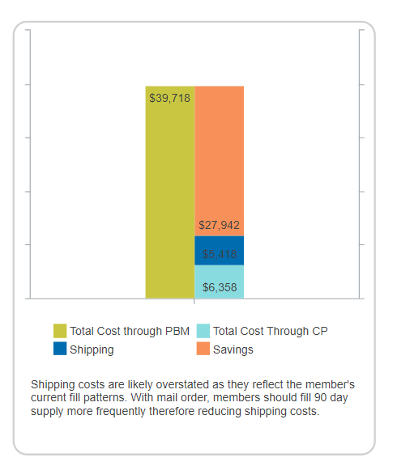
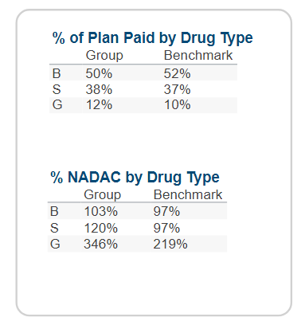
Cost Plus

Slide 13
Jcode
Notes:
Medications running through the medical plan accounts for 8% of spend and has remained consistent since 2021
In the last 4 years spend has increased from $17.95 to $23.11 for cancer medications; this does not include the administration/facility charges

Slide 14
Medications Paid Higher Than Expected
Advancement in Alerts
Keytruda
VI has pulled together a BOB average paid amount. We will flag items paid at 1.5x that amount.
In this case the largest outlier is from the same facility.

Slide 15
Pharmacy Market Overview

Slide 16
Bob Eisendrath, Managing Partner, Alera Pharmacy Solutions Bob leads our National Pharmacy practice and has over 30 years of healthcare experience with the last 25 years focused on pharmacy benefit management, reducing risk, controlling costs and contract analysis. Bob held several leadership positions at CVS/Caremark with responsibility for large employer and labor coalitions and high-profile large national clients. Bob has a BA from the University of Wisconsin, Madison

Slide 17
State of the Pharmacy Market
Unstable and chaotic…is it broken?
2023 new drug prices rose 35% in US compared to previous year
Over last 5 years, RX spend increased $258B
Double digit trend…GLP-1’S, specialty drugs, acceptance of biosimilars
Over 80% of consumers find the cost of drugs too high and 25% are deterred by the cost
Legislation and more legislation – transparency, rebates and spread pricing
New pricing models introduced by Big Three – More Transparency!
Digital Pharmacy in Mainstream – Amazon & Mark Cuban Cost Plus Program
J&J/ Wells Fargo/JP Morgan lawsuit impacts
Tariffs…what we know today…
Notes:
We are now seeing brand disc going backwards as an adjustment due to the American rescue plan act which is $35 insulin.

Slide 18
Looking Ahead – Strategic Implications
Marketplace Challenges
GLP-1 drugs: Rising demand necessitates cost-containment strategies
Biosimilars: Cost-saving potential but limited access in some cases
Specialty Drug Management: PBMs to play a greater role in cost controls
Gene & Cell Therapies: Explore innovative strategies to contain costs
Pharmacy Economics & Policy Shifts: Need for new models balancing affordability & margins. Federal and state changes will demand greater transparency

Slide 19
GLP-1’s: They won’t go away!
GLP-1 spending grew 300%+ since 2020, driven by demand for weight loss and diabetes treatment.
Annual cost per patient: $12,000 - $16,000 per year for GLP-1 drugs (Ozempic, Wegovy, Mounjaro).
Projected U.S. market for GLP-1 drugs will reach $100B annually by 2030.
Expansion beyond diabetes/obesity to sleep apnea, heart failure, addiction
Employer pharmacy benefit costs increased by 15-20% due to GLP-1 coverage.
Employer pharmacy spend is growing by 4-7% annually, driven by specialty drugs and GLP-1 medications.
Employer coverage trends:
50% of employers cover GLP-1s for diabetes only.
30%+ are evaluating coverage for obesity due to high costs.
20%+ have implemented prior authorization or BMI restrictions for coverage.

Slide 20
Understanding Biosimilars, PBM Rebates, and Oversight Tools
What are Biosimilars:
FDA-approved alternatives to biologics
Often 15–35% cheaper than reference brands
Biosimilars are not all clinically or economically equivalent.
FDA-approved biosimilars must show no clinically meaningful differences, but manufacturing, pricing, and contracting can vary widely.
Evaluating Biosimilar Options:
Differences in manufacturing, clinical evidence, and payer contracts
Employers should assess net cost: Price - Rebate + Admin fees
Consider site of care and PBM steering
Notes:
Talk Track: Biosimilars are near-copies of complex biologic drugs, and they’re held to strict FDA standards. They offer significant potential savings but vary in effectiveness, price, and market acceptance.
Talk Track: When choosing biosimilars, not all options are financially or clinically equal. Employers must look at more than just drug cost—understanding where and how the drug is delivered, as well as PBM incentives, is key.

Slide 21
The Rise of Biosimilars
As of 2025, 45+ biosimilars approved by the FDA; ~25 are oncology- or immunology-related.
By 2027, biosimilars are projected to generate $180B in savings globally.
Only 35% of Humira scripts moved to biosimilars in 2024
How Employers Can Evaluate Cost-Efficiency:
Total Net Cost = Drug price – Rebate + Admin fees
Consider:
Site of care
PBM formulary placement (is the preferred option actually the most cost-effective?)
Outcomes data if available
Notes:
Talk Track: Adoption is growing, but slower than expected. Resistance often comes from rebate-driven formulary strategies. Employers must push for net-cost transparency.
Talk Track: Adoption is growing, but slower than expected. Resistance often comes from rebate-driven formulary strategies. Employers must push for net-cost transparency

Slide 22
Biosimilars vs. Rebates
Biosimilars Disrupt the Rebate Model:
Brand drugs = high rebates
Biosimilars = lower list price, lower/no rebates
PBMs may prefer higher-rebate brands
"Biosimilar vs. Brand Drug Flow"
Brand Drug: High List Price → High Rebate → Higher Net Cost (PBM profits)
Biosimilar: Lower List Price → Minimal Rebate → Lower Net Cost (PBM less profit)
Impact on Employers and Plan Sponsors
Rebate guarantees may rise even as actual rebate capture declines (e.g., rebates shifted to a different corporate entity).
Preferred drug lists may favor drugs with high PBM revenue, not necessarily the lowest net cost for employers.
Notes:
Talk Track: Biosimilars challenge the traditional rebate model. PBMs make more from high-list-price, high-rebate drugs, so even when biosimilars are cheaper, they’re not always preferred on formularies. This misalignment can cost employers.

Slide 23
The Shift in Rebates: What to Watch
What’s Changing:
Increased regulatory and client pressure on PBMs to show rebate transparency.
Vertical integration = rebates flowing through multiple layers.
Impacts to Monitor:
Some PBMs may reduce upfront discounts but shift to more back-end rebate guarantees.
Formularies may favor drugs with the highest rebates, not the lowest net cost.
Watch for new fees (e.g., "network access fees" or "data fees") replacing lost rebate revenue.
Watchouts:
Rebates accounted for 46% of gross drug spend in 2022 (IQVIA). That dynamic is under scrutiny
"Rebate trap": PBMs maintain high-rebate drugs on formulary even if cheaper alternatives exist.
Notes:
Talk Track: PBMs are adapting. Expect new, less-transparent fees and continued use of formulary manipulation. This is why employers must look beyond guarantees and understand where revenue flows

Slide 24
Market Checks & Audits: Your Oversight Toolkit
According to a 2024 Aon study, 81% of large employers believe PBMs retain too much rebate revenue, and 72% are seeking alternatives to traditional rebate contracts.
What’s a Market Check?
Compares your pricing and contract terms to market benchmarks (typically every 12–24 months).
Ensures competitiveness on discounts, rebates, admin fees.
What’s an Audit?
Deep dive into PBM performance (e.g., formulary compliance, rebate pass-through, billing accuracy).
Identifies contract violations or manipulation of drug categories.
Conduct a Full Claims Financial Contract on an annual basis.
Real-World Impact:
Audits can recover $2–$4 PMPM in overcharges or missed rebates.

Slide 25
Cost Management & Risk Mitigation
Gene & Cell Therapy
Gene and cell therapies often cost between $300,000 to $3 million per treatment.
Over 30 FDA-approved gene and cell therapies exist, with dozens more in the pipeline.
Very rare or severe conditions (genetic disorders, certain cancers, and advanced autoimmune diseases)
Innovative Payment Models
Outcomes-Based Agreements (OBAs): Pay based on patient response (e.g., full remission).
Stop-Loss Insurance & Reinsurance: Protect against catastrophic claims from a single high-cost therapy.
Leverage manufacturer assistance, foundations, or cost-sharing programs for eligible employees.
Utilize Predictive Analytics & Centers of Excellence
Assess population health data to estimate potential GCT utilization and financial exposure.

Slide 26
What’s Changing in 2025
Regulatory Scrutiny & Legal Risks:
FTC is actively investigating rebate walls and formulary manipulation.
Some states (e.g., NY, CO, MN) are pushing transparency laws requiring PBMs to report rebate retention and formulary decisions.
There’s renewed discussion in Congress about banning spread pricing or requiring pass-through pricing models.
Business Model Shift – PBMs Won’t Lose Revenue:
PBMs are rebranding their margins:
Moving away from rebates toward "service fees" (e.g., formulary management fees, data access charges).
Increased use of non-transparent "optimization" fees in employer contracts.
As rebates become less central, expect more network management fees, white bagging, specialty pharmacy markup.

Slide 27
Key Predictions (2025–2027)
Trend | What to Expect
Rebate Compression | Downward pressure on high rebates due to biosimilar adoption and price transparency
New Revenue Channels | PBMs will offset lost rebate income via service fees, markups, and restricted networks
Formulary Rigidity | Resistance to including lower-cost options without rebates, even if clinically appropriate
Specialty Drug Steering | More aggressive redirection to vertically integrated specialty pharmacies

Slide 28
Where are we going?

Slide 29
2025 Focus- Cutting through the Noise
NAVIGATION HEADER
Move past tactics- focus on lowest net cost outcomes
Rebates
Prior Auth
Admin Fees
Brand/ Generic Fill Rates
Preferred Formularies
Biosimilar First strategy
Lowest Net Cost
Notes:
This year, our core focus is to remove the noise and zero in on true outcomes—specifically, identifying the lowest net cost when evaluating pharmacy benefit managers.
When we say 'lowest net cost,' we mean the total picture: claims costs + admin fees – rebates. The actual cost to the employer and employees
It’s easy to get distracted by individual strategies—like brand/generic substitution rates, biosimilar fill rates, or how aggressively a PBM applies prior auth or uses preferred formularies. These are all legitimate tools, but no single one tells the whole story.
Right now, we’re seeing that focusing too narrowly on those individual tactics can feel a bit like a shell game.
- For example, a PBM might report high biosimilar use, but in reality, they’ve moved from a Humira biosimilar to an equally expensive alternative like Stelara. The fill rate looks good—but the outcome doesn’t change.
What we’re doing is working backward from the outcome we care about—lowest net cost—and then determining which strategies actually help us get there. That’s the shift we’re making in 2025.
- You’ll see that represented visually here: individual tactics are inputs—but what really matters is how they contribute to driving total net cost down.
- As we continue this work, our next major step is integrating admin fees into our reporting so we can capture the full picture. Right now, we’re able to show claims and rebates, but without admin fees, we’re still missing a key piece.
So this year’s effort is about aligning all our evaluation tools, internal and external, around outcomes, not tactics.”

Slide 30
2025- 2026 Development Goals
NAVIGATION HEADER
Why admin fees matter in the net cost equation
Claims Cost
(Plan Paid + Member Paid + COB)
Admin Fee
Rebates
Net Cost
Notes:
**“Now that we’ve established lowest net cost as the north star, this slide helps break down how we actually calculate it.**
We define net cost as:
Claims Cost, which includes both what the plan pays and what the member pays, plus any coordination of benefits.
Admin Fees, which are recurring fees paid to the PBM—these are often overlooked or excluded in PBM comparisons.
Then we subtract Rebates, which are typically the most advertised feature.
Even if a PBM offers substantial rebates, if their claims costs are high and admin fees are quietly padded in, they may not be the best value.
We’ve seen some innovative PBMs who didn’t lead with rebates, but still delivered a better total cost outcome because their underlying claims costs were lower.
This is how we plan to help employers and advisors compare PBMs and evaluate year to year trends in a fair, accurate way moving forward.”

Slide 31
2024 – 2025 Completed Work
NAVIGATION HEADER
What we’ve done so far
Risk and case mix adjusted efficiency scores that balance utilization and cost per treatment day
Pros:
Controls for case mix and population risk
Easy to see outliers and opportunities for potential strategies
Cons:
Score depends on gross cost benchmarks (rebates do not impact)
Continued integration of rebates
For 4 PBMs, rebates are connected directly to the drug/claim line
All others- rebates incorporated to be netted out of total PMPM/PMPM spend
Notes:
**“So far, we’ve made strong progress in building the foundation to evaluate pharmacy plans more effectively.**
The most recent major advancement is the development of our risk- and case mix-adjusted efficiency scores. These look at cost per day of treatment and utilization, giving us a fast, visual way to spot outliers or potential opportunities for AEC-Rx collaboration
The pros here are big: we control for differences in case mix, and the results are intuitive and easy to share.
The limitation is that these benchmarks are based on gross cost, not net cost—so rebates aren’t yet accounted for in these comparisons.
The second area is rebate integration.
For 4 PBMs, we’ve been able to tie rebates directly to the drug or claim line—which gives us transparency into how rebates affect cost at a granular level.
For the rest, we’ve started incorporating rebates in aggregate, netting them out of the total PMPM spend so we still get directional insight.
Altogether, these efforts let us spot innovation opportunities—especially when we compare employer results to the rest of our book of business. And as we move into 2025–2026, we’re building on this foundation to connect everything into one complete, lowest net cost view.”**

Slide 32
NAVIGATION HEADER
Integration of fixed costs/admin fees/ interface fees – lowest net cost
Integration of AWP price for better pricing comparisons (vs NADAC)
Enhanced GLP-1 Reporting- staying current with changing landscape of drugs with high plan impact
Global cost driver reporting combining Med and Rx data to highlight global trends
Clearer PBM comparison research- apples to apples comparisons.
2025 Research and Development
Efforts will be accomplished throughout 2025
Highlight opportunities for further research and AEC-Rx support.
Notes:
**“Looking ahead, our 2025–2026 focus is all about continuing to build the infrastructure that allows us to report on and evaluate pharmacy plans in a way that is both complete and actionable.
The first priority is the full integration of admin fees and fixed pharmacy costs into our reporting. These often aren’t captured in claims data but significantly impact net cost. We’re expanding our tools to support ongoing entry and maintenance of this information—from per-script fees to interface charges—so we can reflect the full financial picture.
Next, we’re incorporating AWP pricing into our cost comparisons. We’ve heard from brokers and advisors that aligning our reports with what they’re used to seeing from their PBMs helps close the communication gap and make our insights easier to act on.
We’re also enhancing our GLP-1 reporting, not just because of the financial impact, but also because of the evolving strategies employers are putting in place to manage their use. We’re seeing a wide range of approaches—from programs that act as gateways to access (like requiring participation in nutrition or lifestyle programs before approving GLP-1s), to those that are more supportive in nature, offering wellness resources alongside the medication. We’re developing reporting that helps evaluate and compare these strategies so employers can understand what combination of factors help create the most effective GLP-1 strategy
Zooming out, we’re building global cost driver reporting that blends medical and pharmacy data to tell a more complete story—so we can show what’s driving total spend, and how medical and pharmacy trends intersect. This helps tease out emerging issues and makes it easier to translate population-level trends into strategy.
And finally, we’re investing in clearer, apples-to-apples PBM comparisons. That means not just showing who’s offering the most rebates, but which PBMs are achieving the lowest net cost after everything is factored in.
Altogether, this work brings us closer to our goal: giving employers and advisors the tools they need to make smarter, data-backed decisions about pharmacy strategy—without getting lost in the noise.”**

Slide 33
What if?

Slide 34
Pharmaceutical Supply Chain
PBM

Slide 35
What if Alera Could….
GLP-1 like Medications
PBM

Slide 36
Managing Cell and Gene Therapies
Alert tells you someone has a Dx that may qualify them for a cell or gene therapy- what is next?
Source outside the country?
Source through a foundation or manufacturer?

Slide 37
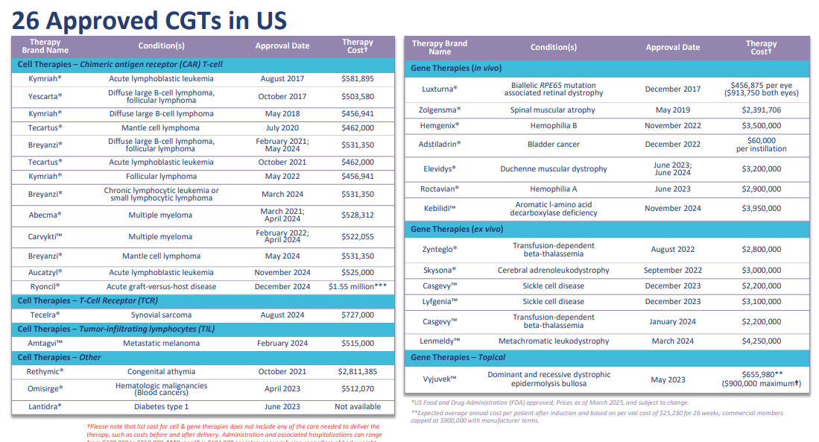

Slide 38
Emerging Therapeutic Solutions
Berkley – step down deductible for these programs if triggered correctly.
Full clinical review to determine if the person qualifies
Locate the most effective approach for treatment
Have already established pricing for drug and administration
Monitor the person for 3 years- medication guarantees

Slide 39
How do we leverage this?
Typically, they require coverage for your entire employer
Medical Directors from Vital Oversight can make the connection
Need to have the data in Vital Incite and Someone needs to find it.
Henry Ford Health System: The $991,711 Claim was repriced to $600,407, achieving $391,304 in savings
University of Michigan: The $991,711 Claim was repriced to $594,464, achieving $397,247 in savings

